Slide 1
Modifications Committee Meeting 70
MOD_02_16
Changes to MEC for DSU

Slide 2
About Us
Company Activities
Electricity Exchange operates two Demand Side Units in the SEM
23 MW is high cost dispatchable demand and standby generation
18 MW is low cost CHP and Bio Fuel generation
Technology Development
IoTAS is a high speed power monitoring system developed for the provision and monitoring of System Services
Up to 32,000 samples per second (Voltage: 3P, Current: 3P+N)
Half-cycle RMS voltage and energy calculations with swell and sag monitoring
Single cycle frequency and harmonics
Company Ownership
50% recently acquired by Bord na Móna
25% Paddy Finn
25% Duncan O’Toole (Captured Carbon)

Slide 3
Overview of Proposed Modification
Current Limitation
TSC prevents demand sites with MEC > 10 MW from participating as Demand Sites in a Demand Side Unit (DSU)
This prevents Generator Units from using their house load to provide additional capacity and system services (future) through DSU participation
Opportunity
Allowing Generator Units to include a portion of their house load will improve the utilisation of existing power system assets
This will enhance the provision of System Services such as FFR
Challenges
The original intention of the related clauses was to prevent Generator Units trading in the market as DSUs. This must be protected
Metering arrangements must avoid GU uninstructed imbalance charges
Connection Agreements may need to be amended

Slide 4
Example
Example
Example of proposed operation and desired outcome
GU Only
GU + DSU
Uninstructed Imbalance should be calculated based on GU_Response – DSU_Response
MEC: 155 MW
Spare MEC: 5 MW
160 MW
GU: MWOF: 150 MW
Uninstructed Imbalance
160 MW
Net Export: 150 MW
Energy Payment: 155 MW
(Site receives additional benefit as per traditional DSU)
Parasitic Load: 10 MW
DSU MWOF: 5 MW
DSU Response: 5 MW

Slide 5
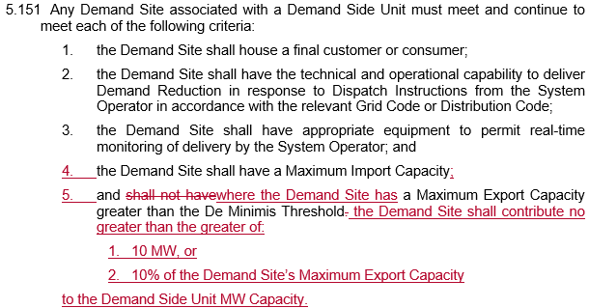
Proposed Modification
Proposed Wording
Intended Result
Demand Sites with MEC > 10 MW will be able to participate in DSU
The volume of capacity eligible to participate can scale with parasitic load for larger GUs
Larger GUs will be restricted to operating 10% of MEC under DSU to protect the intention of the original clause

Slide 6
Other Considerations
Trading Site
A DSU Aggregator has an independent Trading Site and TSSU that is not linked to any of the Individual Demand Sites it aggregates
This does not have any specified MEC associated with it and, as such, this avoids the need to split the MEC between the GU and the DSU
In the event that the site’s DSU capacity is > 10 MW, it would need to register as a stand-alone DSU
In this instance, the Trading Site would be the same as that of the GU which may preclude sites from participating with more than 10 MW in practice
Connection Agreements
Where a site intends to provide DSU capacity using a combination of Dispatchable Demand (Capacity, FFR, POR, SOR) and diesel generation (capacity, TOR1, TOR2, RR, RMx) it will be necessary to engage with the SO in advance to seek an amendment to the site’s connection agreement

Slide 7
Conclusions
Code Objectives Furthered
This modification will facilitate greater participation by existing assets in the Single Electricity Market in line with the Code Objective 1.3.3 ”to facilitate the participation of electricity undertakings engaged in the generation, supply or sale of electricity in the trading arrangements under the Single Electricity Market;”
This modification will also enable the use of dispatchable demand assets on the sites of Generator Units to be used for the provision of System Services through a Demand Side Unit which will, in line with Code Objective 1.3.4 “promote the short-term and long-term interests of consumers of electricity on the island of Ireland with respect to price, quality, reliability, and security of supply of electricity.” As a result, the increased utilisation of existing assets on the power system may delay the need for the additional generation infrastructure.
Feedback
We kindly request the Modifications Committee’s feedback on this proposal and, in particular, any other obstacles outside of the clauses on which modification is sought that may be impacted

