Slide 1
Energy Storage
Battery Storage
February 2014

Slide 2






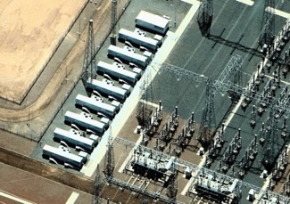
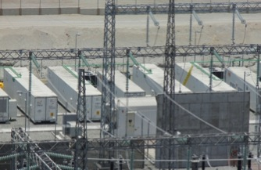
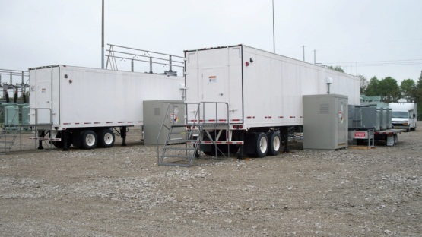
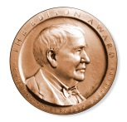
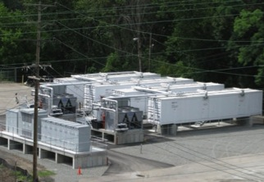
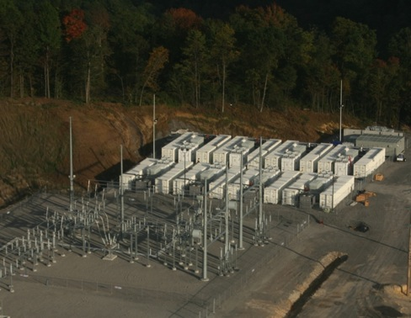
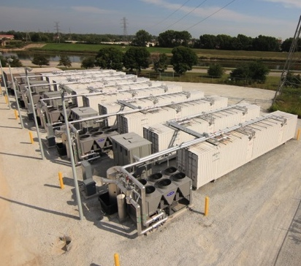

AES Energy Storage: power system partner since 2008
More than 180 MW of resource, 1GW in development
Customers:
40 MW, Chile
2014
24 MW Los Andes
Chile, 2009
40 MW Angamos
Chile, 2012
AES Carina @ IPL
World’s first grid Lithium-ion battery
Feb 2008
16 MW Johnson City
New York, 2010
64 MW Laurel Mtn.
West Virginia, 2011
40 MW, Tait,
Ohio 2013
© 2013 The AES Corporation All Rights Reserved

Slide 3
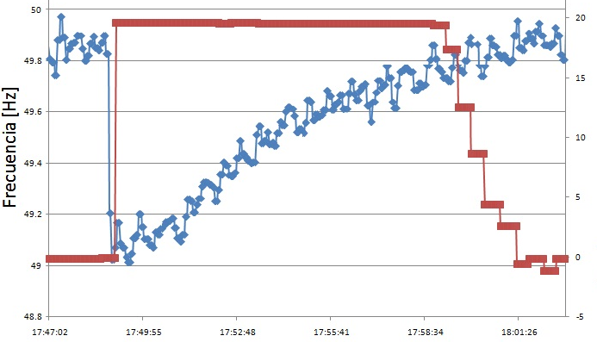
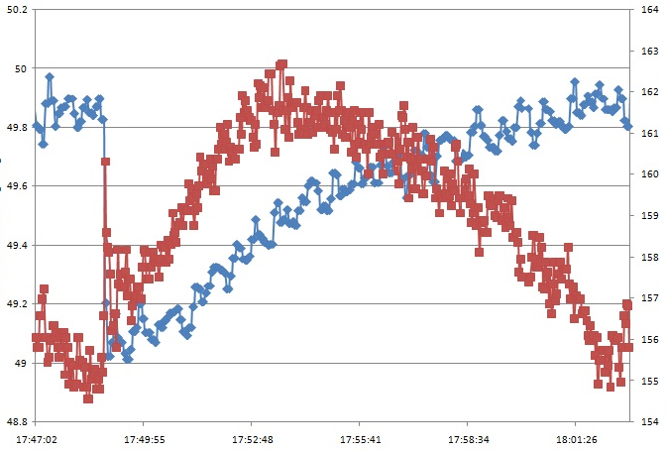
Synchronized Reserve: Quick, precise response to event
Source: CDEC-SING, AES
© 2013 The AES Corporation All Rights Reserved

Slide 4
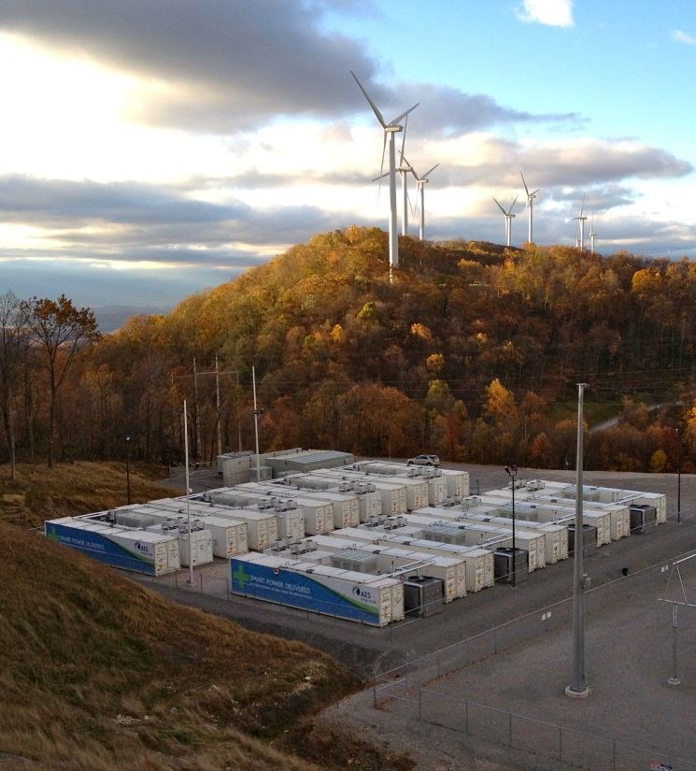
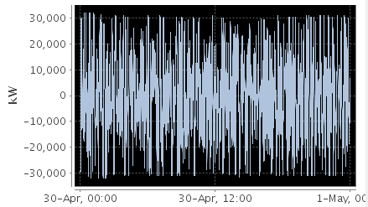
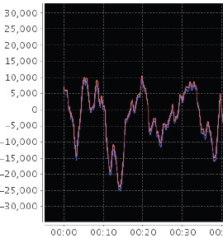
Frequency Regulation: Laurel Mountain 32MW energy storage operating commercially in PJM since 2011.
Operating range of +32MW to -32MW
Precise response to 4 second AGC
Ramp rate mitigation
Economic, daily bid in PJM power market
© 2013 The AES Corporation All Rights Reserved

Slide 5
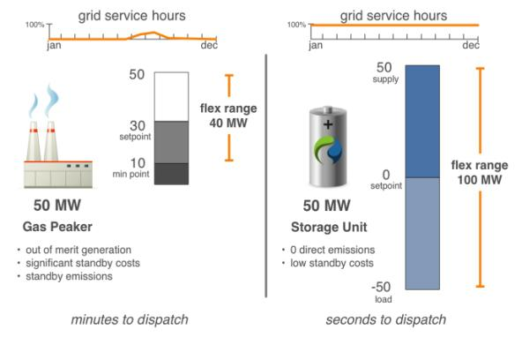
Flexibility: a 2X operating range, low standby cost, and nearly instantaneous power.
100 supply
100
50
Set point
20
Min point
Flex range 80MW
Flex range 200MW
100 MW
100 MW
100 load
© 2013 The AES Corporation All Rights Reserved

Slide 6
Advanced energy storage systems can deliver existing and future system support needs.
Existing Ancillary Services | Energy Storage
Primary Op. Reserve | ✔
Secondary Op. Reserve | ✔
Tertiary Op. Reserve | ✔
Tertiary Op. Reserve 2 | ✔
Replacement Reserve | ✔
MVAR Leading | ✔
MVAR Lagging | ✔
Proposed New Ancillary Services | Energy Storage
Synchronous Inertial Response | ✔
Fast Frequency Response | ✔
Fast Post-fault Active Power Recovery | ✔
Ramping Margin | ✔
Dynamic Reactive Response | ✔
*Storage also provides minimum generation support by being able to act as a load
© 2013 The AES Corporation All Rights Reserved

Slide 7
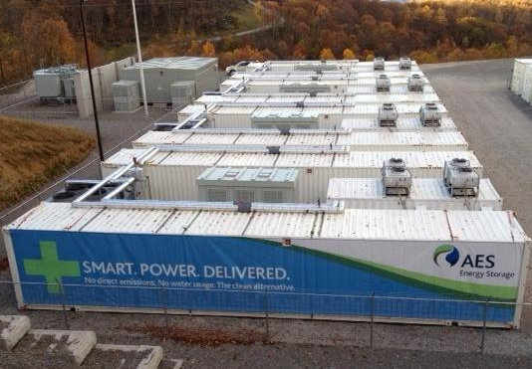
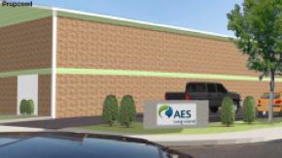
AES - summary technical capabilities
System Characteristics | AES
Regulation Capacity | Modular, 20MW up to 400MW
Round Trip Efficiency | 85%-90% (based on dispatch)
Operating Range | +/- full nameplate e.g. +100MW to -100MW
Availability | 97% (EAF all year round)
Operating Temperature | -20 C to 40 C
Power Factor | ± 0.95 at full load
Ramp-Up/Down Rate | (0% to 100% output in 200ms)
Voltage Support | Voltage Droop Settings < 50ms response time
Automatic Generator Control | < 50ms response time after control latency
Ride Through | Low Voltage Ride Through (settable thresholds) Low Frequency Ride Through (settable thresholds)
Standards | IEEE 519, 1547 UL 1741 NEC
Start-up time | <1 second, continuously synchronized
Dispatch | PLC-SCADA, Modbus TCP
Minimum generation | No minimum to remain synchronized
PCS Technology | IGBT-based inverters
Storage Technology | Advanced Lithium-Ion Batteries or similar
© 2013 The AES Corporation All Rights Reserved

