Slide 1
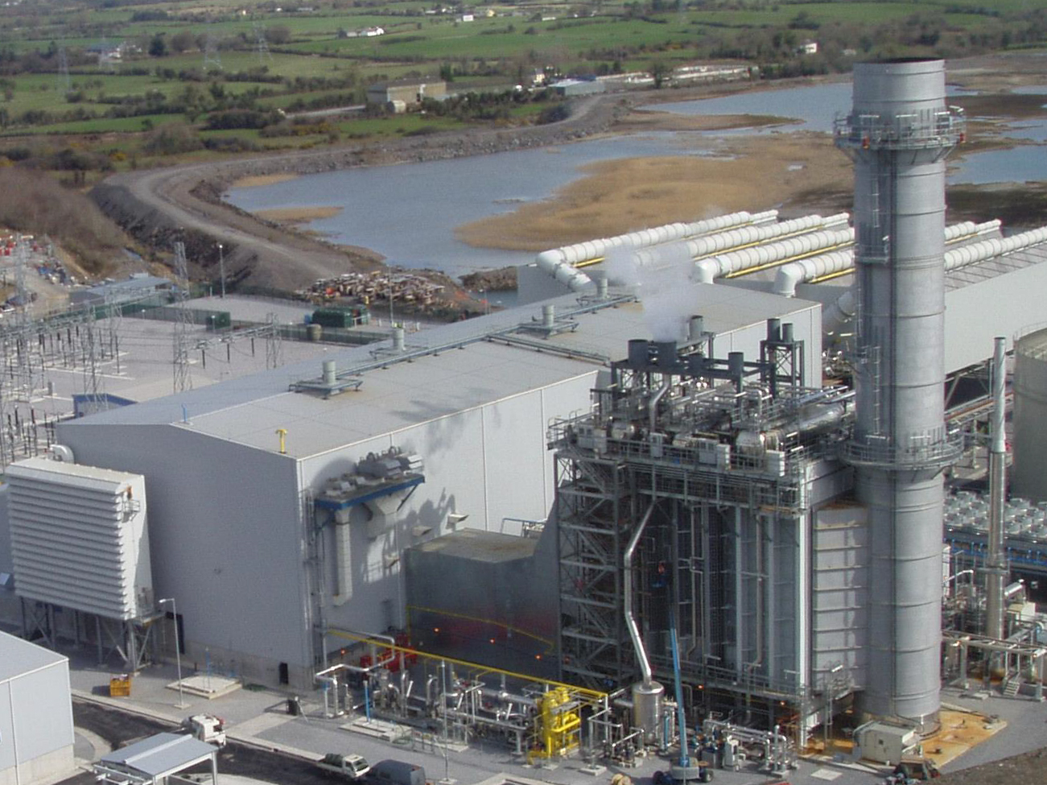
Supplementary Interim Secondary Trading
TYNAGH ENERGY
L I M I T E D
21 November 2019

Slide 2
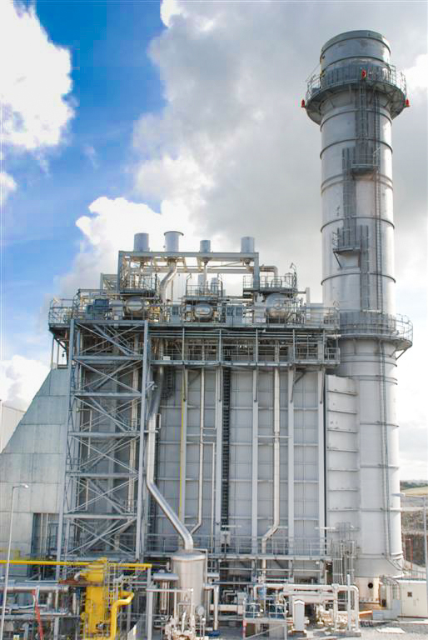
Background
Background
Requirements
Financial Trading
Registered Trades
Load Following
Master Trade Request
Trade Request
Capacity and Trade Register
Original Code
Two ways to transfer RO Obligations:
  Secondary Auctions (section H)
  Assignment (B.21)
Secondary auctions not available for go-live - RA’s introduced an interim solution - M.7
Interim Secondary Trading Arrangements
Opt out for units who were undergoing a planned outage
Participant can notify EirGrid nine days prior to the month that they are going on scheduled outage. They are then allowed opt out of their obligation and will not carry the risk, but equally will not get paid the RO payment.

Slide 3
Requirements
Background
Requirements
Financial Trading
Registered Trades
Load Following
Master Trade Request
Trade Request
Capacity and Trade Register
State aid Decision
Paragraph 51 of the State aid Decision states:
Reliability options will be tradable on the secondary market…it is not expected to be operational until Q4 2018...
Security of Supply
The modification will contribute to Security of Supply, as participants will trade to the original cleared capacity.

Slide 4
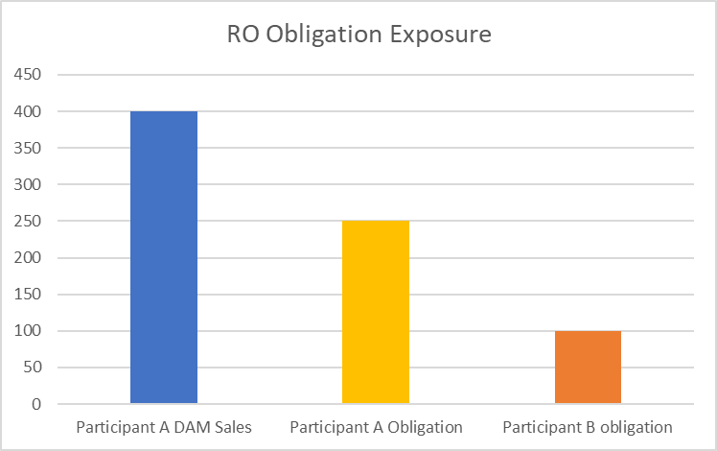
Financial Trading
Background
Requirements
Financial Trading
Registered Trades
Load Following
Master Trade Request
Trade Request
Capacity and Trade Register
Financial Trading does not provide a hedge
If A acquires B’s obligation, and A sells baseload in the DAM and an event occurs in the BM. Then:
In a high price event, B’s Obligation will still be exposed in the BM but A will not have been paid the high market price to cover the exposure of B’s obligation

Slide 5
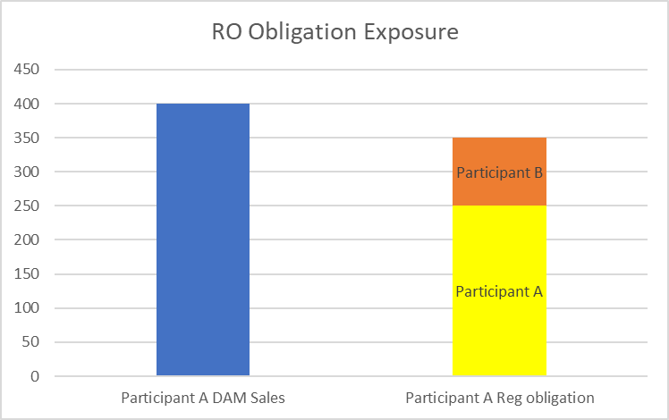
Registered Trading
Background
Requirements
Financial Trading
Registered Trades
Load Following
Master Trade Request
Trade Request
Capacity and Trade Register
Registered Trades allow the obligation to be covered
If A acquires B’s obligation and registers it. Then A sells baseload in the DAM and a high price event occurs in the BM. Then:
A’s DAM position will cover the exposure from both A and B’s Obligation.

Slide 6

Load Following
Background
Requirements
Financial Trading
Registered Trades
Load Following
Master Trade Request
Trade Request
Capacity and Trade Register
The nature of the Load Following Obligation or FSQC is a key factor in this proposal
The FSQC is calculated for every 30 minute period.
FSQC approximates to:
FSQC ≈ $\frac{System Demand+Capacity Reserve}{Capacity Cleared in Auction}$
In first 8 months of I-SEM it varied between a min of 32% and a max of 82.4%
Monthly max of 82.4% in December
Monthly max of 51% in May

Slide 7
Master Trade Request
Background
Requirements
Financial Trading
Registered Trades
Load Following
Master Trade Request
Trade Request
Capacity and Trade Register
Master Trade Request Process
Both parties submit a Master Trade Request to the RA’s for approval
RA’s approve the request
Inform the System Operators of the approved Master Trade Request

Slide 8
Trade Request
Background
Requirements
Financial Trading
Registered Trades
Load Following
Master Trade Request
Trade Request
Capacity and Trade Register
Trade Request Process
Both parties submit a Trade Request to the System Operators for approval
The request details :
  Buyer
  Seller
  Quantity
  Price
  Exact Period Covered
  Maximum Forecast FSQC*
System Operator verifies the trade does not exceed stated limits, and enters the trade in the Capacity and Trade Register
Notes:
(EirGrid’s relevant Forecasted System Demand + Capacity Reserve from the Capacity Auction)/Cleared volume in the auction

Slide 9
Capacity and Trade Register (1)
Background
Requirements
Financial Trading
Registered Trades
Load Following
Master Trade Request
Trade Request
Capacity and Trade Register
Record of all participants trades and obligations
Participants obligation will be updated with the trade.
Each participant will be paid for the value of their holding over their agreed trades.
If a participant with a 100MW obligation is on an outage with a max FSQC of 60% they could trade out of their RO for possibly 50% of the market rate.
They will still be paid for the 50% of the auction cleared price
Once the trade period has expired the obligation returns in full to the original owner

Slide 10
Capacity and Trade Register (2)
Background
Requirements
Financial Trading
Registered Trades
Load Following
Master Trade Request
Trade Request
Capacity and Trade Register
Example
Participant A takes on Participant B’s obligation for June 2019 for 50% RO revenue.
Before the trade the expected obligations and payments are as follows:
After the trade the table looks as follows:

