Slide 1
TYNAGH ENERGY
Mod_07_22 – Indexation to Calculation of Capacity Payments

Slide 2
Mod 07_22 – Rationale for Modification
Mod Rationale
Recent inflationary pressure in construction and materials costs have created a significant risk to New Capacity projects set to be delivered in the coming year. Failure to address this issue will result in a significant Security of Supply risk which will likely come at a significant cost to consumers.
When the CRM decision was made in 2015, it was deemed unnecessary to include indexation in Capacity Payments. This position was manageable up until the recent macroeconomic events which have driven up inflation, particularly related to construction and materials. Higher levels of inflation make it extremely difficult for participants to ensure that they can recover their costs, particularly given that Capacity contracts are secured three to four years in advance.
Similar issues have already impacted RESS-1 in Ireland with only 630MW out of a total awarded 1,275MW of renewable contracts expected to energise by the end of this year. It is understood that a significant number of these projects are not expected to complete at all, given construction costs rising by 10-15% in the period since their contracts were awarded.
The T-3 Auction was introduced to address existing Security of Supply concerns in the SEM. However, existing inflation rates means it is a possibility that many of the projects which secured contracts will not be able to build. Failure to secure this capacity will result in power shortfalls on the island of Ireland. This will likely result in emergency generation being required at a significant cost, and delivery risk to stakeholders.

Slide 3
Mod 07_22 – Rationale for Modification
Mod Justification and Alignment with Code Objectives
This modification is necessary to increase the likelihood of delivery of New Capacity. This modification aligns with the following TSC objectives:
To facilitate the efficient, economic and coordinated operation, administration and development of the Single Electricity Market.
  In order to ensure the efficient and economic operation of the SEM, it is necessary that potential new participants can recover their costs through the various market channels. Failure to address this risk will jeopardise this.
To facilitate the participation of electricity undertakings engaged in generation, supply or sale of electricity in the trading arrangements under the Single Electricity Market
  Current high inflation rates have created a significant barrier to entry for New Capacity projects, with a significant risk of costs spiralling during development. This acts as a disincentive for potential project developers who will not be able to accurately forecast such inflation rates. Failure to address this challenge will likely obstruct the participation of new generation undertakings in the SEM.
To promote competition in the Single Electricity Market
  As above, it is necessary to address this risk to secure new participants, and hence competition, in the SEM.
To promote the short-term and long-term interests of consumers of electricity on the island of Ireland with respect to price, quality, reliability, and Security of Supply of electricity.
  Addressing the challenge of rising inflation will significantly increase the likelihood of New Capacity being delivered in the SEM. This helps to address Security of Supply in the short-term and long-term. Additionally, we believe there is a price benefit to consumers in ensuring the delivery of planned capacity. Failure to secure New Capacity in a timely manner will mean the continued reliance on emergency generation to meet Ireland’s Security of Supply needs. This results in significantly higher costs for consumers, for a temporary fix.

Slide 4
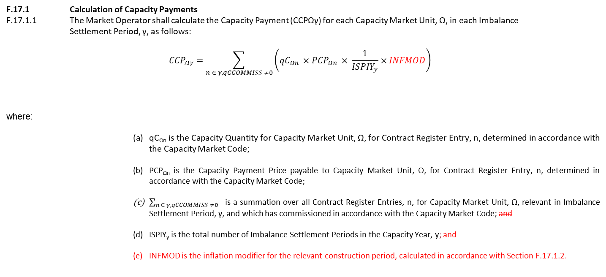
Mod 07_22 – Proposed Amendment
The modification itself would apply to the Trading and Settlement Code, to Section F.17 which relates tot the calculation of Capacity Payments
The modification proposal introduces a new term to increase Capacity Payments to account for inflation periods between years.
F.17.1 Calculation of Capacity Payments
F.17.1.1 The Market Operator shall calculate the Capacity Payment (CCPΩγ) for each Capacity Market Unit, Ω, in each Imbalance Settlement Period, γ, as follows:
$${CCP}_{Ωγ}=\sum_{n ∈ γ, qCCOMMISS ≠0}{\left({qC}_{Ωn} ×{PCP}_{Ωn} × \frac{1}{{ISPIY}_{y}}×INFMOD\right)}$$
where:
        qC_{Ωn} is the Capacity Quantity for Capacity Market Unit, Ω, for Contract Register Entry, n, determined in accordance with the Capacity Market Code;
        PCP_{Ωn} is the Capacity Payment Price payable to Capacity Market Unit, Ω, for Contract Register Entry, n, determined in accordance with the Capacity Market Code;
        $\sum_{n ∈ γ, qCCOMMISS ≠0}{ }$ is a summation over all Contract Register Entries, n, for Capacity Market Unit, Ω, relevant in Imbalance Settlement Period, γ, and which has commissioned in accordance with the Capacity Market Code; and
        ISPIY_{y} is the total number of Imbalance Settlement Periods in the Capacity Year, y; and
        INFMOD is the inflation modifier for the relevant construction period, calculated in accordance with Section F.17.1.2.

Slide 5
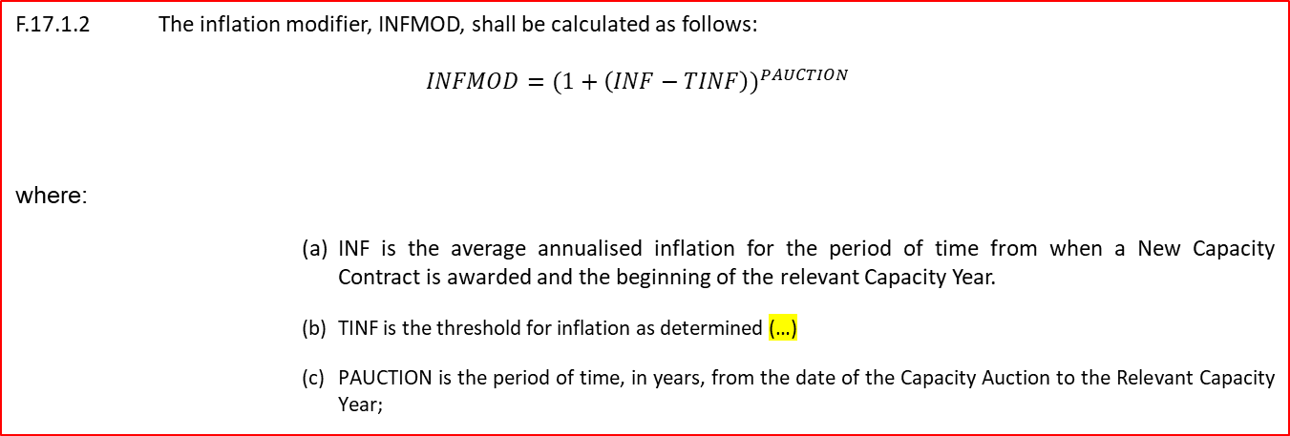
Mod 07_22 – Proposed Amendment
The modification itself would apply to the Trading and Settlement Code, to Section F.17 which relates to the calculation of Capacity Payments
The INFMOD term will be calculated with the below modification:
F.17.1.2 The inflation modifier, INFMOD, shall be calculated as follows:
$$INFMOD={(1+\left(INF−TINF\right))}^{PAUCTION}$$
where:
        INF is the average annualised inflation for the period of time from when a New Capacity Contract is awarded and the beginning of the relevant Capacity Year.
        TINF is the threshold for inflation as determined (…)
        PAUCTION is the period of time, in years, from the date of the Capacity Auction to the Relevant Capacity Year;
The PAUCTION term will apply from year in which the relevant Capacity was awarded, to the current Capacity Year. This will facilitate the recovery of costs related to operational inflation.

Slide 6
Mod 07_22 – Current Positions
The following issues were discussed at a dedicated Industry Call on 18 July. These points represent the current thinking of Tynagh in relation to the modification.
Modification will apply to both inflation and deflation.
Threshold for standard inflation to be a variable parameter determined by the RAs. Should be based on Auction Price Caps.
CPI should be used for indexation (a blended rate to cover two jurisdictions) if applied to operational costs as well as construction. More specific construction-related indices can be applied if recovery is based on the construction period only.
Modification shall apply to both New and Existing Capacity.
Modification is required urgently to address current cost exposure for participants developing New Capacity.

Slide 7
Mod 07_22 – Next Steps
We propose the following Next Steps to progress this modification proposal:
Deferred to Mods Committee Meeting 112 in September. Pending outcome of the Capacity Workshop and discussion today we will amend the modification proposal for discussion/voting at the next Mods Committee Meeting.

Slide 8
Appendix – Appropriateness of Inclusion in TSC
Some Committee Members questioned whether the modification was more suitable for inclusion in the TSC or the CMC?
Section F.9.4.4 states that: “The final Capacity Auction Results relating to a Participant are final and binding on that Participant”.
Section F.9.1.2 of the Capacity Market Code states: “Except to the extent provided for in the Trading and Settlement Code, the Capacity Payment price shall not be subject to adjustment or indexation.
We believe that it would be inappropriate to introduce this change in the CMC, given that the TSC is concerned with calculating Capacity Payments received by participants.
We propose that this modification is further discussed at the CMC for information.
CMC Results
Capacity Auction Results
TSC Capacity Payments Calculation - Present
Awarded Capacity Associated with Unit.
Awarded Capacity Associated with Unit.
Capacity Payment Price
Proposed Inflation Modifier
Capacity Payment price for the relevant Unit.
x
x
…for Capacity Duration
Capacity Duration for the relevant Unit.

