Slide 1
Amendment to Payment Deferral Settlements Team
04/11/25

Slide 2

Amendment to Payment Deferral
With this Urgent Modification, SEMO is trying to address potential issues identified with the calculation of Payment Deferral and is proposing a more harmonised, equitable approach for the Market.
The current Payment Deferral methodology is only applicable to those registered Market Participants who provide Metered Generation to the grid. The implications of Payment Deferral are therefore confined to a subset of Market Participants and not harmonised across all those impacting the funding shortfall. In some scenarios, Participants who are owed a payment could receive a charge due to current Payment Deferral logic.
As per current iteration of T&SC, Payment Deferral is calculated as per below:
Available Working Capital Amount Minus the Settlement Document (SD) Amount
Multiplied by each participants Metered Generation* divided by total generation* on the island.
i.e. T&SC currently refers Payment Deferral paragraph to algebra from Shortfalls and Unsecured Bad Debt in section G.2.7:
*Generation per billing week

Slide 3
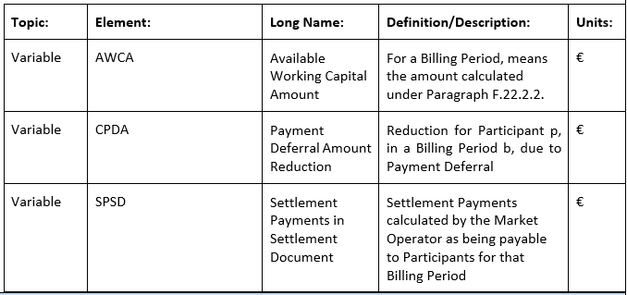

Amendment to Payment Deferral
SEMO proposes revising the Payment Deferral algebra to ensure that all participants owed funds receive an evenly distributed, proportionally reduced payment. This Modification will impact all Participants who are due to receive payments from the market as per their Settlement Document i.e. including Generators, Assetless Units, Supplier Units etc. it will lead to a more equitable and non-discriminatory outcome as per the following example (Slide 4).
SEMO proposes to amend Section F.22.3.1 of T&SC by including new algebra and new elements to the T&SC Glossary.

Slide 4
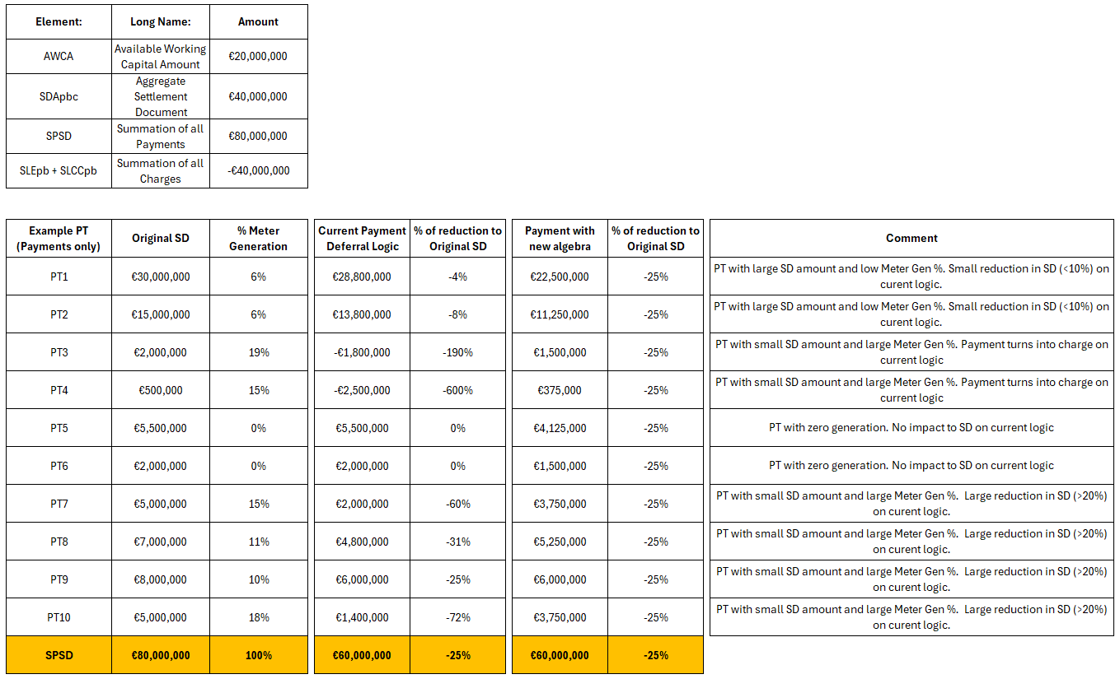
Amendment to Payment Deferral - Example
In this example the
Available working Capital is €20M
Aggregate Settlement Document (SD) is €40M
Original SD payments is €80M
SD chargers is €40M
Payment Deferral amount is €20M

