Slide 1
Balancing Market – Long Day Participant Submissions

Slide 2
BM – Long Day Participant Submissions (MPI)
On the 28th of October, the local time in Ireland 02:00 IST reverts to 01:00 IST / UTC.
Impact:
  The I-SEM Trading day will still contain 50 half hour periods due to the addition of the 1 hour (Long Day).
  The 28th of October Trade Date will commence @ 22:00 UTC and cease @ 23:00 UTC.
Participant Impact:
  Physical Notifications
  Simple & Complex Offer Data

Slide 3
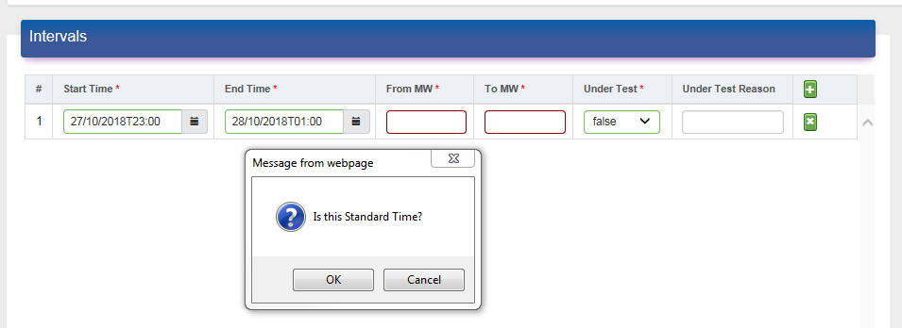
BM – Long Day Participant Submissions (MPI)
The MPI requires the user to define the time zone (UTC or Local) if they select 01:00 28th of October on the MPI, when the user selects “OK” it is entered as UTC time in the XML submission.
The same is applicable to Simple and Complex COD submissions.
When generating an XML submission for the Trading Date the 28th, the first time period will start @ 22:00 UTC / 23:00 IST and end at 23:00 UTC as per the above screenshot.

