Slide 1

The Regulation on wholesale Energy Market Integrity and
Transparency (REMIT)

Slide 2
Overview of REMIT
Regulation 1227/2011
Tailor-made regime for wholesale energy markets
Prohibits insider trading
Requires publication of inside information
Prohibits market manipulation
Detailed reporting of energy transactions
Registration of energy market participants
ACER to have monitoring and coordination roles

Slide 3
REMIT Implementation Timeline
REMIT dependent
Implementing Acts dependent
REMIT enters into force
Prohibitions and Obligations apply
6 months
“Registration Format” published by ACER
Adoption of the Implementing Acts
within 3 months
NRAs have to set up the register
after 6 months
Data reporting and monitoring by ACER
18 months
NRA competences implemented into national law
December 2011
June 2012
June 2013
?

Slide 4
REMIT Implementation Timeline
Implementing Acts dependent
Adoption of the Implementing Acts
within 3 months
NRAs have to set up the register
after 6 months
Data reporting and monitoring by ACER
t
(?)
t+3
months
t+6
months

Slide 5
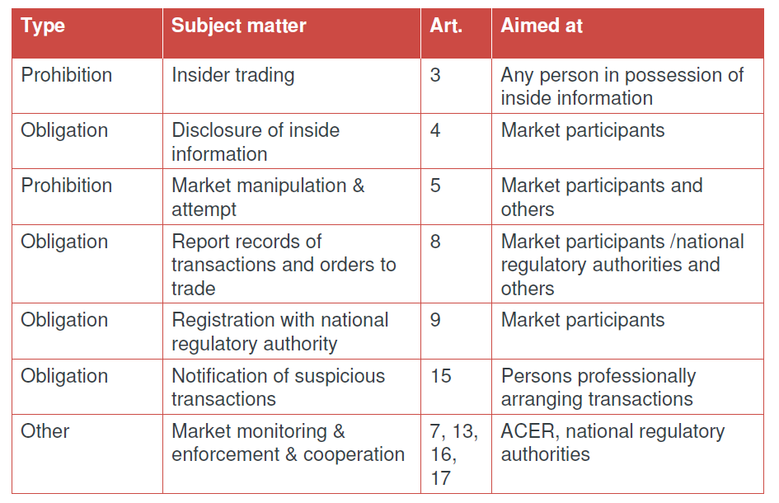
REMIT Structure

Slide 6
Next Steps?
ACER Roundtable on REMIT September 23rd
– discussion of pilot project and questions on Registered Reporting Mechanisms
Awaiting Implementing Acts
Obligation on SOs and Market Participants to report to ACER
Do Market Participants want to report themselves or through a central platform?

Slide 7


