Slide 1
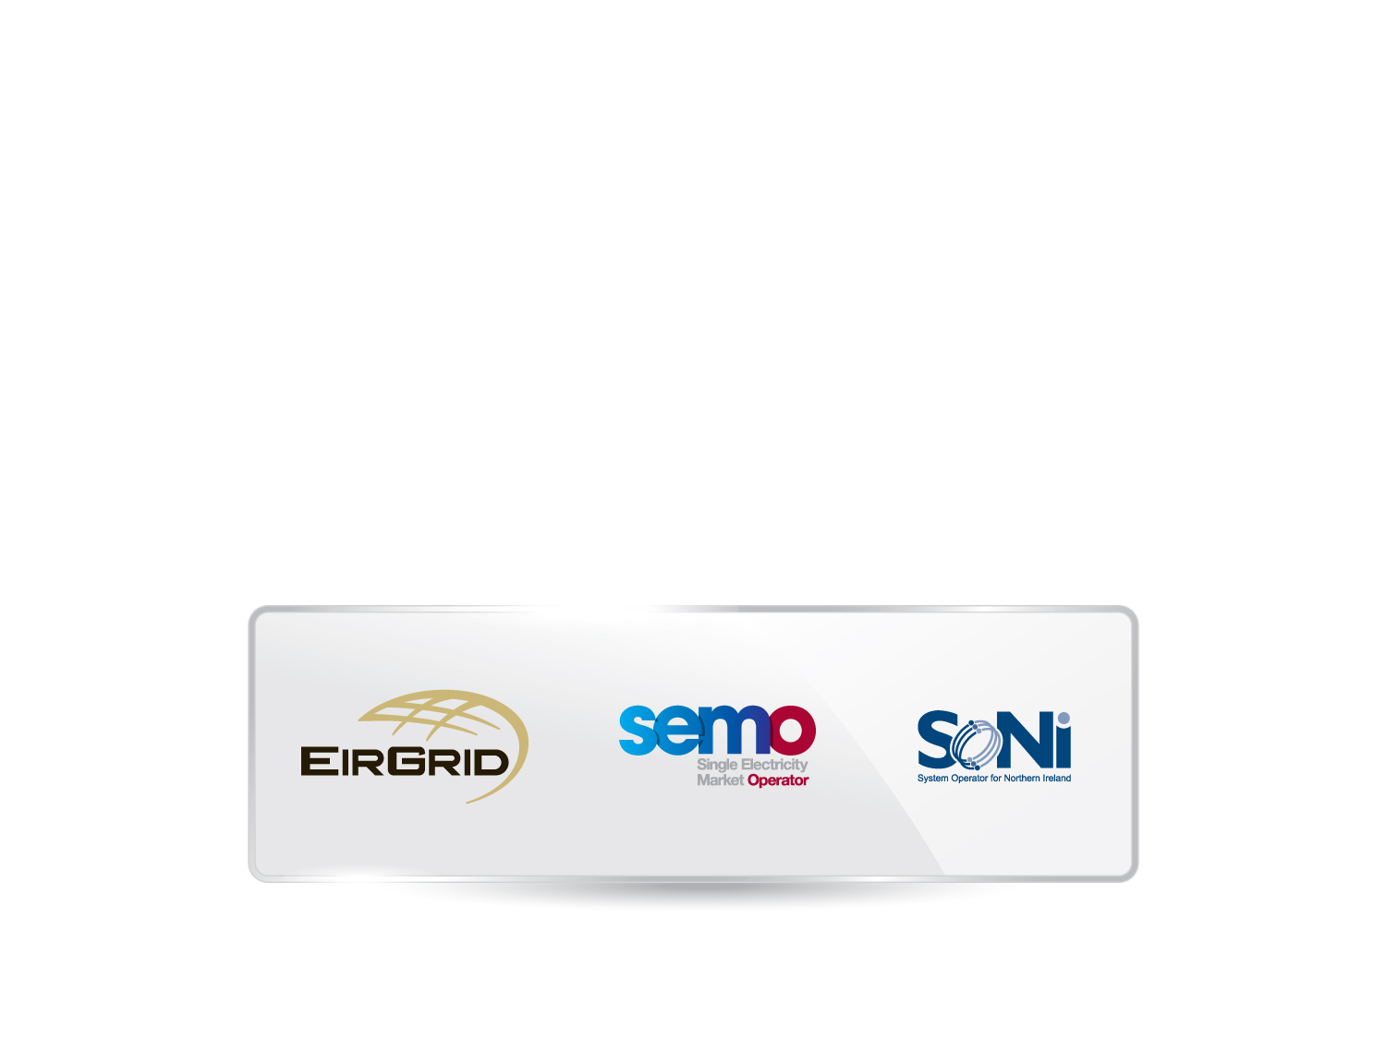
Mod_02_13
Registration of Charges

Slide 2
Cash Collateral in SEM
There are currently 70 cash collateral accounts in SEM which together constitute 6% of the total SEM collateral (cash plus LOCs)
SEMO regularly draws down on collateral accounts for small amounts without issue, where payments due have not been received on time
There has been one liquidation case so far in the SEM. There was no issue for SEM in that case

Slide 3
