Slide 1
Representation of Interconnector Participants on the Modifications Committee (Mod 05 15)

Slide 2
Overview of proposed T&SC Changes
Rationale for Mod Proposal

Slide 3

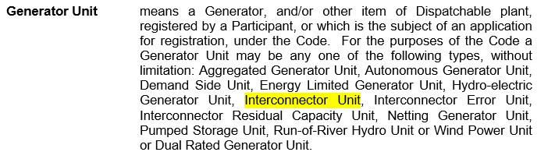
Generator Participants currently represent Interconnector Participants*
*T&SC Version 16.0 (Glossary)

Slide 4

Mod 05 15 - Interconnector Participant (New)

Slide 5
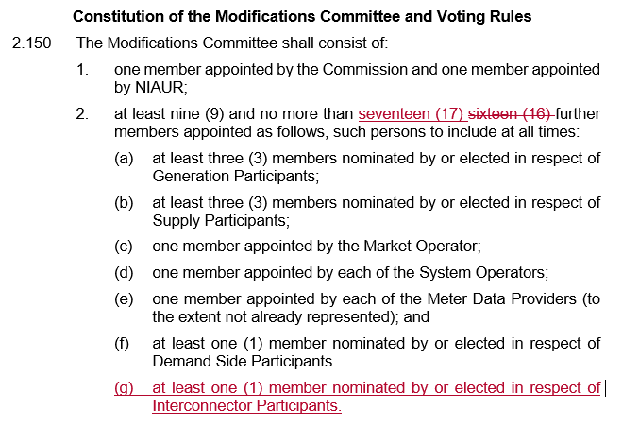
Mod 05 15 - Interconnector Participant (New)

Slide 6
Mod 05 15 – Rationale for Change
Cross border trade through Interconnectors a very significant feature of SEM
A number of standalone Interconnector Participants now registered in SEM
Burden of representing Interconnector traders at Mod Panel shouldn’t fall upon Generator Participants
An opportunity to gain perspectives from other markets within Modification debates
Recent precedence for addition of new Mod member – Demand Side Member (Mod_01_12)

