Slide 1
MOD_10_13
Remove the requirement on the SOs to sent certain Dispatch Instructions for Pumped Storage Units to MO

Slide 2
Context
Certain combinations of Dispatch Instructions and Dispatch Instruction Codes are issued in “blocks” by the TSOs
Appendix O describes the hierarchy used to rank and validate those issued with the same timestamp
A particular sequence of events lead to a FAIL instruction not being validated
Proposal from TSOs to remove requirement to send certain instructions to avoid this situation in future

Slide 3
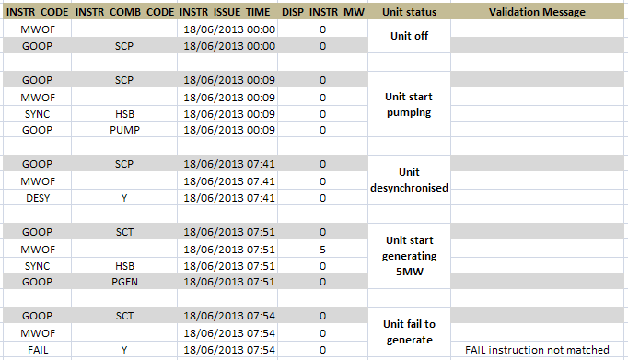
Dispatch Instructions

Slide 4
T&SC Drafting Change
Appendix O
O.16 A Dispatch Instruction having a GOOP Instruction Code and having a SCP Instruction Combination Code mayust precede a Dispatch Instruction having a GOOP Instruction Code and a PUMP Instruction Combination Code.

Slide 5
Summary
No change required to either MO or TSO systems
Pumped Storage Units will still receive the instructions via EDIL
Process change in the TSOs’ preparation of Dispatch Instruction Data feeds
Vendor has confirmed no impact on Instruction Profiling

