Slide 1
Make Whole Payments Modification Proposals
Modifications Committee Meeting
04 December 2014

Slide 2
Introduction
Two RA Modification Proposals submitted
Mod_09_14 Amendment to Make Whole Payments for Interconnector Units
Mod_10_14 Make Whole Payments for Interconnector Units

Slide 3
Background
SEM has seen a significant increase in level of Make Whole Payments (MWP) recently.
This increase has been predominantly attributable to interconnector units.

Slide 4
Level of MWPs

Slide 5
Impact of Trading Pattern
In addition to increasing levels of MWPs, the recently seen trading patterns have reduced the efficiency on IC trades
Generally reducing imports across the day when price differentials suggest ICs should be fully importing
Creating an inefficient export signal
This is increasing prices in SEM in addition to increased MWPs costs
The RAs do not believe that the current treatment of MWPs in the Code is a prerequisite to efficient export when price differentials are in the right direction.

Slide 6
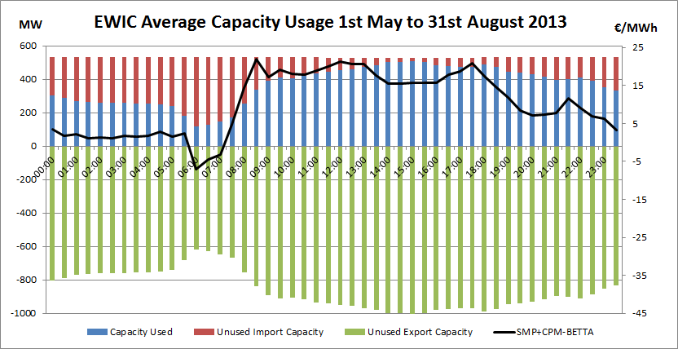
2013 RA Analysis

Slide 7
Total Export MIUNs June 2014

Slide 8
Example - June 2014 Analysis
IC MWPs – circa €900,000
Export MIUNs – 116,963 MWh
Actual IC Exports 5,062 MWh
These net exports represent a significant cost

Slide 9
Explanation of Proposals
Mod_09_14 Amendment to Make Whole Payments for Interconnector Units
The purpose of this Modification Proposal is to amend the Code so that Interconnector Users receive Make Whole Payments based on their aggregate position across all gate windows (EA1, EA2 & WD1) in which they have traded from the current Code wording where each gate window is considered separately for the calculation of Make Whole Payments.

Slide 10
Explanation of Proposals (2)
Mod_10_14 Make Whole Payments for Interconnector Units
The purpose of this Modification Proposal is to amend the Code so that Interconnector Units no longer receive Make Whole Payments in the market.

Slide 11
Summary
Level of MWPs has increased significantly of late
In addition to absolute level there has been a corresponding reduction of efficient import trades through netting
RAs are of the view that the current situation in the Code is not a perquisite for efficient trading cross border
RAs have proposed two potential solutions
We look forward to the discussions and deliberations of the Committee

