Slide 1

MOD_14_12
Reference to MO Status for VTOD

Slide 2
Context (1)
Mod_47_08 V2
  Approved by the RAs in May 2009
  Implemented in the SEM systems in November 2010
This Mod resulted in a CMS change whereby a participant could have up to 6 Approved Validation Data Sets for a particular generation unit in the SEM systems
Approval time for newly submitted Validation Data Set of 10 Working Days

Slide 3
Context (2)
The implementation of MOD_47_08 in the SEM systems requires that as well as SO approval (or rejection) for a submitted Validation Data set, the MO must also approve (or reject) the set before it becomes an Approved Validation Data Set.
This Modification Proposal seeks to ensure that the MO responsibility is outlined in the TSC and that an appropriate timeline is attributed to this.
It is not intended to change the 10 Working Day timeline for SO validation which came about from MOD_47_08 V2

Slide 4
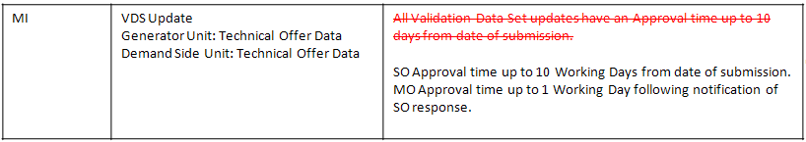
T&SC Drafting Change
BODY OF TSC:
3.42F The System Operator shall assess each submitted Validation Data Set within 10 Working Days
and either approve or reject the submitted Validation Data Set and advise the Market Operator accordingly.
3.42G If a submitted Validation Data Set is approved by the relevant System Operator, the Market Operator shall ensure that the approved status is matched in the CMS within 1 Working Day, in order for the relevant Validation Data Set shall to be deemed to be an Approved Validation Data Set. and The set will be identified thereafter by its Validation Data Set Number. Otherwise the submitted Validation Data Set shall be deemed to be rejected.
Agreed Procedure 4: Transaction Submission and Validation:
2.6.6.3 Change of Validation Data Set:
If a Participant wishes to change the data elements of one of its six Validation Data Sets, it may do so using the “Submission of Validation Data Sets” process above. There is an approval time of up to ten days for changes to VDSs. for this submission is outlined in Table 4 of this Agreed Procedure, “Data Transaction Approval Requirements”.

Slide 5
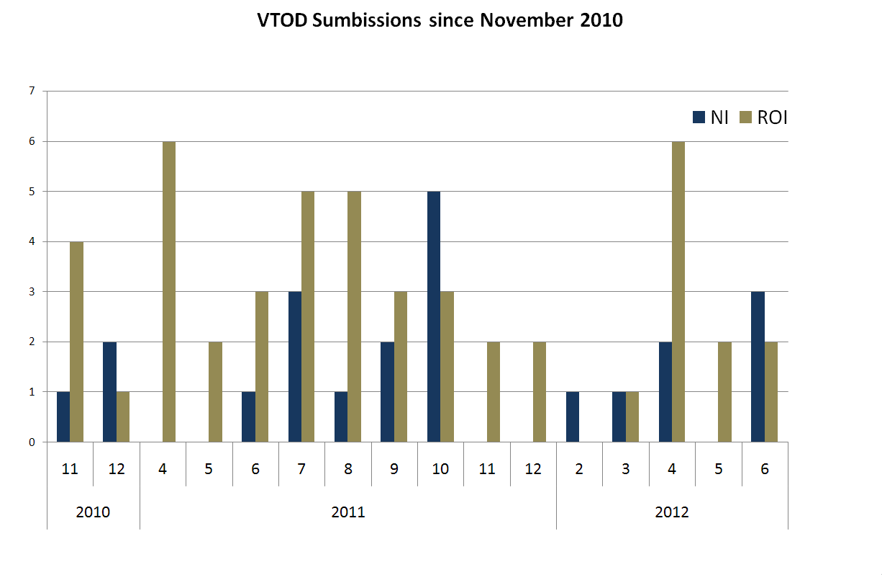

Slide 6
Summary
Since November 2010 the TSOs have received 69 VTOD requests
Vast majority have matching MO status on same working day as SO status communicated (>90%)
Modification seeks to reflect the role of the MO in respect of VTOD in the TSC

Slide 7


