Slide 1
Allowing DSUs to act as Predictable Price Takers in the SEM
4th December, 2014

Slide 2
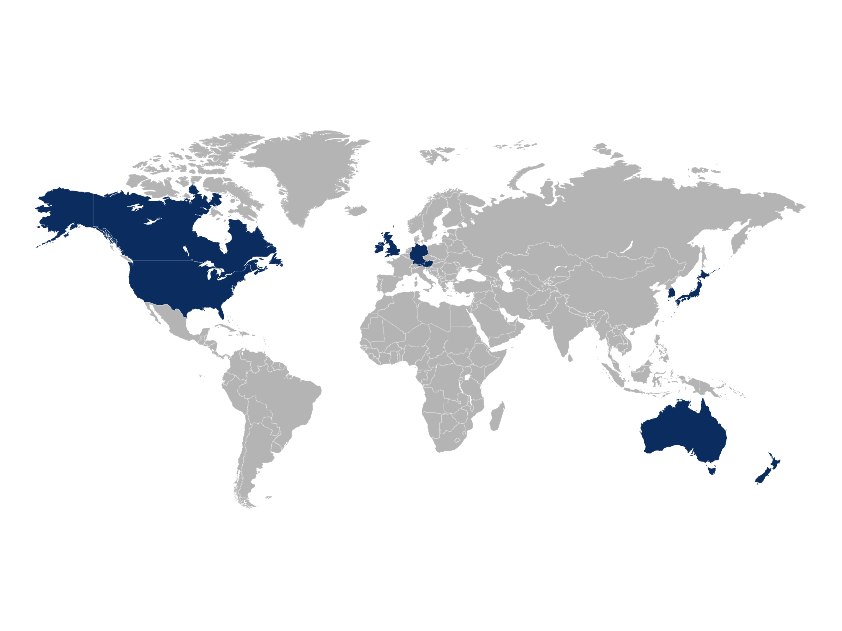
A Global Demand Response Footprint
Countries Covered

Slide 3
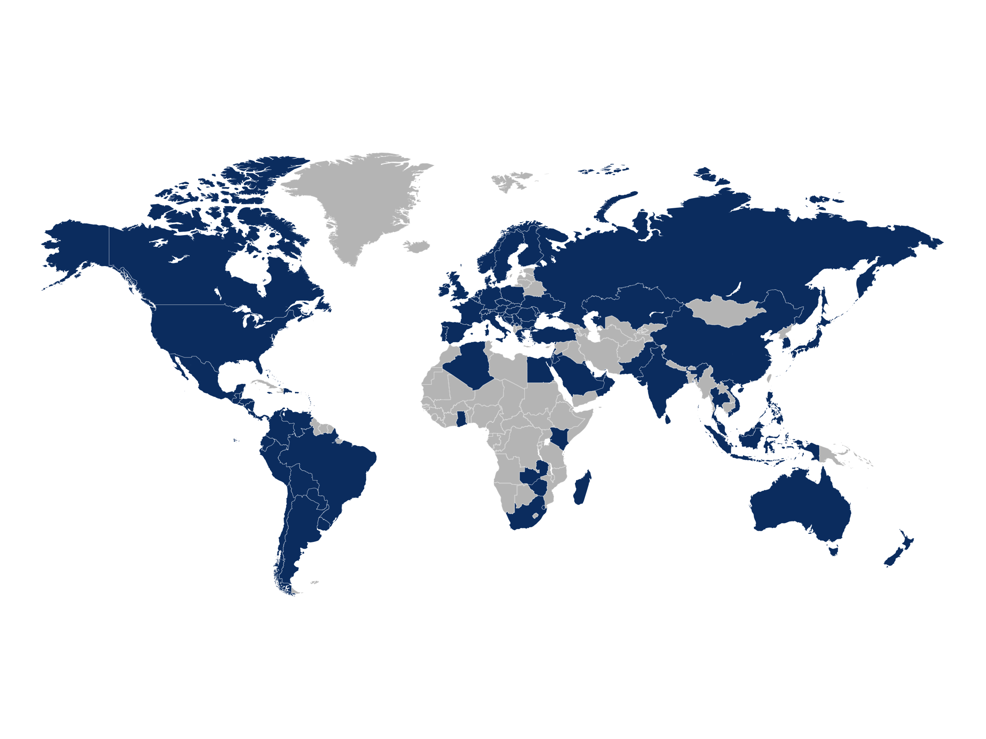
Global Capability
We meet you where you operate – in 104 countries
24–27GW of Peak Load under management
~9GW of Dispatchable Demand Response (DR)
11 Countries with DR operations
100+ Utilities / System Operator relationships
14,000+ C&I Facilities in our network
~1.5 Billion Data Points / Month into our NOC
~1,000 Employees worldwide
Countries Covered
Streaming data from over 14,000 enterprise sites
Supporting 15 languages
Global offices in 12 countries
Managing one million bills annually
Worldwide currencies and measurements

Slide 4
Activation Energy
Launched First DSU in ROI in July 2012
Largest Provider in the market
Strong Focus on Regulation
100% customer retention
100% Eirgrid Tests passed
100% performance on all dispatches received
Acquired by EnerNOC in February 2014

Slide 5
DSU Market Growth
Activation Energy/EnerNOC 104MW
Others 55MW

Slide 6
DR in Ireland
Paid Capacity Payments from the SEM
DR treated in the same way as generators
30 minutes response
2 hours demand reduction
Live signal sent to TSO similar to generators
Demand response from load reduction or switch over to back up generation

Slide 7
Capacity Existing on customers sites
High Efficiency CHP
Biomass Generation
Small Scale
Generators not retail metered
Suitable for Aggregation
Increased capacity/flexibility for TSO

Slide 8
Barrier
5.154 Each Demand Side Unit shall be classified as a Predictable Price Maker Generator Unit
Prevents clasification of small suitable units being registered as Predictable Price Makers
EnerNOC can not see any reason for this limitation
Propose modification of this clause
5.154 Each Demand Side Unit shall be classified as a Predictable Price Maker Generator Unit or Predictable Price Taker Generator Unit.

Slide 9
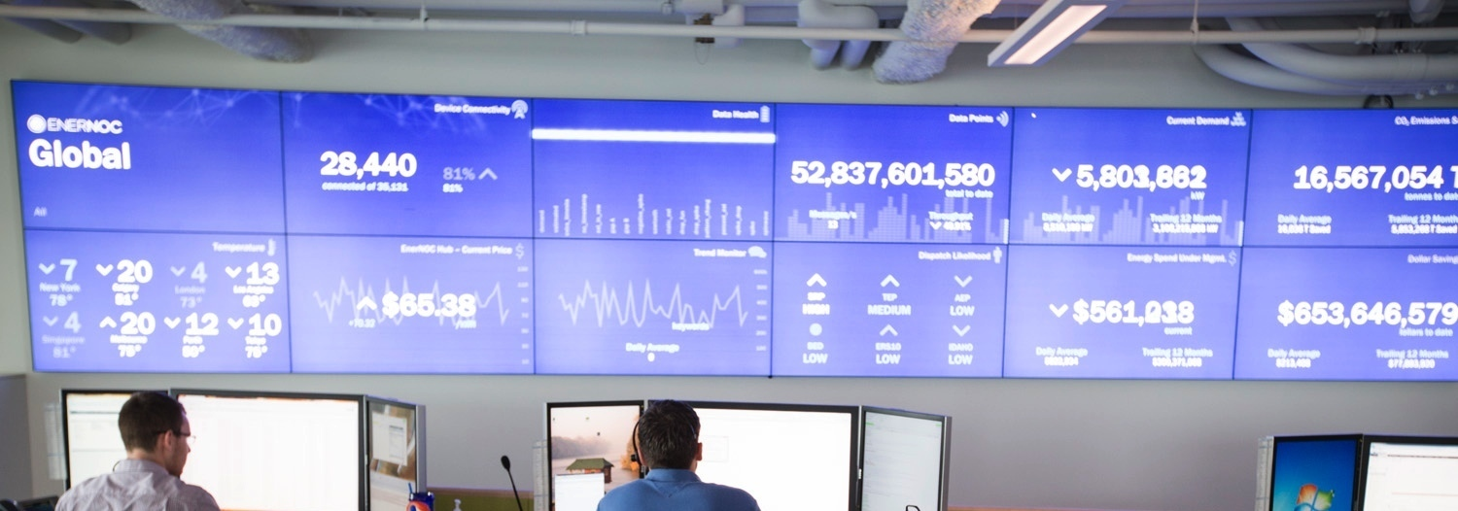
Thank You
Patrick Liddy
Patrick.Liddy@enernoc.com

