Slide 1
Unit Registration Process Improvement
SEMO
05/12/2012

Slide 2
Introduction
Background
What?
Why?
How?
Current Process
Proposed Process
Next Steps

Slide 3
Background
What?
Simplify the SEM registration process for Applicants, SEMO and 3rd Parties (System Operators, Meter Data Providers, etc.)

Slide 4
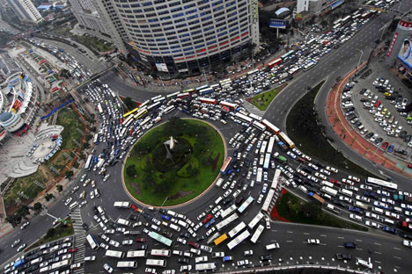
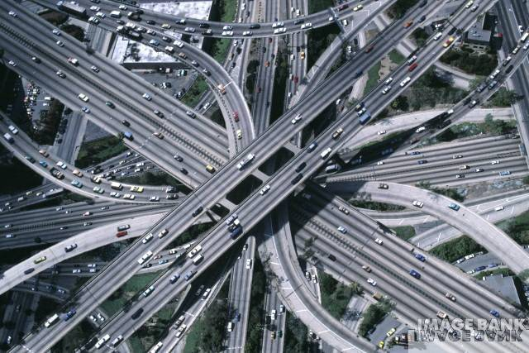
Simplifying Registration

Slide 5
Background
Why?
Current Process:
Not very transparent
Frustration for all parties involved
60 Working Days
New Process:
Clear visibility of progress
Greater Clarity on requirements
Speedier Registration

Slide 6
Background
How?
Distinct stages of Registration
Applicants know precisely where and how far they are progressed
Clearer process flows
Less confusion about what’s required and when
Quicker Registration

Slide 7
Current Process

Slide 9
Unit Registration
(
2
)
s
At least
1
0
WD
prior to
On Meter Data
A
Effective Date
On or after Effective
R
Date
Validation date
/
A
Final Confirmation of
I
Operational and
/
or
Advise MO and Party of
/
P
Within
10
WD
D
Systems Readiness
&
Meter Validation Date
M
provide TLAFs
Prior to Effective Date
Complete Meter
O
/
Email
Validation
, &
Reissue
S
data if necessary
Email
At least
5
WD
prior to
Receive Commencement
As required by each
Raise a Dispute in
Effective Date
Notice
MDP and Party
accordance with
Post r
equired Credit
AP
14
Cover
.
Post
y
Receive revised
t
Effective Date
All Parties work
r
a
P
together to resolve
/
the issues
t
n
a
c
i
p
l
p
A
Effective Day
-
5
WD
s
5
.
Raise a
Dispute
Move
Effective Date
forward
to date
agreed between
relevant Parties as
feasible
&
When issued
When issued
Receive SO
Receive notice of
Confirmation
At least
5
WD
prior to
Meter Validation Date
Effective Date
Within
20
–
30
WDs
Resolution outcomes
1
,
2
,
3
Within
1
WD
Email
Check Posting of
Email
of Effective Date
1
.
Outstanding Issue
?
Credit Cover
,
Credit Cover
.
Hold final
3
.
2
.
Credit Cover Issue
?
Effective Date
,
Inform all relevant
Post
Registration
Agree a
new
Effective Date
?
Parties and facilitate
At least
4
WD
prior to
Meeting
4
.
Withdraw Application
?
or
resolution
to Effective date
Call
5
.
Raise a Dispute
?
Other Issue
?
Post
Issue Commencement
Required
Yes
Notice
&
update list of
r
Credit Cover
registered Units in
o
Posted in time
?
accordance with AP
6
t
a
r
e
p
Post
/
Email
O
No
t
e
k
4
.
Withdraw Application
r
a
M
Is it more than
NO
,
RETURN TO FINAL MEETING STAGE
365
days since
original Effective
Date
?
Withdrawal notice
Go to
End
Withdrawal
:
Yes
Unit
Registration
(
1
)

Slide 10
Proposed Process

Slide 11
Proposed Process
Application
Review
Readiness
Go Live

Slide 12
Proposed Process
Split process into 4 stages
Stages are separate to each other:
Can’t advance until current stage is finished
Can’t return to a previous stage
Each stage has distinct timelines

Slide 13
Proposed Process
Most changes relate to new structure
Splitting into 4 stages, changing order of steps, etc.
Extension requests are removed
if requirements are not met process reiterates

Slide 14
Proposed Process
Some minor changes:
Explicitly stating when the creation of IDs is to occur
Introduction of “Confirmation of Receipt of Application”
Allowing for EFT of Registration Fee

Slide 15
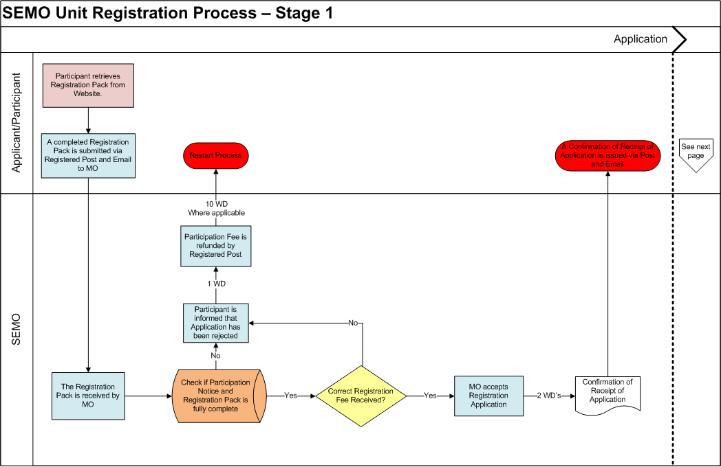
Stage 1 - Application

Slide 16
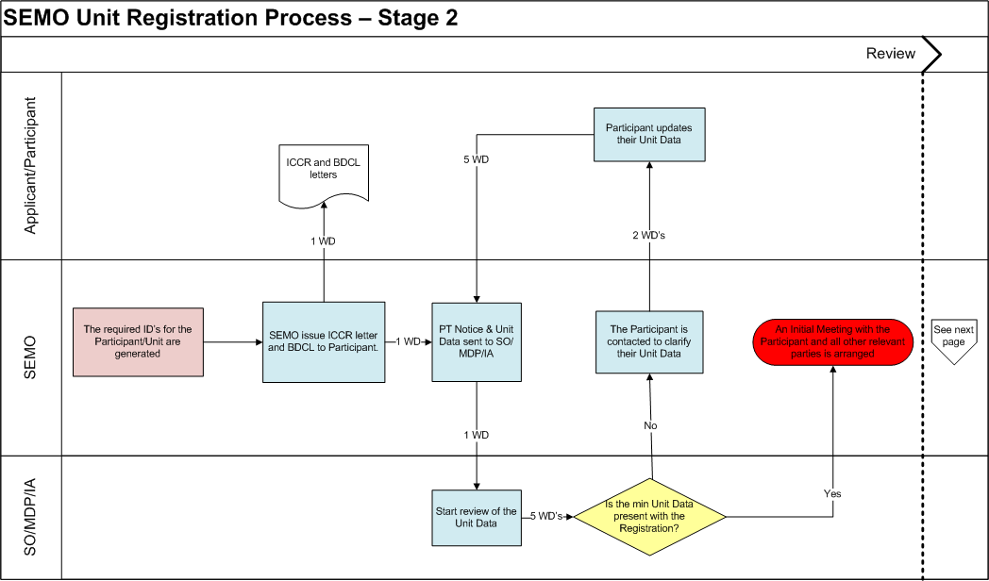
Stage 2 - Review

Slide 17
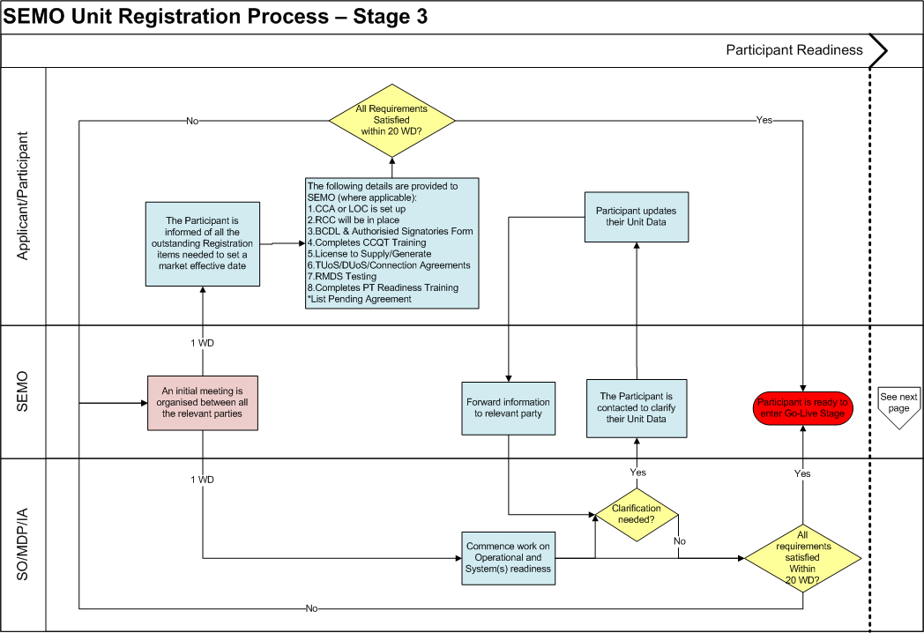
Stage 3 – PT Readiness

Slide 18
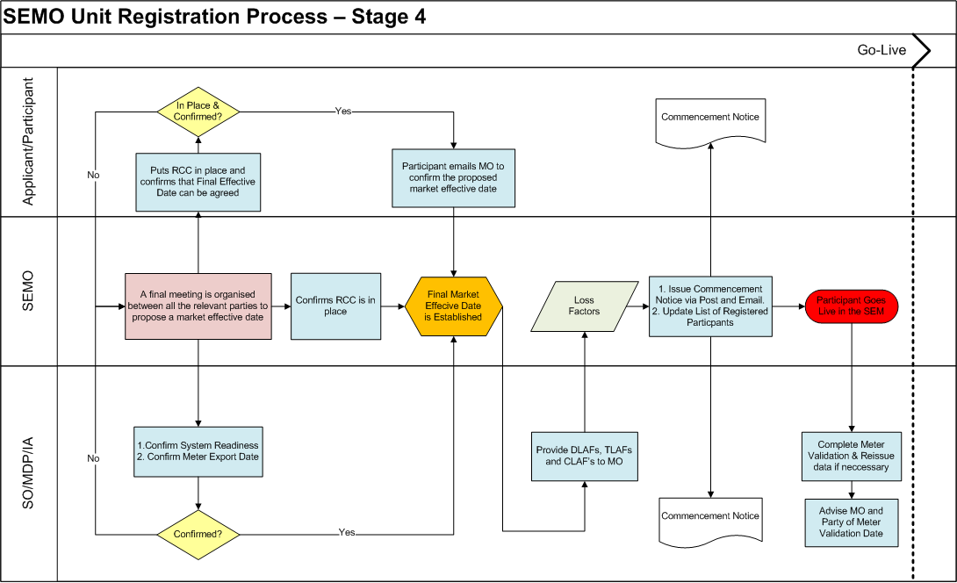
Stage 4 – GO-Live

Slide 19
Benefits of Proposed Process
Stages adds transparency to progress of applications
Delays in one section cannot affect another
Effective date only agreed when all requirements are met
reduces need to change effective date

Slide 20
Impacts on Market Participants
Existing generators and suppliers
No impact
Registering a new unit
No system impact
Improved registration pack
Improved registration process
Unit type change
No impact
Deregistration/Party Applications
No impact

Slide 21
Next Steps
Get agreement
Relevant parties (SO, MDPs & IA)
Minimum requirements for registration documents

Slide 22
Next Steps
Modify AP1 (provisional mod submitted):
Section 3.2.5 – Procedural Steps
Section 3.2.6 – Swim Lanes
Appendix 1 – Definitions and Abbreviations

Slide 23
Questions?

