Slide 1
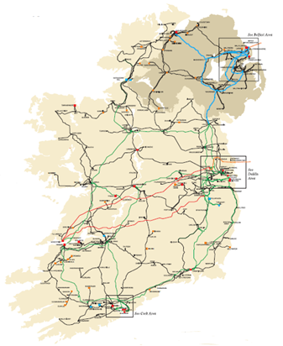
SK3
80MW
SK4 80MW
In-house
45MW
MEC 130MW
&
MIC
45MW
Station gate Delivery 115MW
Trading boundary 115MW*TLAF
Proposal
let
TSSU TLAF
=
Station node TLAF
only
Under restrictive conditions

Slide 2

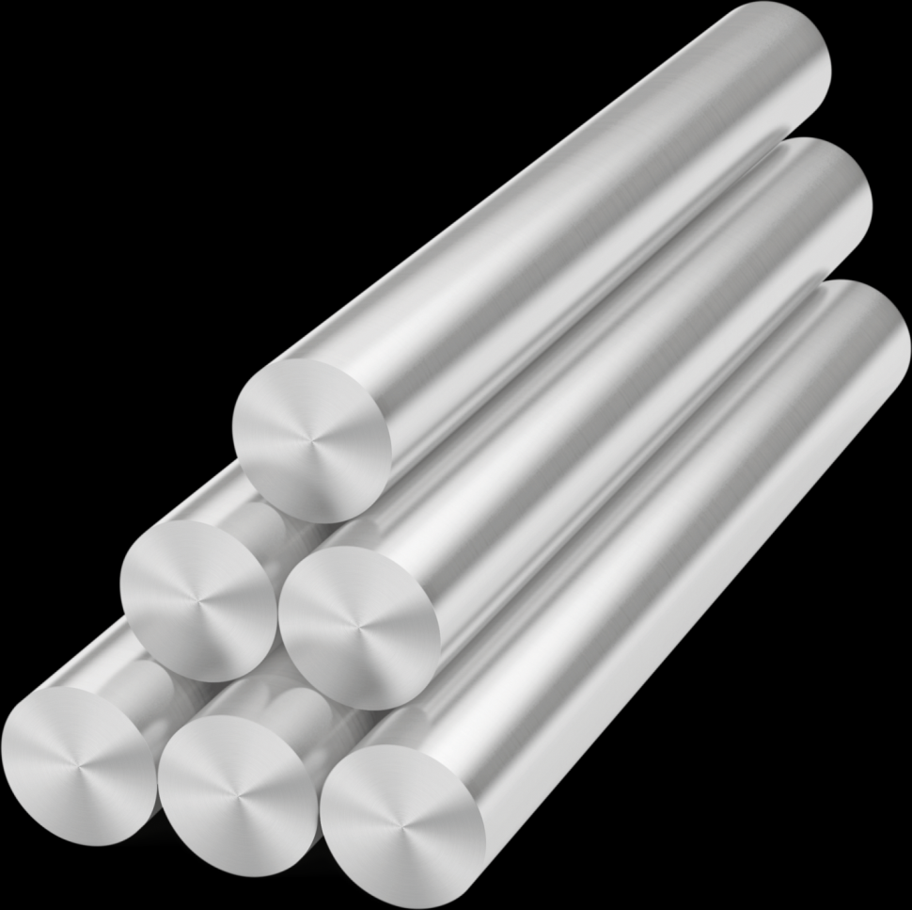
Treatment of TLAFs for Trading Sites with Autoproducers
AUGHINISH Alumina Ltd
June 2017

Slide 3
Introduction of Aughinish Alumina Ltd
In the Electricity Market
2005 High Efficiency Combined Heat and Power
  CADA 2006 to 2016
  Priority Dispatch
Autoproducer Configuration
  Registered as a Supplier by law but have no customers
  Separate metering to give TSO dispatch control
  Generators are currently PPTG
Energy revenue reduces the alumina plant’s energy costs
  Reduced revenue affects the alumina plant

Slide 4
Aughinish
Structure in the SEM
Party PY_000024 Aughinish Alumina ltd
Participant
CP_400024
TS_400031 (Trading Site Account)
Generation A/C PT_400024
Supply A/C PT_400047
SK3 GU_400120
PPTG
SK4 GU_400121
PPTG
NGU GU_410120
APTG
TSSU
SU_400030
(if QMv>QMu)

Slide 5
Aughinish
Structure in the SEM
Party PY_000024 Aughinish Alumina ltd
Participant
CP_400024
TS_400031 (Trading Site Account)
Generation A/C PT_400024
Supply A/C PT_400047
SK3 GU_400120
PPTG
SK4 GU_400121
PPTG
NGU GU_410120
APTG
TSSU
SU_400030
(if QMv>QMu)
Net Generator
363 days/yr
Net Importer
2 days/yr

Slide 6
Aughinish
Structure in the SEM
Party PY_000024 Aughinish Alumina ltd
Participant
CP_400024
TS_400031 (Trading Site Account)
Generation A/C PT_400024
Supply A/C PT_400047
SK3 GU_400120
PPTG
SK4 GU_400121
PPTG
NGU GU_410120
APTG
TSSU
SU_400030
(if QMv>QMu)
Net Generator
363 days/yr
Net Importer
2 days/yr
TLAF 0.97
TLAF 0.97
TLAF 0.97
TLAF 1.00

Slide 7
Aughinish
Migration SEM to I-SEM
Party PY_000024 Aughinish Alumina ltd
Participant
CP_400024
TS_400031 (Trading Site Account)
Generation A/C PT_400024
Supply A/C PT_400047
SK3 GU_400120
PPTG
SK4 GU_400121
PPTG
NGU GU_410120
APTG
TSSU
SU_400030
(if QMv>QMu)
TU_xxxxxx Trading Unit

Slide 8
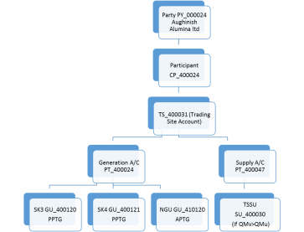
Aughinish
Structure in the
I-SEM TSC Part B
Party PY_000024 Aughinish Alumina ltd
Participant
PT_400024
TS_400031 (Trading Site Account)
SK3 GU_400120
PPTG
SK4 GU_400121
PPTG
TU_xxxxxx Trading Unit
TSSU SU_400030

Slide 9
Aughinish
Structure in the
I-SEM TSC Part B
Party PY_000024 Aughinish Alumina ltd
Participant
PT_400024
TS_400031 (Trading Site Account)
SK3 GU_400120
PPTG
SK4 GU_400121
PPTG
TU_xxxxxx Trading Unit
TSSU SU_400030
TLAF 0.97
TLAF 0.97
TLAF N/A
TLAF 1.00
365 day / yr

Slide 10
Aughinish
Structure in the
I-SEM TSC Part B
Party PY_000024 Aughinish Alumina ltd
Participant
PT_400024
TS_400031 (Trading Site Account)
SK3 GU_400120
PPTG
SK4 GU_400121
PPTG
TU_xxxxxx Trading Unit
TSSU SU_400030
Proposal
let
TSSU TLAF
=
Station node TLAF
only
Under restrictive conditions
TLAF 0.97
TLAF 0.97
TLAF N/A
TLAF 1.00
365 day / yr

Slide 11
Real-world in the SEM
Net sale of Power
SK3
80MW
SK4 80MW
In-house
45MW
MEC 130MW
&
MIC
45MW
Station gate Delivery 115MW
Trading boundary 115MW*TLAF
Energy payment = (MSQ_{SK3} + MSQ_{SK4} – NGU_{Aughinish})*lossAdjustment *SMP
= (80 + 80 – 45) * 0.973 *SMP
= 111.9 MWh *SMP

Slide 12

Real-world in the I-SEM BM
TSC part B representation of unit sale of power
In-house
45MW
SK3
80MW
SK4 80MW
45MW consumption
Trading boundary
!!!!
MEC 130MW
Station gate
Delivery
160MW
Energy payment = QMLF_{SK3} + QMLF_{SK4} + QMLF_{TSSU} + QMLF_{TU} * PIMB
= 80*.973 + 80*.973 + (-45*1.00) + 0 * PIMB
= 110.68 * PIMB
SEM 111.9MWh*SMP
I-SEM 110.7MWh*PIMB
1.2MWh

Slide 13

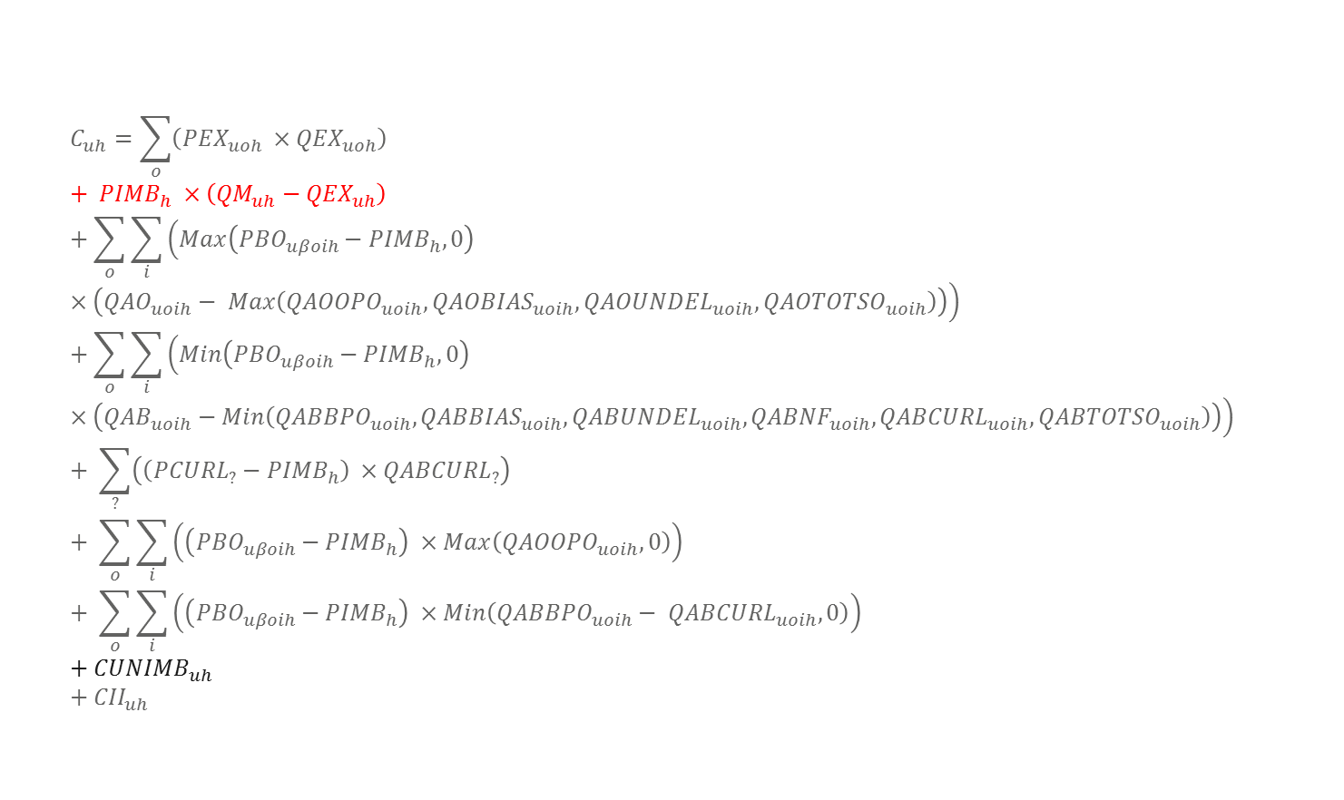
Extract from:
10 Dec 2015 Rules Working Group Meeting III
$$C_{uh}=\sum_{o}{\left({PEX}_{uoh} ×{QEX}_{uoh}\right)}+ {PIMB}_{h} ×\left({QM}_{uh}−{QEX}_{uh}\right)+\sum_{o}{\sum_{i}{\left(Max\left({PBO}_{uβoih}−{PIMB}_{h}, 0\right)×\left({QAO}_{uoih}− Max\left({QAOOPO}_{uoih}, {QAOBIAS}_{uoih}, {QAOUNDEL}_{uoih}, {QAOTOTSO}_{uoih}\right)\right)\right)}}+\sum_{o}{\sum_{i}{\left(Min\left({PBO}_{uβoih}−{PIMB}_{h},0\right)×\left({QAB}_{uoih}−Min\left({QABBPO}_{uoih}, {QABBIAS}_{uoih}, {QABUNDEL}_{uoih}, {QABNF}_{uoih}, {QABCURL}_{uoih}, {QABTOTSO}_{uoih}\right)\right)\right)}}+ \sum_{?}{\left(\left({PCURL}_{?}−{PIMB}_{h}\right) ×{QABCURL}_{?}\right)}+ \sum_{o}{\sum_{i}{\left(\left({PBO}_{uβoih}−{PIMB}_{h}\right) ×Max\left({QAOOPO}_{uoih}, 0\right)\right)}} + \sum_{o}{\sum_{i}{\left(\left({PBO}_{uβoih}−{PIMB}_{h}\right) ×Min\left({QABBPO}_{uoih}− {QABCURL}_{uoih}, 0\right)\right)}}+{CUNIMB}_{uh}+{CII}_{uh}$$

Slide 14
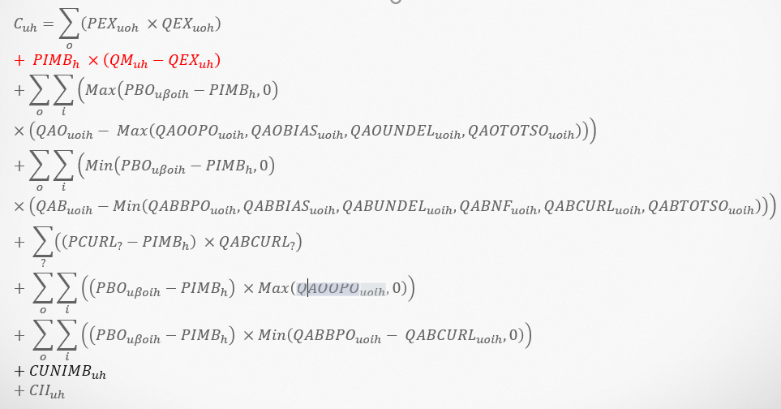
Aughinish BM Settlement
SK3
+
SK4
+
TSSU
+
TU
+
+
+

Slide 15
The I-SEM Solution
Losses to a supplier
Apply the loss factor to the TSSU
Let TSSU TLAF= the station node TLAF
  If the registered MEC is greater than MIC
  If in a period QM_{uy} is greater than 0MW
Else the TSSU TLAF = 1
Energy payment = QMLF_{SK3} + QMLF_{SK4} + QMLF_{TSSU} + QMLF_{TU} * PIMB
= 80*.973 + 80*.973 + (-45*0.973) + 0 * PIMB
= 111.9 * PIMB
SEM 111.9MWh*SMP
I-SEM 111.9MWh*PIMB
0.0 MWh

Slide 16
Justification
Key principle; no Transmission Losses for onsite load
Achieves objective
  removal of Netting Generator Unit (NGU)
  Maintains the link between on-site demand supplied by generating units within the Trading Site
  The principle not to change anything, which doesn’t need changing to comply with market coupling.
Changes only materially affect Trading Site with a contiguous Autoproducer
Avoids €500,000/annum cost to Aughinish Alumina manufacturing facility.
  Risk to viable operation of alumina manufacturing plant
  760 job directly affected
  €130 m / year spent in Irish economy
  Risk to carbon emission targets
  Discourages further investment in low carbon thermal power generation
Avoids need for
  Plexos model modifications and resultant market resettlements for all participants.
  Avoid potential market resettlements for all participants from later CodeMod
  Behind the meter aggregation - Maintains normal metering and dispatch controls

Slide 17
Conclusion
This is not a Modification of treatment
Transmission Losses do not occur inside the trading site
MOD-03-17 mitigates the unintended consequences of removing the Netting Generator Unit

Slide 18
Questions
SK3
80MW
SK4 80MW
In-house
45MW
MEC 130MW
&
MIC
45MW
Station gate Delivery 115MW
Trading boundary 115MW*TLAF

Slide 19
Appendix

Slide 21
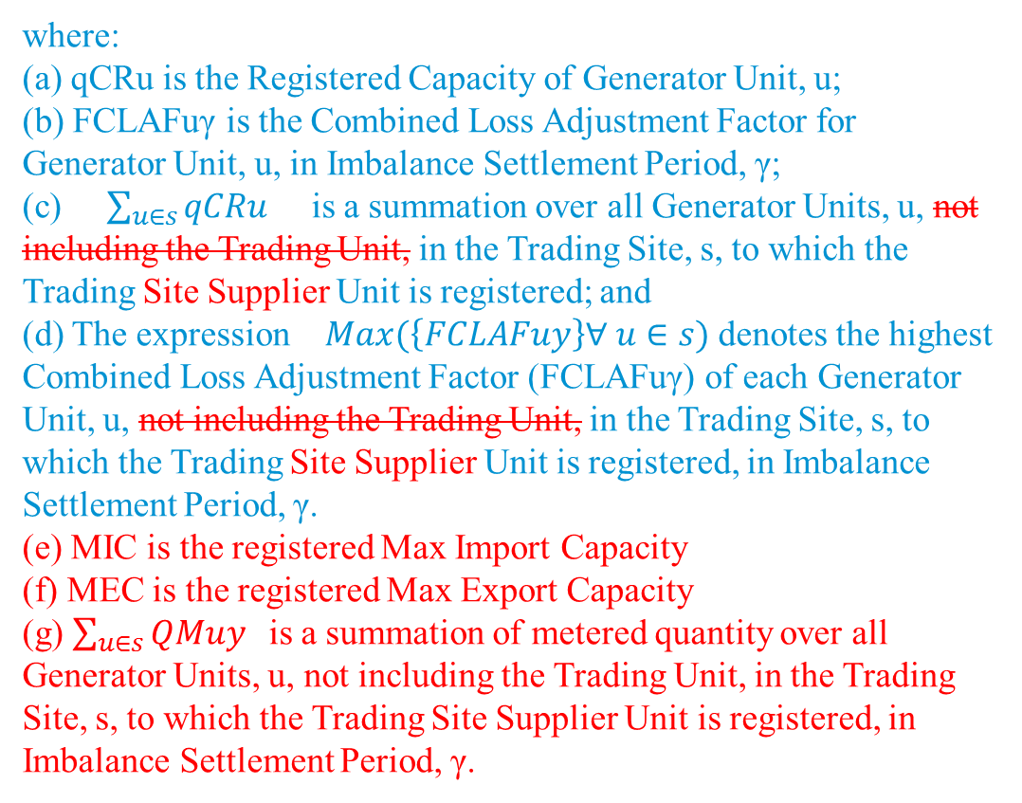
where:
(a) qCRu is the Registered Capacity of Generator Unit, u;
(b) FCLAFuγ is the Combined Loss Adjustment Factor for Generator Unit, u, in Imbalance Settlement Period, γ;
(c) $\sum_{u∈s}{qCRu }$ is a summation over all Generator Units, u, not including the Trading Unit, in the Trading Site, s, to which the Trading Site Supplier Unit is registered; and
(d) The expression $Max(\left\{FCLAFuy\right\}∀ u∈s)$ denotes the highest Combined Loss Adjustment Factor (FCLAFuγ) of each Generator Unit, u, not including the Trading Unit, in the Trading Site, s, to which the Trading Site Supplier Unit is registered, in Imbalance Settlement Period, γ.
(e) MIC is the registered Max Import Capacity
(f) MEC is the registered Max Export Capacity
(g) $\sum_{u∈s}{QMuy }$ is a summation of metered quantity over all Generator Units, u, not including the Trading Unit, in the Trading Site, s, to which the Trading Site Supplier Unit is registered, in Imbalance Settlement Period, γ.

