Slide 1
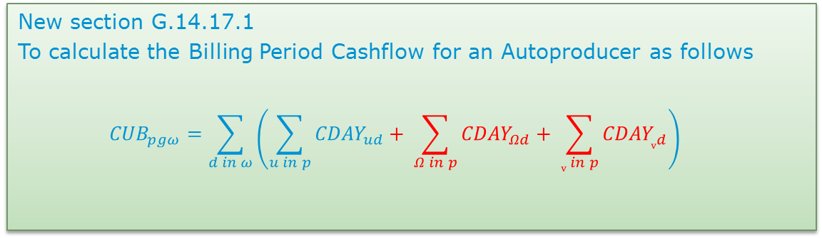
Mod_03_18
Autoproducer Credit Cover
New section G.14.17.1
To calculate the Billing Period Cashflow for an Autoproducer as follows
$${CUB}_{pgω}=\sum_{d in ω}{\left(\sum_{u in p}{{CDAY}_{ud}}+ \sum_{Ω in p}{{CDAY}_{Ωd}}+ \sum_{v in p}{{CDAY}_{vd}}\right)}$$

Slide 2

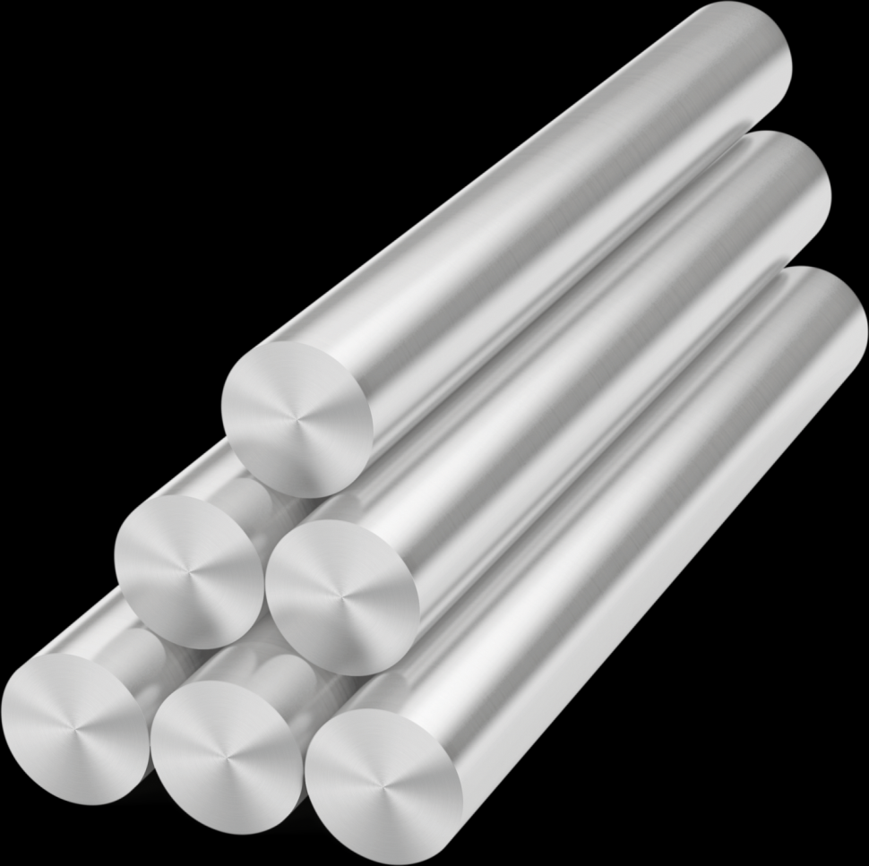
Autoproducers Credit Calculation
AUGHINISH Alumina Ltd
Jan 2018

Slide 3
Aughinish historic delivery

Slide 4
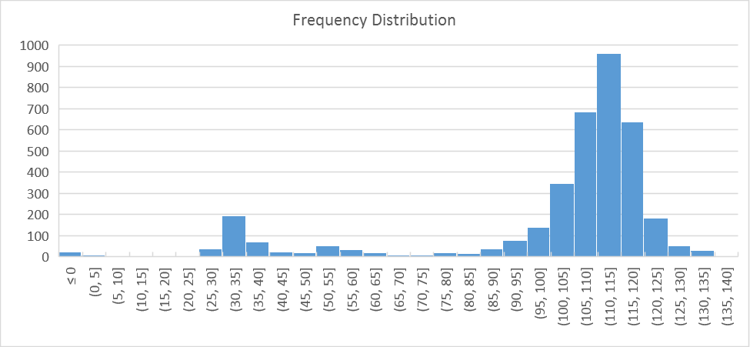
Aughinish historic delivery
Freq Distribution over 10 years
99.6% availability in 2017
Consumption <10MW
2nd Tuesday in May
Delivery at 110MW
Or
Delivery at 35MW

Slide 5
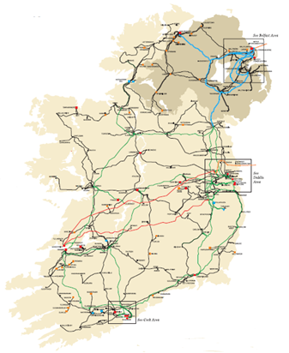
Aughinish historic delivery
Physical units
SK3
80MW
SK4 80MW
In-house
45MW
MEC 130MW
&
MIC
45MW
Station gate Delivery 115MW
Notes:
This is what we do
This is what an Autoproducer is intended to represent in the TSC Part A, B & C

Slide 6
ISEM Strategy

Slide 7
ISEM Strategy
Steam needed for Alumina plant
Trading strategy
  100% DAM
  100% Balance Responsible
Minimal constraints
Notes:
Priority dispatch
I-SEM Allows volume to follow market signals

Slide 8
Autoproducer Problem

Slide 9
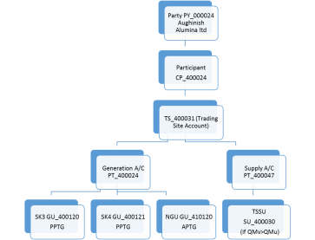
Autoproducer Problem
Structure in the
I-SEM TSC Part B
Party PY_000024 Aughinish Alumina ltd
Participant
PT_400024
TS_400031 (Trading Site Account)
SK3 GU_400120
PPTG
SK4 GU_400121
PPTG
TSSU SU_400030
TU_400001 Trading Unit
Netting Generator Unit Removed
Q imb
-115MW
+80MW
+80MW
-45MW

Slide 10
Autoproducer Problem
Physical units
SK3
80MW
SK4 80MW
In-house
45MW
Station gate Delivery 115MW and
QExAnte = 115MW
Balancing Market Units
In-house
45MW
SK3
80MW
SK4 80MW
QM NGU TSSU - 45MW
TU
Virtual
QM SK4 80MW
QM SK3 80MW
QM TU =0 MW but QExAnte = 115MW
Notes:
This is what we do
This is what an Autoproducer is intended to represent in the TSC Part A, B & C

Slide 11
Autoproducer Problem
Physical units
115MW Generator
Q_{imb} = +0MW
Balancing Market Units
115MW Autoproducer
Q_{imb} = +160MW and -160MW
Notes:
This is what we do
This is what an Autoproducer is intended to represent in the TSC Part A, B & C

Slide 12
Implication

Slide 13
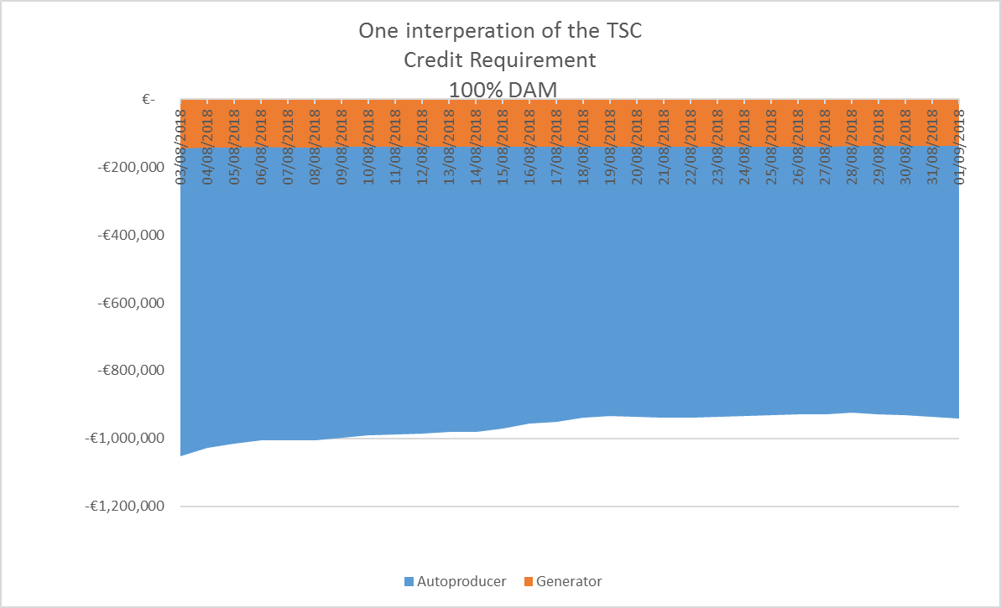
Implication
One Interpretation of Credit Requirement
100% DAM
100% Balance Responsible

Slide 14
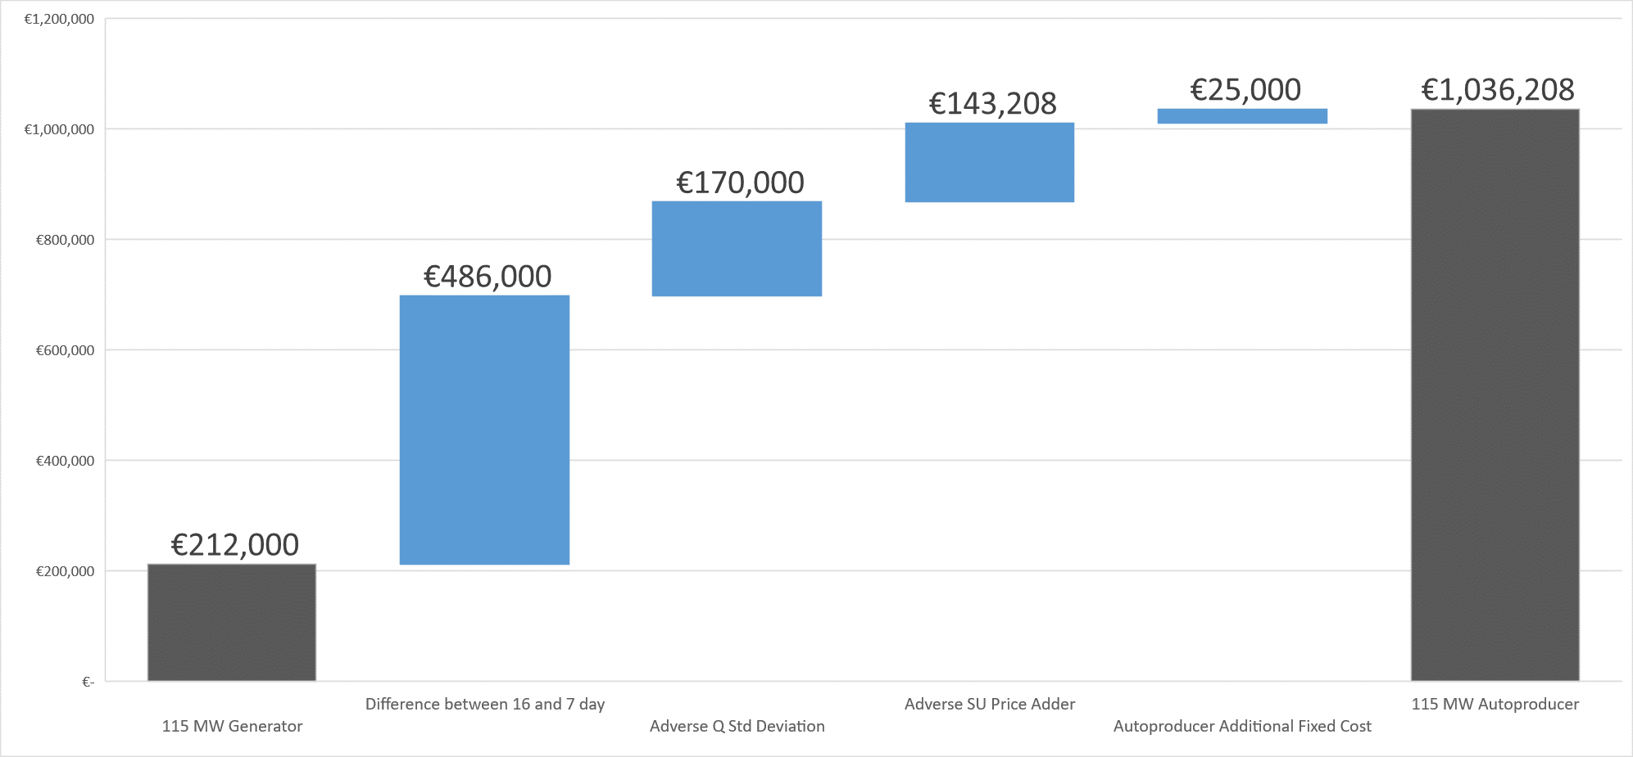
Implication
Autoproducer Excess Collateral (100% balance responsible)
€800,000

Slide 15
The I-SEM Solution

Slide 16

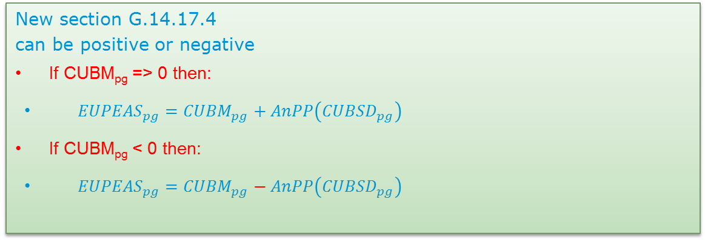
The I-SEM Solution
For all Units
GU Cashflow
CMU Cashflow
SU Cashflow
Registered to an Autoproducer Site
In
Settlement Day, d
For all
d in Sample Undefined Exposure Period, ω
New section G.14.17.1
To calculate the Billing Period Cashflow for an Autoproducer as follows
$${CUB}_{pgω}=\sum_{d in ω}{\left(\sum_{u in p}{{CDAY}_{ud}}+ \sum_{Ω in p}{{CDAY}_{Ωd}}+ \sum_{v in p}{{CDAY}_{vd}}\right)}$$
New section G.14.17.4
can be positive or negative
If CUBM_{pg} => 0 then:
${EUPEAS}_{pg}={CUBM}_{pg}+AnPP\left({CUBSD}_{pg}\right)$
If CUBM_{pg} < 0 then:
${EUPEAS}_{pg}={CUBM}_{pg}−AnPP\left({CUBSD}_{pg}\right)$

Slide 17
Justification

Slide 18
Justification
Changes only affect Trading Site with a contiguous Autoproducer
Provides for equal treatment for all participants
Over collateralisation (by one participant)
Bar DAM trading
  Spill into BM
  Counter intuitive trading
  Reduce liquidity in DAM
Would jeopardies the 700 jobs on site in West Limerick.
  The alternative price of steam would be uncompetitive in a global alumina market.
Increased carbon emissions
Discourages further investment in High Efficiency CHP

Slide 19
Conclusion

Slide 20
Conclusion
This is a correction of the code it aligns credit Calc with settlement of an Autoproducer
Autoproducers ExAnte trades (Trading Unit) are matched from their physical units. Q_{imb} = +160MW and -160MW
Any participant should only be exposed to their imbalance position
Must be implemented for go-live

Slide 21
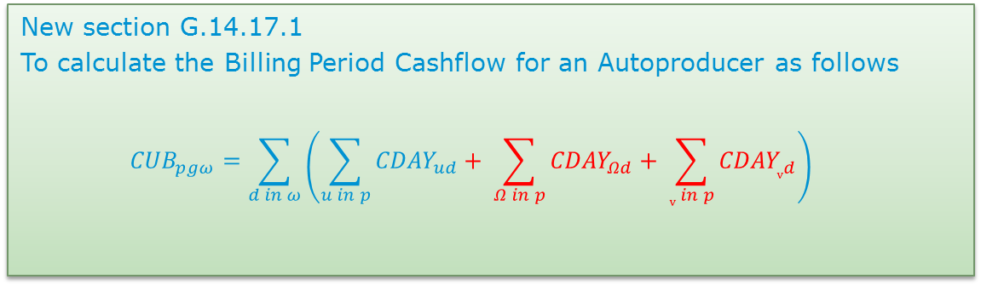
Questions
New section G.14.17.1
To calculate the Billing Period Cashflow for an Autoproducer as follows
$${CUB}_{pgω}=\sum_{d in ω}{\left(\sum_{u in p}{{CDAY}_{ud}}+ \sum_{Ω in p}{{CDAY}_{Ωd}}+ \sum_{v in p}{{CDAY}_{vd}}\right)}$$

Slide 22
End

Slide 23
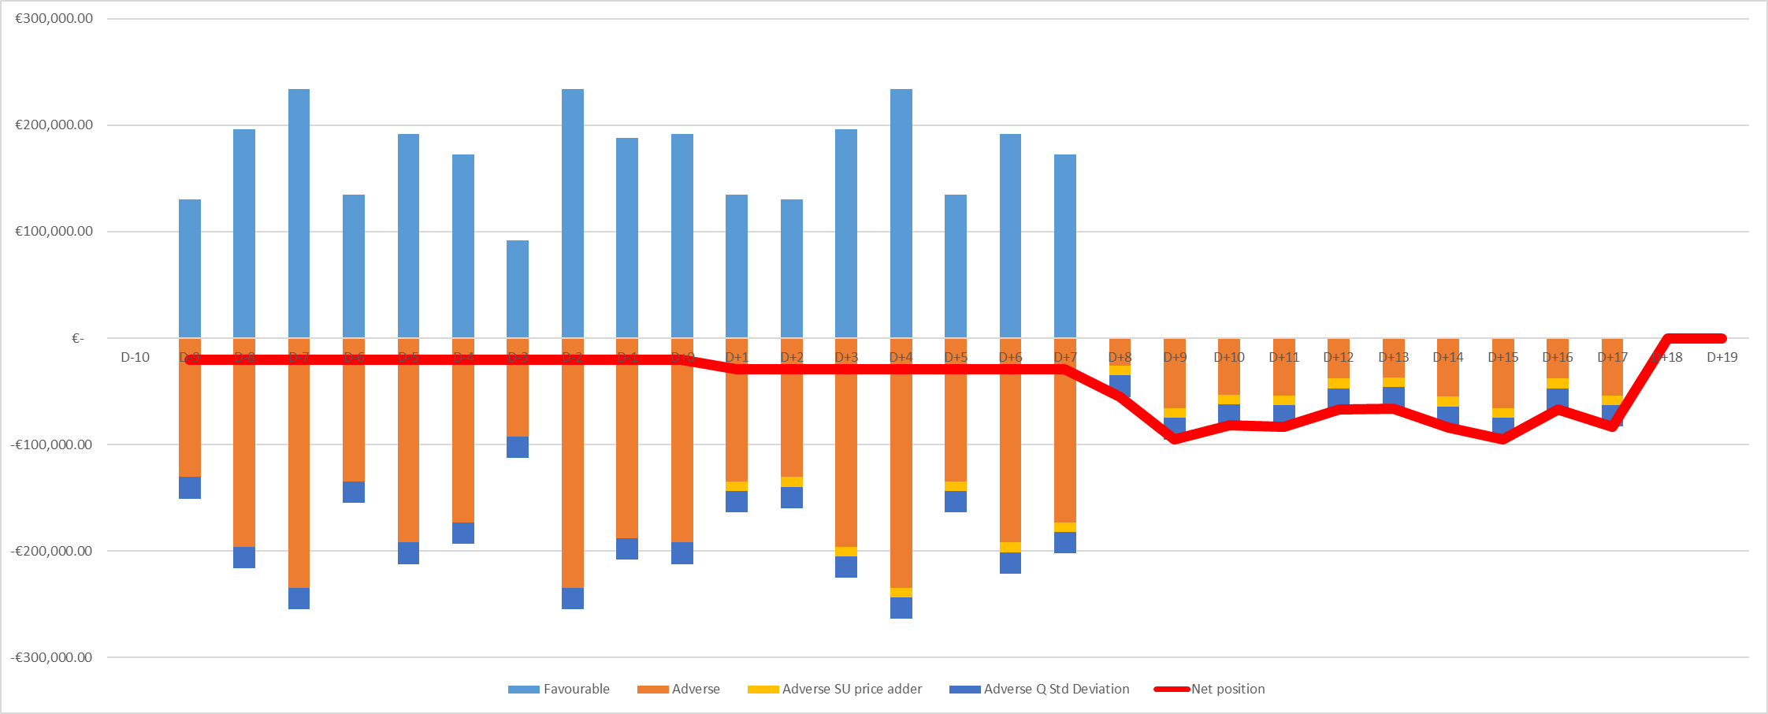
Implication
D+7
Today D=0
Today D+17
∑ of the Red line = maybe € 800,000 𝑡𝑜 𝑎 𝑚𝑢𝑙𝑡𝑖𝑝𝑙𝑒

Slide 24
Definitions
Trading Site Supplier Unit
means a Supplier Unit that contains only the Demand within a Trading Site, and is settled on a net basis against the Generator Units on that Trading Site under the rules specified in the Code.
Trading Site
means one or more Generator Units and at most one Trading Site Supplier Unit of which, …… all Generator Units are covered by a single Connection Agreement, or ………all such Units are located on a Contiguous Site…..
Autoproducer Site
Unless not dispatchable…..must have separate metering for its import energy and export energy… A party must register Generation Units and Supplier Units separately for the purpose of a Trading Site

Slide 25
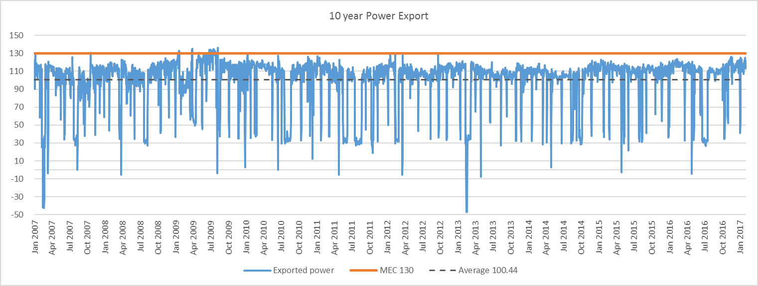
Aughinish historic delivery

Slide 26
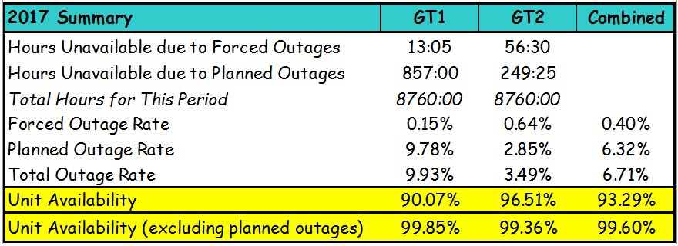
Aughinish historic delivery
99.6% Reliability

