Slide 1
Working Group Recommendation
Mod_03_18
Autoproducer Credit Cover

Slide 2
Working Group Mod_03_18 timeline
Jan 2018 original proposal Meeting 79
Affects DSU as well as Autoproducer
Time constraints for ISEM go-live in May
Agreed to set up Working Group
Agreed to put short term measures in place
Mar 2018 interim solution proposed Mod_09_18 Meeting 81
Version 2 Mar 2018 extraordinary Meeting 82
Version 3 effective date 27 Aug 2018
Working Group Mod _03_18
Meeting 1 Jan 2019
Meeting 2 May 2019
27 June 2019 Working Recommendation
Future: New Participants

Slide 3
Problem refined
Credit Requirement for Defined Exposure Period
No issue with TSC
Credit Requirement for Undefined Exposure Period
Settlement under the TSC combines 1)Generation and 2)Demand for Autoproducers and for DSU
Collateral Undefined Exposure Period, under the TSC, independently assess 1)historical generation cash flow and 2) historical demand metered quantity
The Working Group agree the TSC as it stands produces excess collateral requirements

Slide 4
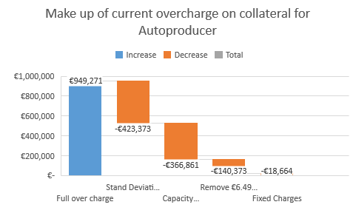
Materiality Self Assessment
€ 949k calculated by Aughinish
Additional € 400k to 700k if Supplier suspension delay period is changed.
DSU:
Normal exposure of € 1,000,000
Max exposure could be up to € 4,100,000
Huge additional cost if Supplier suspension delay period is changed

Slide 5
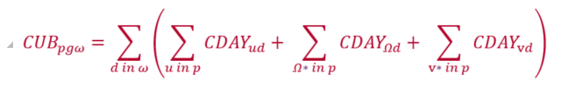
Mod_03_18 Version 2
Undefined Exposure Period
Future exposure is based on historical cash flow for affected units within a participants portfolio
G.14.17.1 The Billing Period Cashflow (CUBpgω) for Participant p in respect of its:
(a) Trading Site Supplier Units which are registered as part of Autoproducer Sites or as part of Trading Sites which contain Demand Side Units;
(b) Autoproducer Units which are registered as part of Autoproducer Sites which are registered as part of Trading Sites,
(c) Demand Side Units which are registered as part of Trading Sites,
(d) Trading Units which are registered as part of Autoproducer Sites which are registered as part of Trading Sites
(e) Capacity Market Units which are registered as part of Autoproducer Sites which are registered as part of Trading Sites
(f) Capacity Market Units which are registered as part of Demand Side Units which are registered as part of Trading Sites

Slide 6
Working Group Recommendation
Any future code modification of Supplier Suspension Delay Period should consider exempting Trading Site Supplier Units.
Approve Version 2 of Mod_03_18
Advice sought on New Participants who contain Autoproducer Units or Demand Side Units

Slide 7
End

Slide 8


Autoproducers Credit Calculation
AUGHINISH Alumina Ltd
Jan 2018

Slide 9
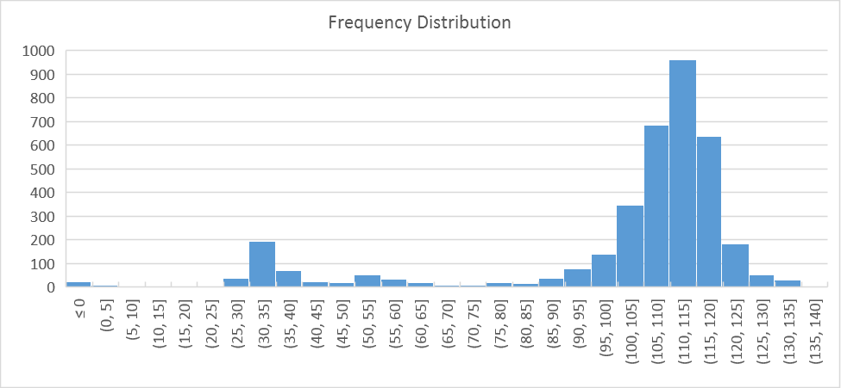
Aughinish historic delivery
Freq Distribution over 10 years
99.6% availability in 2017
Consumption <10MW
2nd Tuesday in May
Delivery at 110MW
Or
Delivery at 35MW

Slide 10
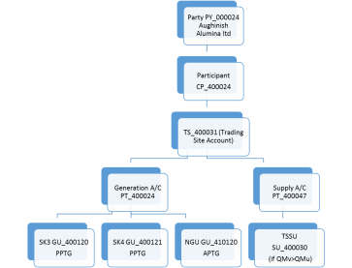
Autoproducer Problem
Structure in the
I-SEM TSC Part B
Party PY_000024 Aughinish Alumina ltd
Participant
PT_400024
TS_400031 (Trading Site Account)
SK3 GU_400120
PPTG
SK4 GU_400121
PPTG
TSSU SU_400030
TU_400001 Trading Unit
Netting Generator Unit Removed
Q imb
-115MW
+80MW
+80MW
-45MW

Slide 11
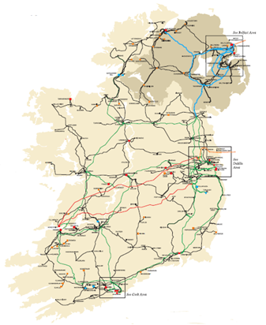
Autoproducer Problem
Physical units
SK3
80MW
SK4 80MW
In-house
45MW
Station gate Delivery 115MW and
QExAnte = 115MW
Balancing Market Units
In-house
45MW
SK3
80MW
SK4 80MW
QM NGU TSSU - 45MW
TU
Virtual
QM SK4 80MW
QM SK3 80MW
QM TU =0 MW but QExAnte = 115MW
Notes:
This is what we do
This is what an Autoproducer is intended to represent in the TSC Part A, B & C

Slide 12
Autoproducer Problem
Physical units
115MW Generator
Q_{imb} = +0MW
Balancing Market Units
115MW Autoproducer
Q_{imb} = +160MW and -160MW
Notes:
This is what we do
This is what an Autoproducer is intended to represent in the TSC Part A, B & C

Slide 13
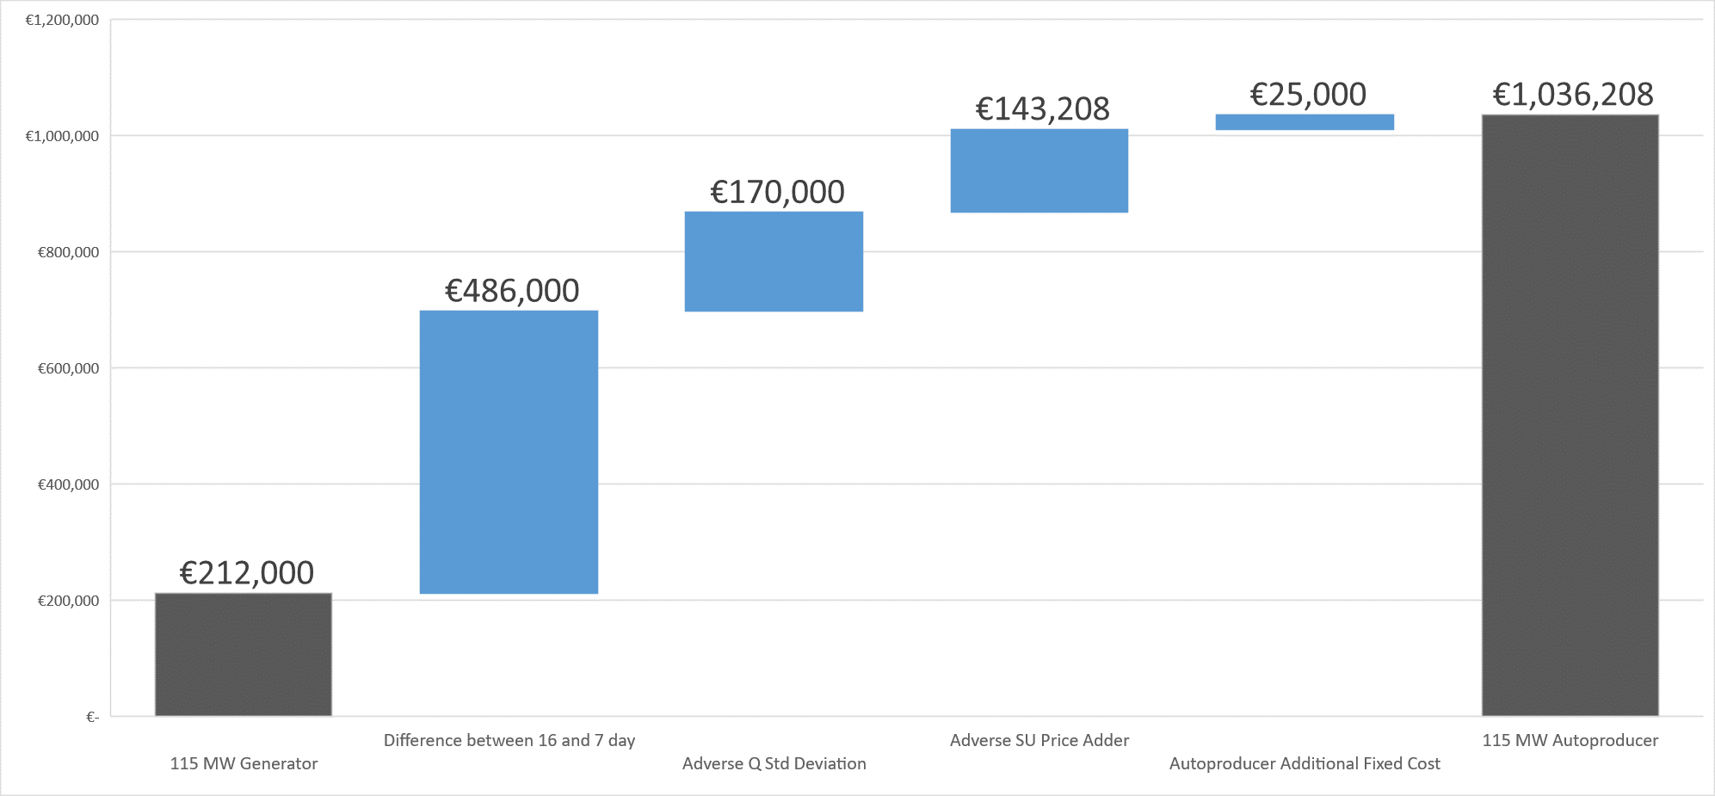
Implication
Autoproducer Excess Collateral (100% balance responsible)
€800,000

Slide 14
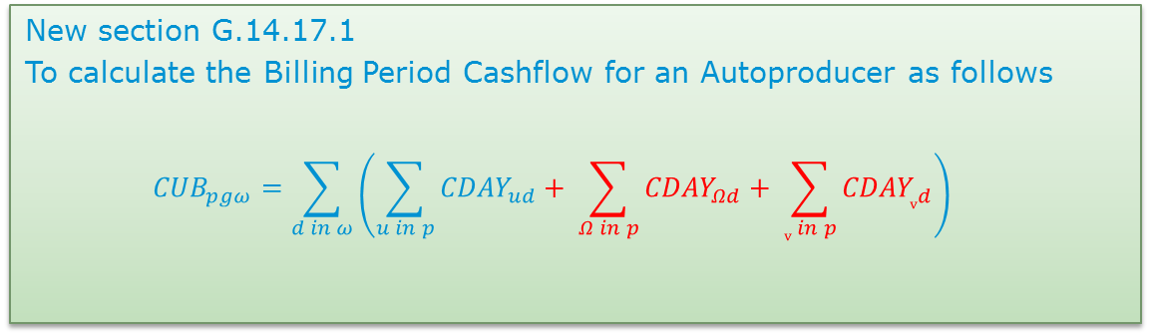
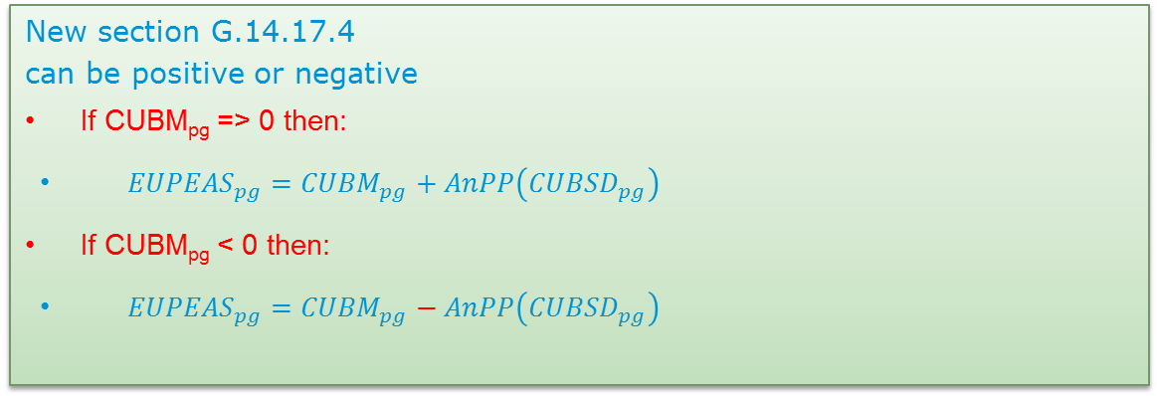
The I-SEM Solution
For all Units
GU Cashflow
CMU Cashflow
SU Cashflow
Registered to an Autoproducer Site
In
Settlement Day, d
For all
d in Sample Undefined Exposure Period, ω
New section G.14.17.1
To calculate the Billing Period Cashflow for an Autoproducer as follows
$${CUB}_{pgω}=\sum_{d in ω}{\left(\sum_{u in p}{{CDAY}_{ud}}+ \sum_{Ω in p}{{CDAY}_{Ωd}}+ \sum_{v in p}{{CDAY}_{vd}}\right)}$$
New section G.14.17.4
can be positive or negative
If CUBM_{pg} => 0 then:
${EUPEAS}_{pg}={CUBM}_{pg}+AnPP\left({CUBSD}_{pg}\right)$
If CUBM_{pg} < 0 then:
${EUPEAS}_{pg}={CUBM}_{pg}−AnPP\left({CUBSD}_{pg}\right)$

Slide 15
Justification
Changes only affect Trading Site with a contiguous Autoproducer
Provides for equal treatment for all participants
Over collateralisation (by one participant)
Bar DAM trading
  Spill into BM
  Counter intuitive trading
  Reduce liquidity in DAM
Would jeopardies the 700 jobs on site in West Limerick.
  The alternative price of steam would be uncompetitive in a global alumina market.
Increased carbon emissions
Discourages further investment in High Efficiency CHP

Slide 16
Conclusion
This is a correction of the code it aligns credit Calc with settlement of an Autoproducer
Autoproducers ExAnte trades (Trading Unit) are matched from their physical units. Q_{imb} = +160MW and -160MW
Any participant should only be exposed to their imbalance position
Must be implemented for go-live

