Slide 1
Mod_03_18 Version 3 Autoproducer & DSU Credit Cover Thomas O’Sullivan 5 Dec 2019

Slide 2
Working Group Mod_03_18 timeline
Jan 2018 original proposal Meeting 79
Affects DSU as well as Autoproducer
Agreed to set up Working Group
Agreed to put short term measures in place
Mar 2018 interim solution proposed Mod_09_18 Meeting 81
Effective date 27 Aug 2018
Working Group Mod _03_18
Meeting 1 Jan to May 2019
Presentation 27 June Meeting 92
Mod_03_18 Version 3 today 5 Dec 2019 Meeting 95

Slide 3
Problem refined
Credit Requirement for Defined Exposure Period
No issue with TSC
Credit Requirement for Undefined Exposure Period
Settlement under the TSC combines 1)Generation and 2)Demand for Autoproducers and for DSU
Collateral Undefined Exposure Period, under the TSC, independently assess 1)historical generation cash flow and 2) historical demand metered quantity
The Working Group agreed the TSC as it stands produces excess collateral requirements

Slide 4
Materiality Self Assessment
Autoproducer:
€ 949k calculated by Aughinish
Additional € 400k to 700k if Supplier suspension delay period is changed.
DSU:
Normal exposure of € 1,000,000
Max exposure could be up to € 4,100,000
Huge additional cost if Supplier suspension delay period is changed

Slide 5
Mod_03_18 Version 3
Version 3 is new - please disregard any previous version
Maintains the intent
Eliminates additional variables
Less software changes
Better transparency
Cash flow for TSSUs when calculating EUPEG (Undefined Potential Exposure for Trading Payments)
It enables two variants of Billing Period Metered Demand, QMB for a participant:
in respect of any TSSUs
all other Supplier Units
Addresses the issues :
New and Adjusted Participant
Settlement Reallocation Agreement

Slide 6
Mod_03_18 Version 3
Billing Period Cashflow (CUB)
Historical cash flow now includes all units within a DSU or Autoproducer portfolio

Slide 7
Mod_03_18 Version 3
Supplier Billing Period Metered Demand, QMB
Generator outage, consumption of 10MW
No No favorable treatment for a Trading Site when consuming power:
Quantity same as a SU
Imperfection price is same
Capacity exposure is same

Slide 8
Mod_03_18 Version 3
Dialog:
Version 3 solves all material issues raised by the proposer
Version 3 solves new issues:
DSU
New and Adjusted Participant
Settlement Reallocation Agreement
Version 3 is more transparent
Version 3 is more efficient

Slide 9
Aughinish Recommendation
Any future code modification of Supplier Suspension Delay Period should consider exempting Trading Site Supplier Units registered as part of an Autoproducer Site or registered as part of a DSU .
Approve Version 3 of Mod_03_18

Slide 10
Summary of TSC Credit Cover Provisions
Non-Participant-Specific values
SRAs
Participant-Specific values
FAVRA (Forecast for SRAs)
G.14.15.2 (All)
EC_BILIMB (Energy Credit for Secondary PT)
G.14.15.4 (All)
FASRAS (Forecast for SRAs, Secondary PT)
G.14.15.9 (All)
EC_UNBIMB (Risk Period Energy Credit for Secondary PT)
G.14.15.6 (All)
Credit Assessment Prices and Volumes
FAVRA (Forecast for SRAs, Secondary PT)
G.14.15.8 (All)
CC_BILCAP (Capacity Credit for Secondary PT)
G.14.15.5 (All)
FASRAP (Forecast for SRAs, Principal PT)
G.14.15.10 (All)
CC_UNBCAP (Risk Period Energy Credit for Secondary PT)
G.14.15.7 (All)
DAPIMB (Daily Average Imbalance Settlement Price)
G.14.2.1
PCA (Credit Assessment Price)
G.14.2.5
NDAPIMB (# Daily Average Imbalance Settlement Prices)
G.14.2.2
CCAP (Combined Credit Assessment Price)
G.14.2.6
Undefined Exposure for Supplier Units
(Standard PT)
Undefined Exposure for Generator Units
(Standard PT)
Undefined Exposure for Assetless Units
(Standard PT)
Required Credit Cover Determinants
UMPIMB (mean Daily Average Imbalance Settlement Prices)
G.14.2.3
VCAS (Credit Assessment Volume for Supplier Units)
G.14.3.1
BPHAP (# Sample Undefined Exposure Periods in HAP)
G.14.7.2
QUPEB (Billing Period Undefined Potential Exposure, Supplier Units)
G.14.7.6
CUB (Billing Period Cashflow, Generator Units)
G.14.10.1 (Std)
CUB (Billing Period Cashflow, Assetless Units)
G.14.12.1 (Std)
EA (Actual Exposure)
G.13.1.1
SDPIMB (stdev Daily Average Imbalance Settlement Prices)
G.14.2.4
VCAG (Credit Assessment Volume for Generator Units)
G.14.4.1
QMB (Billing Period Metered Demand, Supplier Units)
G.14.7.3
EUPES (Exposure for Trading, Supplier Units)
G.14.7.7 (Std)
CUBM (mean Billing Period Cashflow, Generator Units)
G.14.10.2 (Std)
CUBM (mean Billing Period Cashflow, Assetless Units)
G.14.12.2 (Std)
ETND (Traded Not Delivered Exposure)
G.14.13.1
QMBM (mean Billing Period Metered Demand, Supplier Units)
G.14.7.4
EUPECC (Exposure for Capacity Charges)
G.14.8.1 (Std)
CUBSD (stdev Billing Period Cashflow, Generator Units)
G.14.10.3 (Std)
CUBSD (stdev Billing Period Cashflow, Assetless Units)
G.14.12.3 (Std)
EUPECP (Undefined Exposure for Capacity Payments
G.14.14.1 (All)
Undefined Exposure for Supplier Units
(New/Adjusted PT)
EUPES (Exposure for Trading, Supplier Units)
G.14.3.2
QMBSD (stdev Billing Period Metered Demand, Supplier Units)
G.14.7.5
EUPEG (Exposure for Trading, Generator Units)
G.14.10.4 (Std)
EUPEG (Exposure for Trading, Assetless Units)
G.14.12.4 (Std)
FCR (Fixed Credit Requirement)
G.10.1.1 (All)
EUPECC (Exposure for Capacity Charges)
G.14.3.3 (NorA)
Undefined Exposure for Generator Units
(New/Adjusted PT)
EUPEG (Exposure for Trading, Generator Units)
G.14.4.2
Required Credit Cover
RCC (Required Credit Cover)
G.15.1.1

Slide 11
Summary of TSC Credit Cover Provisions
Non-Participant-Specific values
SRAs
System calculation change
Description change only
Participant-Specific values
FAVRA (Forecast for SRAs)
G.14.15.2 (All)
EC_BILIMB (Energy Credit for Secondary PT)
G.14.15.4 (All)
FASRAS (Forecast for SRAs, Secondary PT)
G.14.15.9 (All)
EC_UNBIMB (Risk Period Energy Credit for Secondary PT)
G.14.15.6 (All)
Credit Assessment Prices and Volumes
FAVRA (Forecast for SRAs, Secondary PT)
G.14.15.8 (All)
CC_BILCAP (Capacity Credit for Secondary PT)
G.14.15.5 (All)
FASRAP (Forecast for SRAs, Principal PT)
G.14.15.10 (All)
CC_UNBCAP (Risk Period Energy Credit for Secondary PT)
G.14.15.7 (All)
DAPIMB (Daily Average Imbalance Settlement Price)
G.14.2.1
PCA (Credit Assessment Price)
G.14.2.5
NDAPIMB (# Daily Average Imbalance Settlement Prices)
G.14.2.2
CCAP (Combined Credit Assessment Price)
G.14.2.6
Undefined Exposure for Supplier Units
(Standard PT)
Undefined Exposure for Generator Units
(Standard PT)
Undefined Exposure for Assetless Units
(Standard PT)
Required Credit Cover Determinants
UMPIMB (mean Daily Average Imbalance Settlement Prices)
G.14.2.3
VCAS (Credit Assessment Volume for Supplier Units)
G.14.3.1
BPHAP (# Sample Undefined Exposure Periods in HAP)
G.14.7.2
QUPEB (Billing Period Undefined Potential Exposure, Supplier Units)
G.14.7.6
CUB (Billing Period Cashflow, Generator Units)
G.14.10.1 (Std)
CUB (Billing Period Cashflow, Assetless Units)
G.14.12.1 (Std)
EA (Actual Exposure)
G.13.1.1
SDPIMB (stdev Daily Average Imbalance Settlement Prices)
G.14.2.4
VCAG (Credit Assessment Volume for Generator Units)
G.14.4.1
QMB (Billing Period Metered Demand, Supplier Units)
G.14.7.3
EUPES (Exposure for Trading, Supplier Units)
G.14.7.7 (Std)
CUBM (mean Billing Period Cashflow, Generator Units)
G.14.10.2 (Std)
CUBM (mean Billing Period Cashflow, Assetless Units)
G.14.12.2 (Std)
ETND (Traded Not Delivered Exposure)
G.14.13.1
QMBM (mean Billing Period Metered Demand, Supplier Units)
G.14.7.4
EUPECC (Exposure for Capacity Charges)
G.14.8.1 (Std)
CUBSD (stdev Billing Period Cashflow, Generator Units)
G.14.10.3 (Std)
CUBSD (stdev Billing Period Cashflow, Assetless Units)
G.14.12.3 (Std)
EUPECP (Undefined Exposure for Capacity Payments
G.14.14.1 (All)
Undefined Exposure for Supplier Units
(New/Adjusted PT)
EUPES (Exposure for Trading, Supplier Units)
G.14.3.2
QMBSD (stdev Billing Period Metered Demand, Supplier Units)
G.14.7.5
EUPEG (Exposure for Trading, Generator Units)
G.14.10.4 (Std)
EUPEG (Exposure for Trading, Assetless Units)
G.14.12.4 (Std)
FCR (Fixed Credit Requirement)
G.10.1.1 (All)
EUPECC (Exposure for Capacity Charges)
G.14.3.3 (NorA)
Undefined Exposure for Generator Units
(New/Adjusted PT)
EUPEG (Exposure for Trading, Generator Units)
G.14.4.2
Required Credit Cover
RCC (Required Credit Cover)
G.15.1.1

Slide 12
End

Slide 13
Autoproducers Credit Calculation AUGHINISH Alumina Ltd
Jan 2018

Slide 14
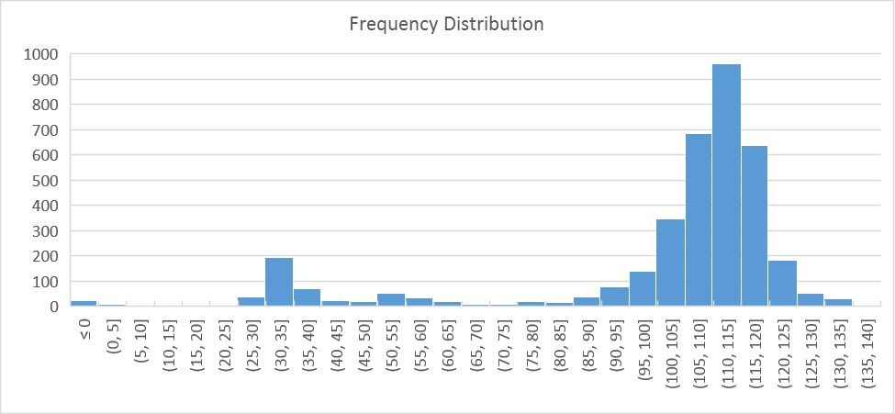
Aughinish historic delivery Freq Distribution over 10 years
99.6% availability in 2017
Consumption <10MW
2nd Tuesday in May
Delivery at 110MW
Or
Delivery at 35MW

Slide 15
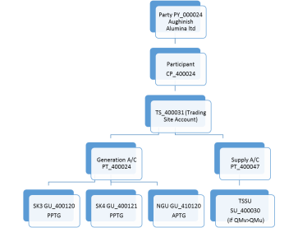
Autoproducer Problem Structure in the I-SEM TSC Part B
Party PY_000024 Aughinish Alumina ltd
Participant
PT_400024
TS_400031 (Trading Site Account)
SK3 GU_400120
PPTG
SK4 GU_400121
PPTG
TSSU SU_400030
TU_400001 Trading Unit
Netting Generator Unit Removed
Q imb
-115MW
+80MW
+80MW
-45MW

Slide 16
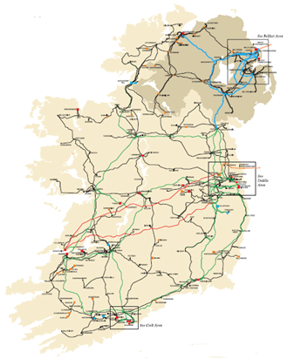
Autoproducer Problem Physical units
SK3
80MW
SK4 80MW
In-house
45MW
Station gate Delivery 115MW and
QExAnte = 115MW
Balancing Market Units
In-house
45MW
SK3
80MW
SK4 80MW
QM NGU TSSU - 45MW
TU
Virtual
QM SK4 80MW
QM SK3 80MW
QM TU =0 MW but QExAnte = 115MW
Notes:
This is what we do
This is what an Autoproducer is intended to represent in the TSC Part A, B & C

Slide 17
Autoproducer Problem Physical units
115MW Generator
Q_{imb} = +0MW
Balancing Market Units
115MW Autoproducer
Q_{imb} = +160MW and -160MW
Notes:
This is what we do
This is what an Autoproducer is intended to represent in the TSC Part A, B & C

Slide 18
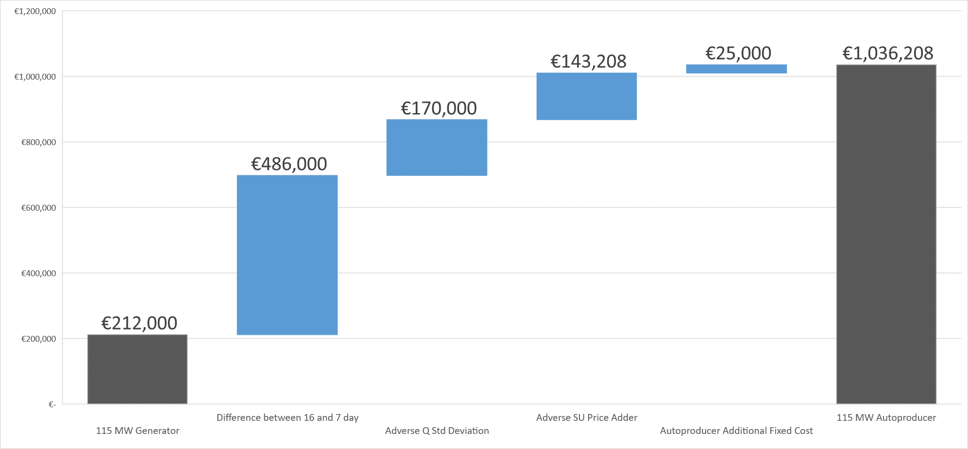
Implication Autoproducer Excess Collateral (100% balance responsible)
€800,000

Slide 19
The I-SEM Solution
For all Units
GU Cashflow
CMU Cashflow
SU Cashflow
Registered to an Autoproducer Site
In
Settlement Day, d
For all
d in Sample Undefined Exposure Period, ω
New section G.14.17.1
To calculate the Billing Period Cashflow for an Autoproducer as follows
$${CUB}_{pgω}=\sum_{d in ω}{\left(\sum_{u in p}{{CDAY}_{ud}}+ \sum_{Ω in p}{{CDAY}_{Ωd}}+ \sum_{v in p}{{CDAY}_{vd}}\right)}$$
New section G.14.17.4
can be positive or negative
If CUBM_{pg} => 0 then:
${EUPEAS}_{pg}={CUBM}_{pg}+AnPP\left({CUBSD}_{pg}\right)$
If CUBM_{pg} < 0 then:
${EUPEAS}_{pg}={CUBM}_{pg}−AnPP\left({CUBSD}_{pg}\right)$

Slide 20
Justification
Changes only affect Trading Site with a contiguous Autoproducer
Provides for equal treatment for all participants
Over collateralisation (by one participant)
Bar DAM trading
Spill into BM
Counter intuitive trading
Reduce liquidity in DAM
Would jeopardies the 700 jobs on site in West Limerick.
The alternative price of steam would be uncompetitive in a global alumina market.
Increased carbon emissions
Discourages further investment in High Efficiency CHP

Slide 21
Conclusion
This is a correction of the code it aligns credit Calc with settlement of an Autoproducer
Autoproducers ExAnte trades (Trading Unit) are matched from their physical units. Q_{imb} = +160MW and -160MW
Any participant should only be exposed to their imbalance position
Must be implemented for go-live

