Slide 1



Working Group on Mod_04_19
Samples of Credit Cover data
19th September 2019
Katia Compagnoni

Slide 2
Background
Initial proposal to run Indicative on weekend considered unachievable;
Various options considered only two remaining:
  Cancelling some or all Credit Cover Report on the first Working Day after a bank holiday; or
  Applying a scaling factor to the Traded Non Delivered Quantity with different values for Working Days and Non Working Days;
Action on SEMO to provide some figures on changes to Credit Cover Requirements after a Bank Holiday or a weekend;

Slide 3
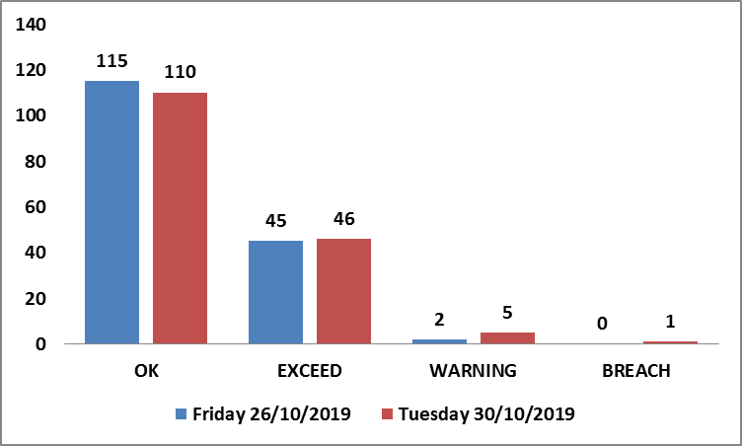
Bank Holiday sample 1 – Oct 2018

Slide 4
Bank Holiday sample 2 – Easter 2019

Slide 5
Bank Holiday sample 3 – Aug 2019

Slide 6
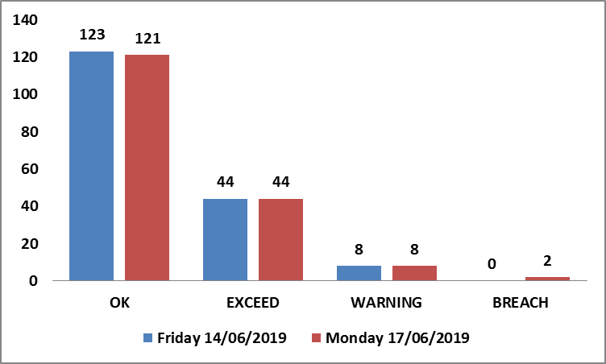
Weekend sample 1 – Jun 2019

Slide 7
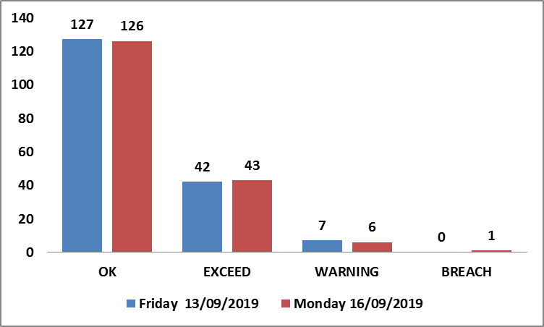
Weekend sample 2 – Sep 2019

Slide 8
Summary
More definite impact noticed in Bank Holidays rather than weekends;
A number of sample weekends found with limited or no impact;
Changes to system have not been impacted without prior approval of the Panel
Considerations needed on:
  Is this issue preventing PTs from trading in Ex-Ante?
  Are PTs comfortable with potential increased risks by cancelling some or all Credit reports after Bank Holidays/weekend?
  Does this affect our obligations to inform ECC for any suspension order issued in the Balancing Market?

