Slide 1
Determining Marginal Energy Action Prices Modification Proposal
20/02/2019

Slide 2
Modification Proposal
The Marginal Energy Action Price (PMEA) is a fundamental input into imbalance pricing. Currently, there are a large number of imbalance pricing periods in which no actions are available to set PMEA in the direction of the Net Imbalance Volume.
This is illustrated over a sample set of days below:
When PMEA is set by an offer when the system is long, or a bid when the system is short, it is very likely that prices in 5 minute and 30 minute periods will not provide a useful signal for market participants to balance their positions.
At go-live, this was expected to occur in a small proportion of periods, but in market operation, this has occurred far more frequently and exacerbated the impact of system events such as those that occurred on the 24th January.
PMEA | 19/01/2019 | 21/01/2019 | 22/01/2019 | 23/01/2019 | 24/01/2019
Opposite NIV | 24% | 24% | 15% | 14% | 24%
Reflects NIV | 73% | 67% | 76% | 63% | 44%
No Energy | 3% | 8% | 8% | 23% | 24%
Missing Data | 1% | 1% | 1% | 1% | 7%

Slide 3
Market Impacts of Current Calculation
Counterintuitive imbalance pricing is not limited to extreme events such as those of the 24 January. The table below provides a comparison of the imbalance price against the Market Back Up Price under the GB and ISEM imbalance price arrangements since Go-Live.
There are a number of things that are potentially driving these outcomes, however:
This is not down to whether the price is more marginal – GB has a higher PAR value but a less volatile imbalance price and a clearer set of balancing incentives across all periods;
Market Participants are choosing to be structurally short in ISEM – this is partially a result of PMEA as the exposure is larger on the bid side if no energy is available in the NIV direction
In only 52% of periods will a participant who is short in a short system be penalised for their imbalance
SYSTEM POSITION | % OF TOTAL PERIODS (ISEM) | % OF PERIODS WITH WRONG INCENTIVE (ISEM) | % OF TOTAL PERIODS (GB) | % OF PERIODS WITH WRONG INCENTIVE (GB)
LONG | 39.43% | 4.90% | 57.07% | 2.99%
SHORT | 60.57% | 47.88% | 42.93% | 4.22%

Slide 4
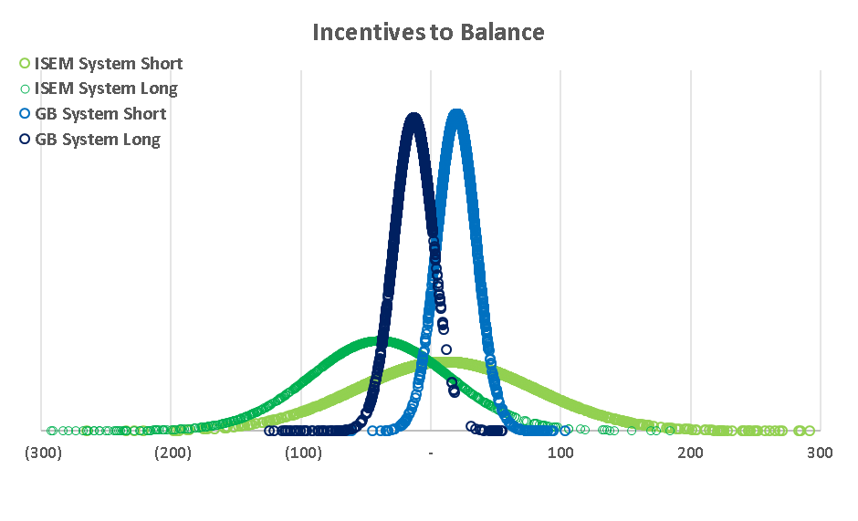
Market Impacts of Current Calculation
This can be seen more clearly in the probability distribution chart:
Market Outcomes are more volatile (reflecting a system with more variable production) with higher penalties applied for an open energy position
Outcomes for short positions are skewed in SEM – there is a substantial chance that a short position will not be penalised in a short system.
This asymmetry has impacts on both the DA auction and liquidity in ID markets
Penalised for being long in long system
Uncertain penalty/reward for being short in short system

Slide 5
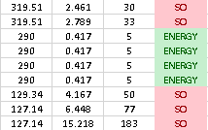
Modification Proposal
Current T&SC calculates PMEA as:
Taking a real example in a pricing period:
No bids available in system that is long 461MW of energy
Some energy offers available at units held at 5MW
PMEA set at €290 which reprices everything below
Imbalance Settlement Period priced at €128.43/MWh
Modification calculates PMEA as:
Taking a real example in a pricing period:
No bids available in system that is long 461MW of energy
Energy offers discounted unless they provide an effective signal
PMEA set at market back up price which reprices everything below
Imbalance Settlement Period priced at €69.05/MWh

Slide 6
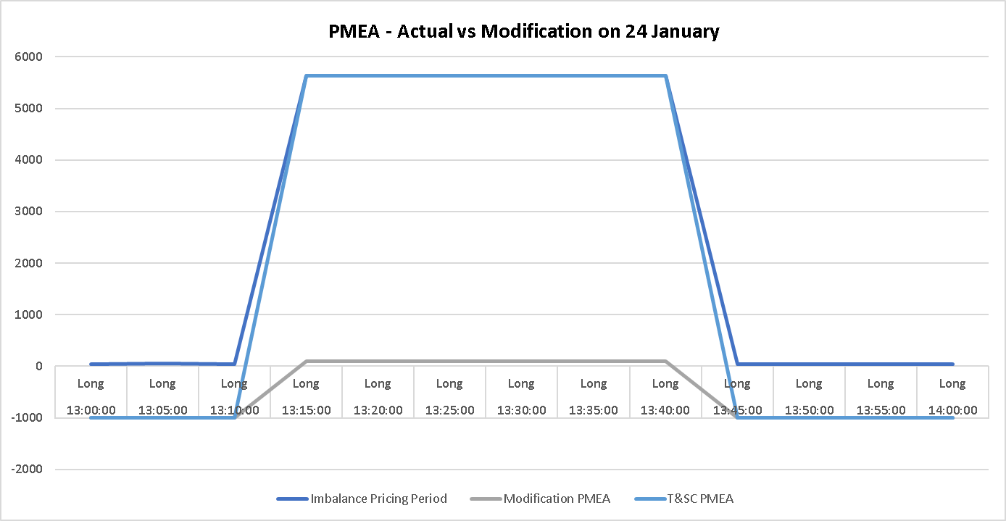
Proposal Justification
PMEA across the 24th January illustrates the issues with the current approach:
As a result of no energy offers on the bid side in periods in which the system was long, energy flagged units on the offer side set PMEA and replacement prices at €5636/MWh
The modification would have prevented PMEA being set at €5636/MWh when no energy in the direction of the NIV was available, and instead used the Market Back Up Price of €92.20/MWh as a proxy
It is important to note that marginal pricing is retained – PMEA is still marginal where energy is available in the correct direction or where all actions are SO flagged

Slide 7
Proposal Justification
This modification will:
Reduce the bias towards leaving the system short that is currently observed;
Reduce the incentives for market participants to exacerbate a system imbalance;
Reduce the dispatch Balancing Costs faced by the TSO when balancing the system;
Reduce the potential for pricing events such as those experienced on the 24th January.
This is in line with the Code Objectives of efficiency, effective participation, competition, transparency and short and long term interests of consumers.
This is particularly relevant for the last point, whereby the TSO is facing substantial and unnecessary costs as a result of imbalance settlement period prices (and therefore DBC) being driven by the spread between bids and offers during periods in which no energy is available to set PMEA in the direction of the system imbalance.

Slide 8
Thank you

