Slide 1



Mod_10_19 Removal of Negative QBOAs Related to Dispatchable Priority Dispatch Units from the Imbalance Price
27th June 2019

Slide 2
Summary Information
This proposal seeks to provide for the removal of the application of Bid Offer Acceptance Prices related to decremental actions on Dispatchable Priority Dispatch units from Imbalance Pricing
This is necessary because Priority Dispatch Units are not scheduled by the TSO based on these bids due to the Priority Dispatch hierarchy that is applied and the obligation to maximise output from Priority Dispatch: It is therefore inappropriate for such bids to set the Imbalance Price but rather, these bids should only be used for the purpose of settlement calculations (Discount Charges)
Such bids can tend to be large negative values which results in negative imbalance prices where they are price setting which is contrary to the design intent for such scenarios and could be argued not to be reflective of the cost of balancing the system at those times and therefore as giving an incorrect signal

Slide 3
Summary Information Continued
This proposal seeks to provide for the use of the submitted prices within Settlement calculations and the over-writing of such values with zeros for the purposes of Imbalance Pricing calculations
This is preferable to the removal of the volumes from the calculation altogether for a number of reasons centred around giving the appropriate pricing signals in scenarios where Priority Dispatch generation is being curtailed since removing the volumes altogether would likely result in a less appropriate signal due to strengthening the signal from the prices of the actions taken in the opposite direction to the curtailment
Removal of the volumes from Imbalance Pricing calculations would also result in the NIV being incorrect and would result in curtailment volumes being treated as an imbalance resulting from Ex Ante rather than a balancing action that was taken for system security reasons, causing the NIV size to appear bigger than it should

Slide 4
Summary Information Continued
This could result in an undesirable signal of higher imbalance price during curtailment which could dis-incentivise cheaper Priority Dispatch from trade in Ex Ante markets during times of curtailment of Priority Dispatch volumes which could cause more of such volumes to spill into the imbalance timeframe, potentially exacerbating the need for curtailment of cheaper Priority Dispatch in real time and/or resulting in it being more costly to balance the system overall
Such higher prices would also intuitively be a less accurate measure of the cost of balancing the system caused artificially by removing these volumes where the intuitively logical price signal where Priority Dispatch generation is being curtailed is to have lower prices in Imbalance than Ex Ante, again, reinforcing the incentive to trade on Ex Ante and thus making system balancing ‘easier’ than if these volumes spill into the balancing arrangements

Slide 5
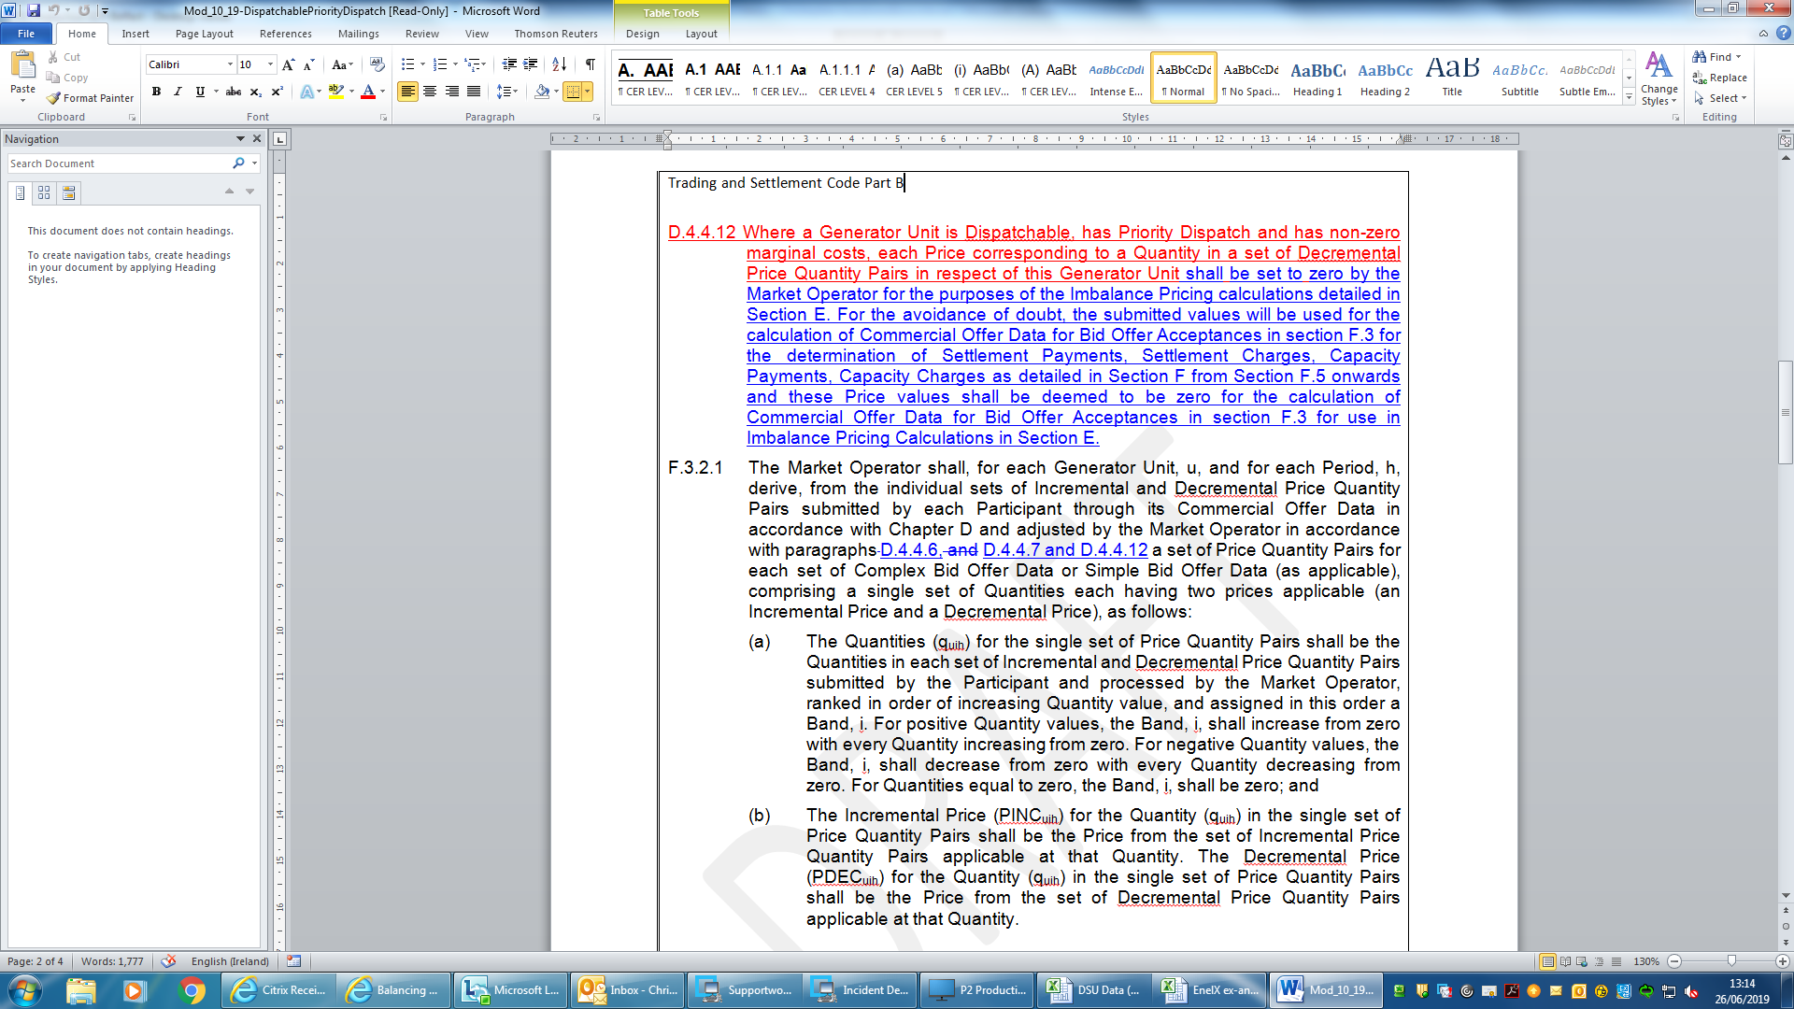
Legal Drafting

Slide 6
Modification Proposal Justification and Implications of not Implementing
Proposal seeks to remedy the inappropriate situation whereby decremental prices submitted by Dispatchable PD units with non zero marginal costs are being used to set the imbalance price despite these prices not being used to determine merit for scheduling decisions on an economic basis
Proposal seeks to ensure such bids are only used for settlement purposes and replace such bids in pricing calculations with zeros to maintain an appropriate pricing signal where such decremental actions are being taken
If this proposal is not implemented then these bids will continue to inappropriately be used for imbalance price formation

Slide 7
Questions?

