Slide 1
Recovery of Costs due to Invalid Ex-Ante Contracted Quantities in Imbalance Settlement
12th December 2017

Slide 2
Background
Specific extremely low probability risks identified resulting in invalid Ex-Ante Market Contracted Quantities
These invalid Contracted Quantities will not be accepted by Imbalance Settlement leading to an imbalance against a SEM NEMO
Looking for a workable solution for I-SEM go-live to mitigate and resolve such imbalances should they eventuate.
Limitations on SEM NEMO’s ability to finance the imbalance in the short term, and cover costs in the long term if not recovered mitigation measures.
Modifications to the SEM NEMO Rules are being progressed to assist with the mitigation measures, but modifications to the TSC are also required.
The modification proposal is here

Slide 3
Invalid Contracted Quantities - Scenarios
Scenario | Probability
Exchange Member trades in the Ex-Ante Markets before a Unit is effective in the Balancing Market | Extremely Low
Exchange Member trades in the Ex-Ante Markets while a Trading Halt should have been in effect. | Very Low
Exchange Member trades in the Ex-Ante Markets while a Suspension of the relevant Unit from the Balancing Market is in effect. | Extremely Low

Slide 4
Invalid Contracted Quantities - Probability
Change in Validity of Unit for Trading
Unit starting, unit suspended, or unit with trading halt applied
Rare Event
Very unlikely Event
Error in communication or application of effective dates of unit in Ex-Ante trading system
Member Trades Anyway
Obligations under rules not to trade when not valid to do so
Unlikely Event
Technical Restriction Not Made
Risk Eventuates
Why is this an extremely low probability? - The diagram below shows the sequence of events that would need to occur in order for this risk to eventuate.

Slide 5
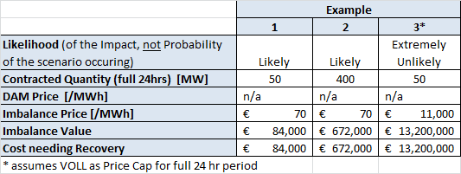
Invalid Contracted Quantities - Impact
While the probability of the scenario occurring is extremely low the impact of such an event could be significant.
It is difficult to quantify the monetary impact of the scenarios – as there is a great deal of variability and lack of historical data in most cases.
However, examples of the costs that could need recovery are illustrated below.
Notes:
Would only relate to one auction as measures could be implemented immediately to rectify once issue identified
Figures assume DAM/IDM payment has not been able to be withheld to minimise the costs.

Slide 6
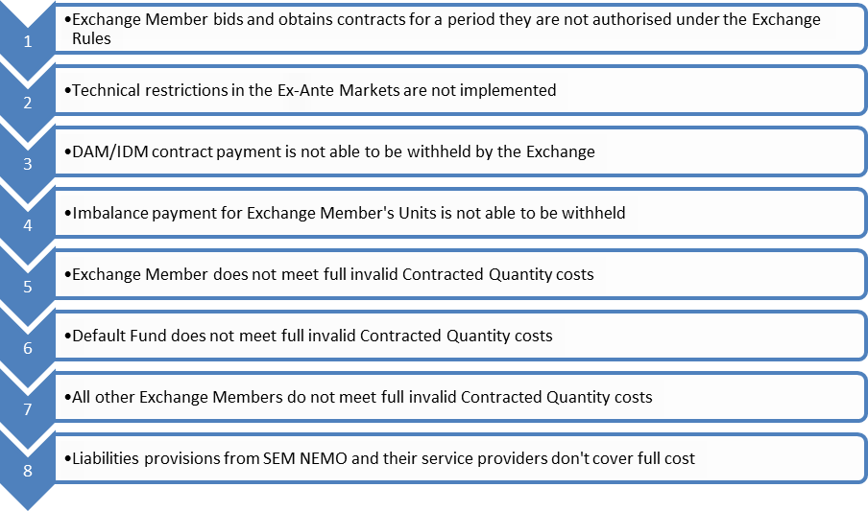
Mitigation Measures
The potential measures to mitigate any costs of invalid Contracted Quantities impacting on Imbalance Settlement include:
Note: These are measures are subject to further validation of viability

Slide 7
Key Components of the Modification Proposal
Provide SEM NEMO’s with time to recover costs through mitigation measures
Adds right of SEMO to withhold TSC payment to Participant that invalid Contracted Quantities relates to minimise cost recovery
Utilise short pay function under TSC to manage imbalance until imbalance recovered
Invalid Contracted Quantity imbalance not included in credit cover requirements for SEM NEMO

Slide 8
Proposal - Benefits
Workable solution for I-SEM Go-Live
No additional upfront costs to Participants:
as costs only eventuate where the extremely low probability event occurs and the mitigation measures don’t work
Accounts for limitations on SEM NEMO’s financial and operating model

Slide 9
Proposal – Implications
TSC Participants temporary reduction in payments while costs are recovered by SEM NEMO
TSC Participants backstop costs if (and only if):
the extremely low probability event actually occurs, and
all the mitigation measures don’t result in the recover costs

Slide 10
Legal Drafting Overview
Majority of changes likely to Section G of Part B of TSC
SEM NEMO can notify MO where invalid Contracted Quantity imbalance cannot be recovered in time for imbalance payment timelines, including details of the invalid Contracted Quantity and cost needing to be recovered
MO will:
Withhold payments due to the Participant for which the invalid Contracted Quantity (if available)
Use short pay functionality to fund the imbalance until costs recovered by the SEM NEMO
If correct notification in a) given to MO, then the MO will not consider SEM NEMO in default or subject to inclusion of invalid Contracted Quantity as part of credit cover requirements.
Where SEM NEMO recovers costs these are paid to the MO for distribution to all Participants who were short paid.

Slide 11
Next Steps
Agreement in principles (today)
Legal drafting for consideration at next Mods Meeting (January)
Approval of Proposal (January)
Implementation (Jan-May)

