Slide 1



Mod_21_18v2
Application of Settlement Reallocation Agreements to Market Operator Charges
16th August 2018

Slide 2
Summary Information
The ISEM Market Rules Working Groups included an understanding that the Settlement Reallocation Agreements should cover all periodical financial obligations, including Market Operator Charges.
This has not been reflected in the drafting of the SRAs as circulated.
Although Mod_21_18v1 aimed to deal with this issue; the effect of Mod_21_18v1 would be to negatively impact on the understanding of Settlement Documents in the TSC as developed with the Irish Revenue and HM Revenue and Customs.
Mod_21_18v2 therefore proposes to amend both Agreed Procedure 10 of the TSC and Appendix 2 of AP10 (The Settlement Reallocation Agreement), which will now have to be re-executed by Market Participants.

Slide 3
Modification Proposal Justification and Implications of not Implementing
This rules do not currently provide for Settlement Reallocation Agreements to apply to transfer of amounts owing related to Market Operator Charges.
Since the decision during the rules working groups was that the Market Operator Charge should be included, this proposal aims to reflect that decision.
If this Modification is not made, then all Secondary Participants would need to be fully collateralised to participate in the market at Go-Live.

Slide 4
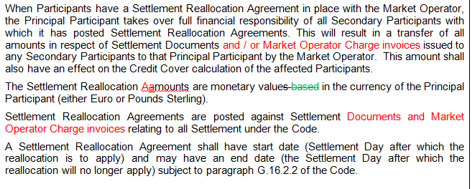
Legal Drafting

Slide 5
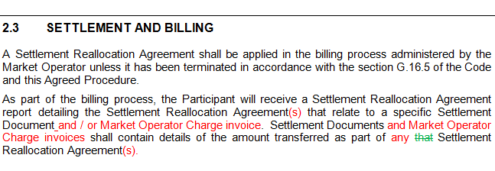
Legal Drafting

Slide 6
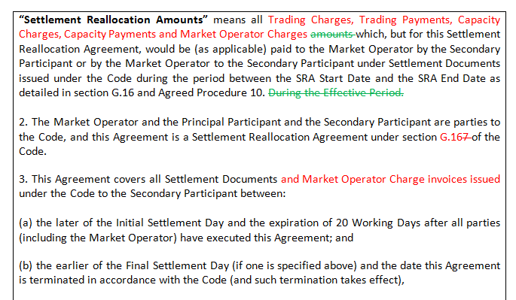
Legal Drafting: AP 10 – Appendix 2

Slide 7
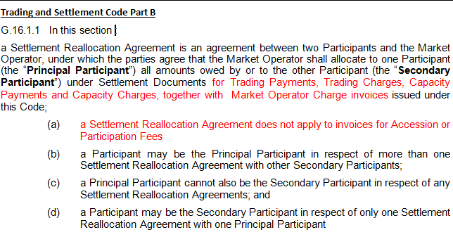
Legal Drafting: TSC PART B

Slide 8
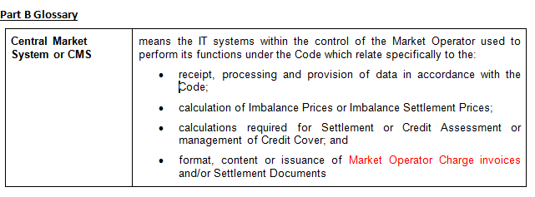
Legal Drafting: TSC PART B Glossary

Slide 9
Legal Drafting: TSC PART B Glossary

Slide 10
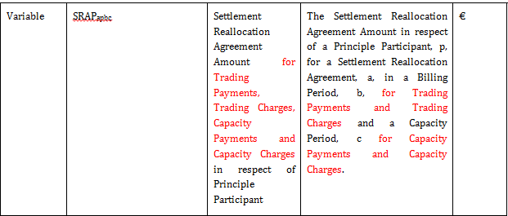
Legal Drafting:

Slide 11
Legal Drafting:

