Slide 1
MOD_22_18
Credit Cover Signage and Subscript Correction
21st June 2018

Slide 2
Summary Information
This proposal seeks to address two issues with the algebraic formulation of some of the credit cover rules within Part B as follows;
There is no subscript assigned to the Historical Assessment Period (HAP) in Part B and as a result the subscripts for Billing Periods and Undefined Exposure Periods are being incorrectly used for one count and two sums over the HAP in clauses to calculate the mean of Daily Average Imbalance Settlement Prices
The application of standard deviation is incorrect in three places due to the signage convention not accounting for the sign of the averaged variable to which the Standard Deviation is being applied

Slide 3
Summary Information – Subscript Errors
We propose using a capital H, which is not currently in use, as the subscript for the Historical Assessment Period
The proposed approach mirrors the approach taken under Part A for similar calculations, albeit that Part A had separate subscripts for energy and capacity Historical Assessment Periods where Part B only requires one for energy due to credit calculations for capacity having a different treatment under Part B (i.e. undefined exposure calculated by socialising payment amounts as opposed to determining a Credit Assessment Price)
There are two incorrect subscript applications for the HAP as follows;
Paragraph G.14.2.2 calculates the number of Daily Average Imbalance Settlement Prices in the HAP by counting the Settlement Days in the applicable HAP but incorrectly denotes this as a count over ‘d in b’ where d is the subscript for a settlement day which is correct but b is the subscript for a Billing Period as opposed to a HAP
Paragraphs G.14.2.3 and G.14.2.4 each calculate a sum over days in a HAP as part of a broader calculation but incorrectly denote this as a sum over ‘d in g’ where g is the subscript for Undefined Exposure Period as opposed to a HAP

Slide 4
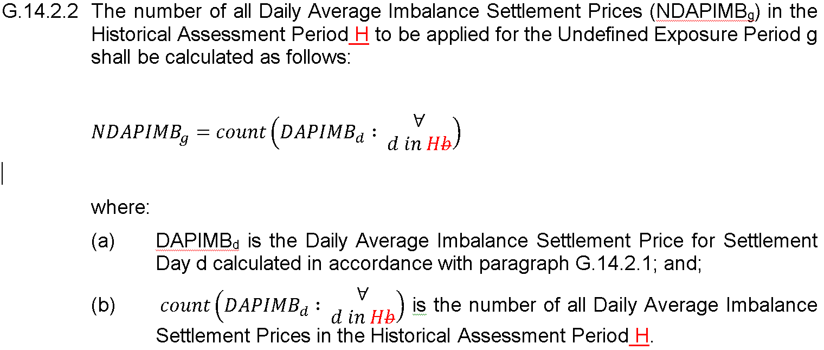
Legal Drafting 1 – Subscript Errors
The proposed legal drafting changes to address the subscript items are as follows;

Slide 5
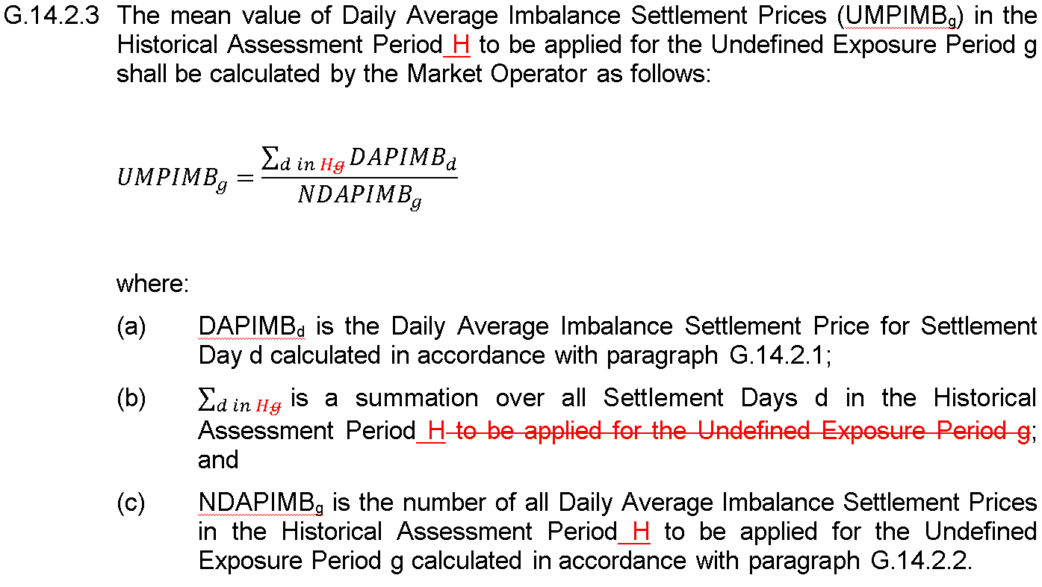
Legal Drafting 2 – Subscript Errors

Slide 6
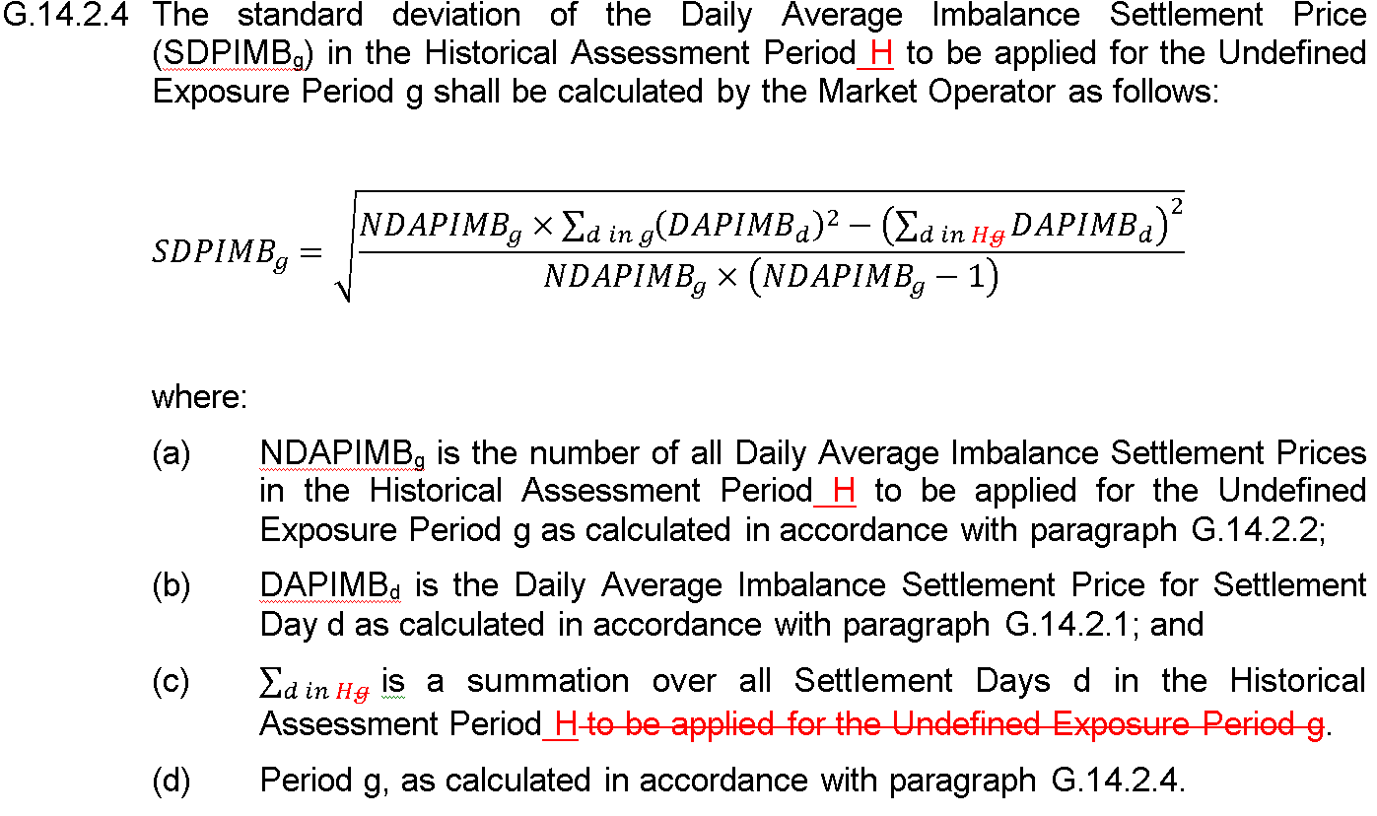
Legal Drafting 3 – Subscript Errors
Note Drafting errors boxed below and please accept my apologies for the oversight here

Slide 7
Further Information – Signage Errors
Note that, while legal drafting for G.14.7.6 on the calculation of the Billing Period Undefined Exposure Quantity for Standard Participant Supplier Units is displayed in this presentation (in the next slide), equivalent changes to G.14.10.4 for Trading Payments for Standard Participant Generator Units and G.14.12.4 for Standard Participant Assetless Units are also proposed
Note also that the current system design reflects the proposed changes already so that a system change will be required if the proposed changes are not implemented and the current system design aligns to the intended market design here with standard deviation increasing the magnitude of the averaged payment/volume variable whereas the current drafting would reduce the magnitude of those averages where the average is negative
Note that an equivalent change is not proposed for the application of Standard Deviation to the Credit Assessment Price despite the fact that hypothetically the same issue could be deemed to apply there
This is because the current system design reflects the existing algebra here so that updating it would require a system change and
In SEMOs view, while negative average Supplier volumes (Demand is negative by convention in Part B) and Generator/Assetless Unit Trading Payments are a certainty under the I-SEM Imbalance arrangements, negative average prices over an entire HAP are so unlikely that it is inappropriate to incur the cost of a system change to treat them

Slide 8
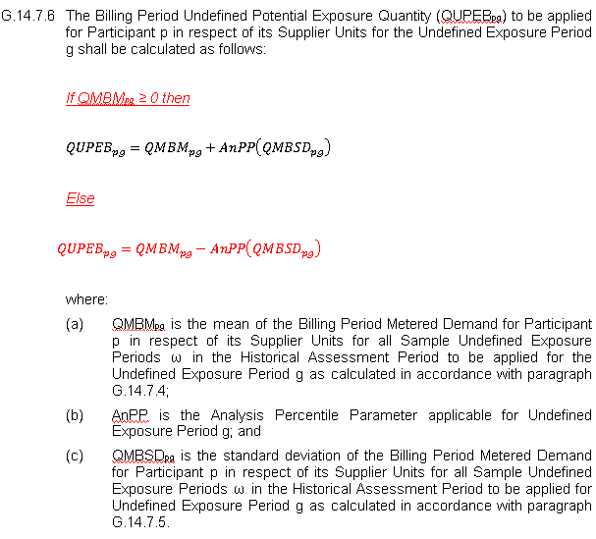
Legal Drafting – Signage Errors
The proposed legal drafting to address the signage items is as follows (this is similar in structure to the approach taken elsewhere when a calculation differs depending on the relative value of one of the inputs, e.g. Part A for Tolerance Bands and Uninstructed Imbalances) ;

Slide 9
Modification Proposal Justification and Implications of not Implementing
This proposal is intended to correct two errors thereby ensuring clarity in the amended clauses and ensuring materially correct credit requirement outcomes
Implementation will further the Code objectives of providing transparency in the SEM and facilitating the efficient and economic administration of the SEM in a financially secure manner
If this proposal is not implemented the subscript error it aims to address will remain resulting in a lack of clarity in those clauses affected and the credit calculations for which it seeks to address a signage issue will apply standard deviation in the incorrect direction in certain scenarios leading to materially incorrect credit requirements

