Slide 1
MOD_24_18
Use of Technical Offer Data in Instruction Profiling / QBOA
Martin Kerin
16th August 2018

Slide 2
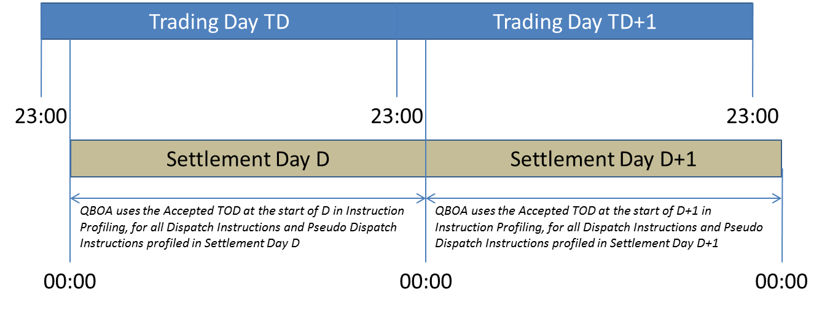
MOD_24_18 Concept

Slide 3
MOD_24_18 Drafting
Part B Appendix O Paragraph 10:
The Market Operator shall, for each entire Settlement Day, use the following Registration Data and Accepted Technical Offer Data for the Trading Day containing the start of that Settlement Day, provided in accordance with Appendix H: “Data Requirements for Registration” and Appendix I: “Offer Data” respectively, shall be used by the Market Operator to calculate all Instruction Profile types for that Settlement Day:

Slide 4
MOD_24_18 Drafting
Part B Appendix O Paragraph 26:
The normal operating modes for a Synchronised Generator Unit are load up mode, ramp up mode, ramp down mode and deload mode. Each operating mode of a Generator Unit is described by a piecewise linear Operating Trajectory that describes the theoretical Output of a Generator Unit over time. The Technical Offer Data used to determine the piecewise linear Operating Trajectory shall be the Accepted Technical Offer Data for the Trading Day containing the start of that Settlement for the Trading Day containing the Instruction Effective Time of the Dispatch Instruction.

