Slide 1



MOD_25_18
Part B Unsecured Bad Energy Debt and Unsecured Bad Capacity Debt
16th August 2018

Slide 2
Summary Information
Discussions at meeting 84 took place highlighting that a similar issue to that raised for Part A under mod_02_17 exists for Part B
Agreement was reached for SEMO to raise a proposal to amend the payment obligation timeline in the same way as for Part A
Discussion also took place in relation to an inconsistency in Part B where it refers to Unsecured Bad Debt being treated via Debit Notes issued to SEM Creditors; however, these are issued to Generator Participants only and pro rata on their share of metered generation
Part B also refers to Debit Note Excess leading to reductions for SEM Creditors pro rata on their proportionate entitlements whereas this is also pro rata on their share of metered generation
This proposal seeks correct these errors via minor updates i.e. without re-wording entire paragraphs

Slide 3
Legal Drafting Changes – Payment Timing
Equivalent changes made to Part B G.2.5.4 and Agreed Procedure 15 as those made to Part A 6.50 and Agreed Procedure 15
    (d) the Market Operator shall, subject to the provisions of the Code, pay the amount set out in each Settlement Document (less the amount set out in any applicable debit note to any Participant who is a SEM Creditor) from the SEM Account to the SEM Creditor’s designated bank account or bank accounts for full value by the Payment Due Date (and the Payment Due Date for the purpose of this sub-paragraph (d) is 17:00, 4 Working Days after the date of the relevant Settlement Document except where an Unsecured Bad Debt has occurred); and
(e) Where an Unsecured Bad Debt has occurred, the Market Operator shall, subject to the provisions of the code, instruct payment of the amount set out in each Settlement Document less the amount set out in any applicable Debit Note (to any Participant who is a SEM Creditor) from the SEM Account to the SEM Creditors designated bank account or bank accounts for full value by 00:00 4 Working Days after the date of the relevant Settlement Document.

Slide 4
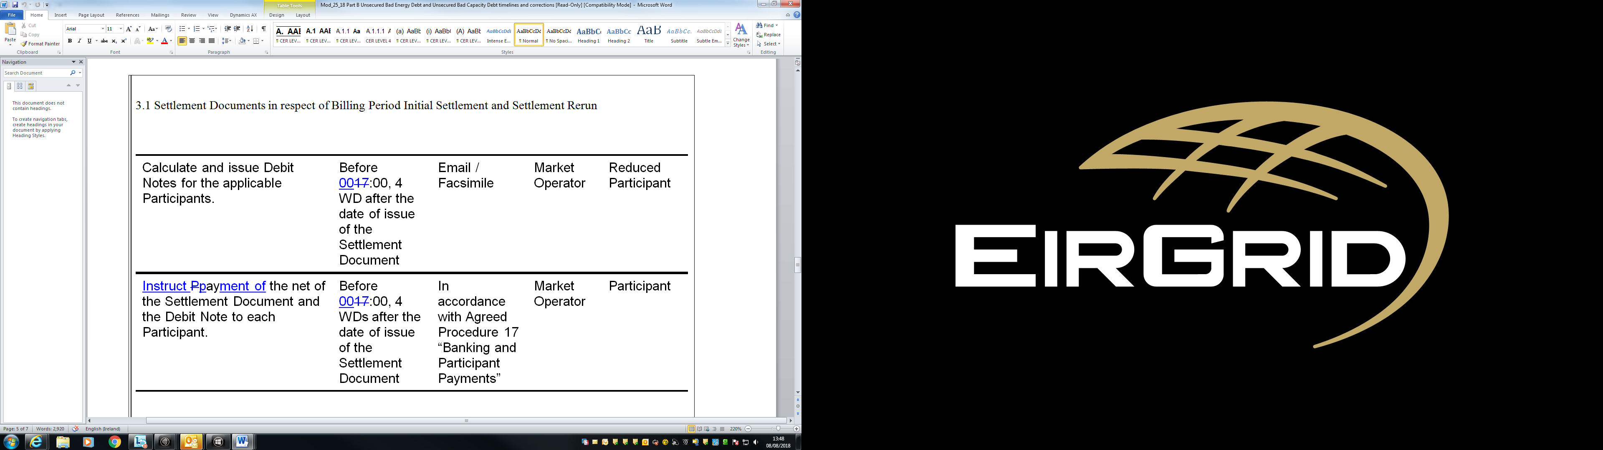
Legal Drafting Changes – Payment Timing Cont.
Equivalent changes made to Part B G.2.5.4 and Agreed Procedure 15 as those made to Part A 6.50 and Agreed Procedure 15

Slide 5
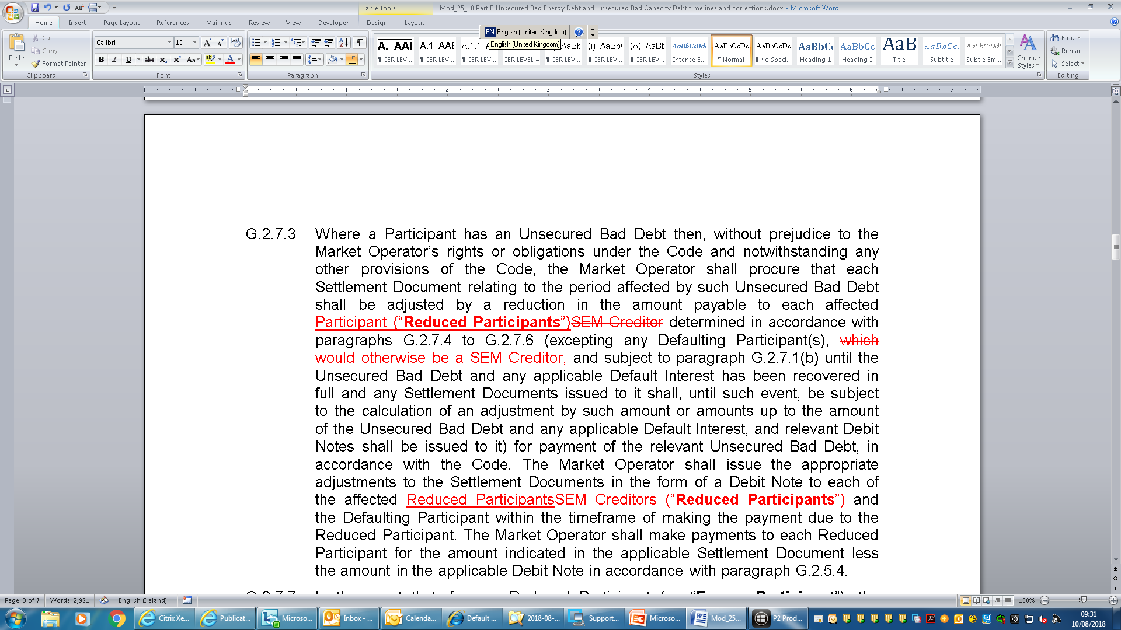
Legal Drafting Changes – Debit Note Treatment Errors
Reduced Participant embedded definition brought forward to replace first reference to SEM Creditor and then SEM Creditor References replaced with Reduced Participant in a variety of places
Reference to Defaulting Participants ‘which would otherwise be a SEM Creditor’ removed rather than replaced since it isn’t essential and replacing with Reduced Participants would change the meaning

Slide 6
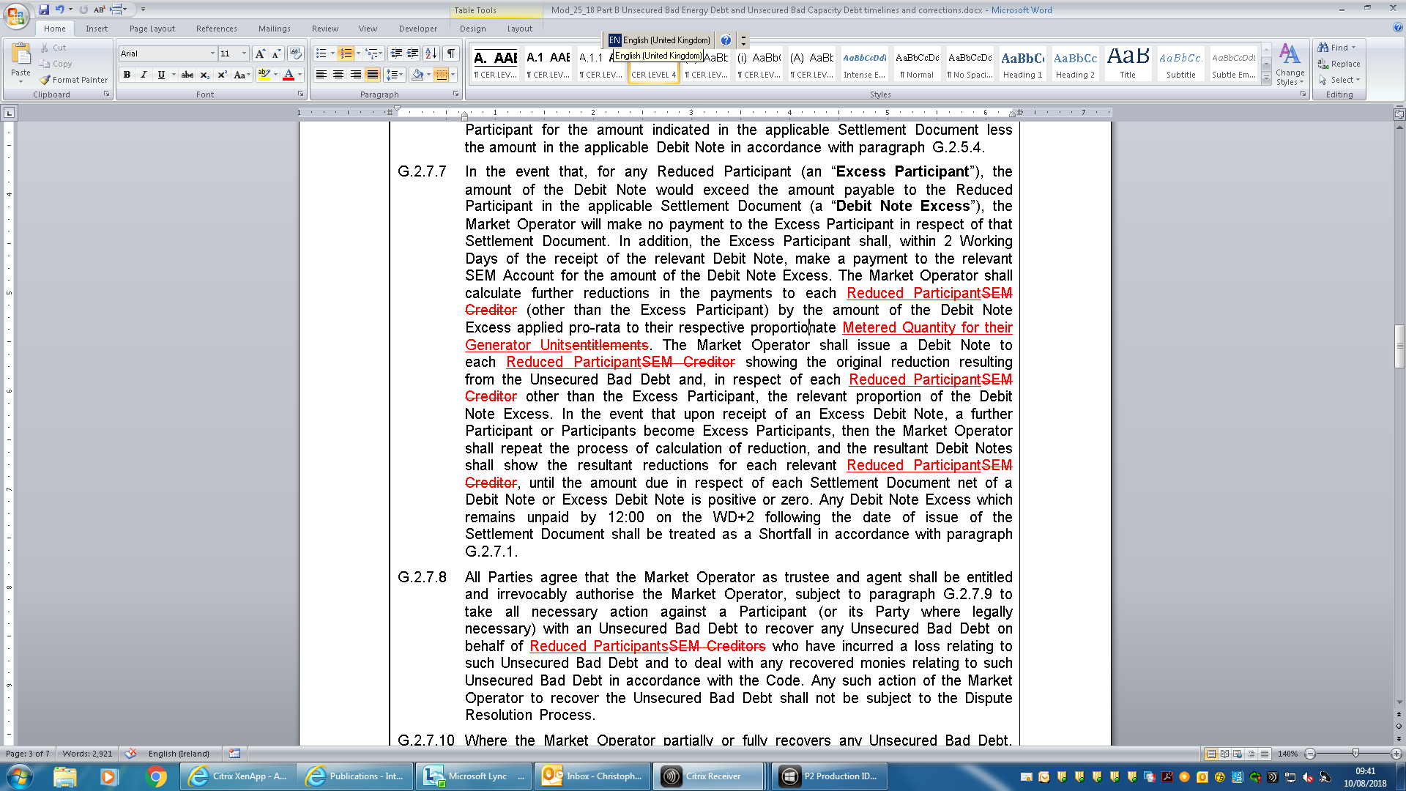
Legal Drafting Changes – Debit Note Treatment Errors
Further changes to replace reference to SEM Creditor with Reduced Participant and correction of incorrect reference to reductions pro rata on entitlements where this is pro rata on Metered Quantity for their Generator Units

Slide 7
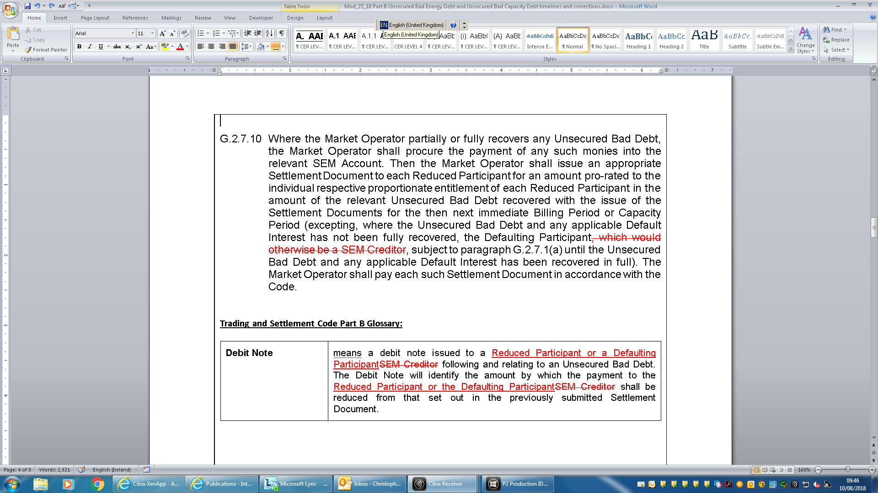
Legal Drafting Changes – Debit Note Treatment Errors
Removal of another reference to Defaulting Participant ‘which would otherwise be a SEM Creditor’ for the same reasons as the previous instance
Revisions to Debit Note definition to account for change from SEM Creditor to Reduced Participant and including reference to Defaulting Participant who can also receive Debit Note under G.2.7.3 to recover the bad debt itself from subsequent Settlement Documents

Slide 8
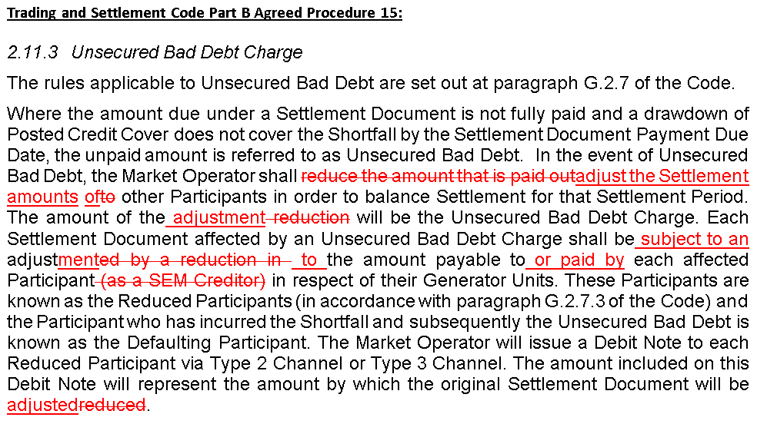
Legal Drafting Changes – Debit Note Treatment Errors
Changes made to the Unsecured Bad Debt section in Agreed Procedure 15 ‘Settlement and Billing’ to correct references to SEM Creditor and statements that Debit Note adjustments are always reductions to payable amounts

Slide 9
Modification Proposal Justification and Implications of not Implementing
This proposal is required to address the fact that the current payment timelines are not practically achievable similar to Mod_02_17 for Part A
This proposal is also required to correct incorrect drafting for Unsecured Bad Debt in Part B where changes in the approach to the short pay process to apply this based on Metered Generation as opposed to Payments Due retain some elements of the Part A approach in error
The approach taken is based on previous discussions and is as agreed at meeting 84
If this proposal is not implemented the Code will continue to reflect payment timing obligations for SEMO where an Unsecured Bad Debt occurs which it is not possible to meet
If this proposal is not implemented the Code will also continue to have errors and inconsistencies around how Unsecured Bad Debt is treated

