Slide 1
Mod_01_20
Setting the price of the marginal energy action when there are no energy actions in the same direction as the NIV

Slide 2
Background
A key concept of balancing market pricing is the distinction between energy and non-energy actions
This works when after the flagging stage energy actions remain in the stack
However due to the constrained power system in Ireland, there are often occasions where there are few or no energy actions from which to form an imbalance price reflective of the system at any given time

Slide 3
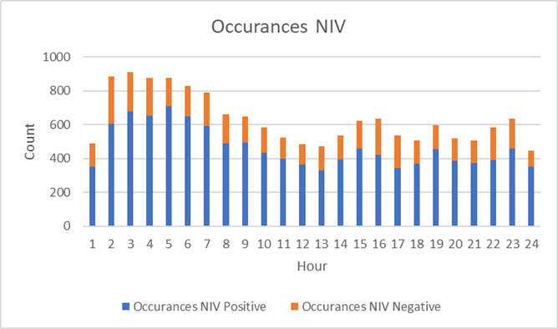
Defining The Specific Issue
This modification seeks to address one specific scenario driven by our highly constrained system:
  What price to use when there are no energy actions in the same direction as the NIV
This issue occurs frequently:
  11% of 5 minute periods
  33% of 30 minute periods
Particularly when the system is short overnight (positive NIV):

Slide 4
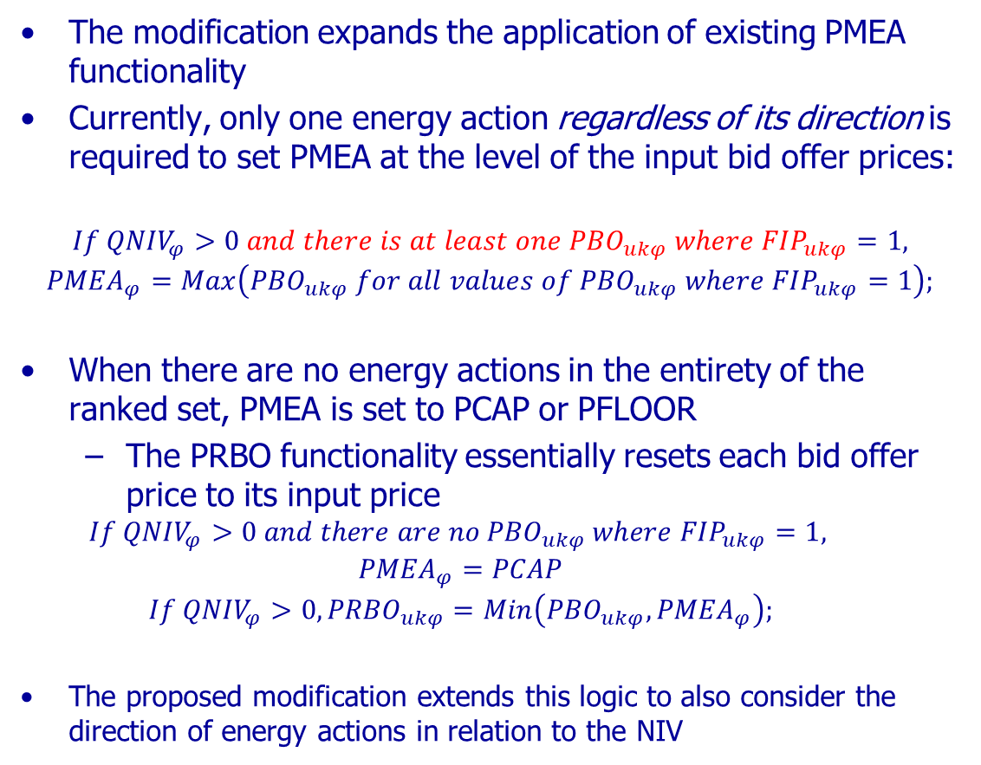
Resolving The Problem
The modification expands the application of existing PMEA functionality
Currently, only one energy action regardless of its direction is required to set PMEA at the level of the input bid offer prices:
$$If {QNIV}_{φ}>0 and there is at least one {PBO}_{ukφ} where {FIP}_{ukφ}=1,$$
$${PMEA}_{φ}=Max\left({PBO}_{ukφ} for all values of {PBO}_{ukφ} where {FIP}_{ukφ}=1\right);$$
When there are no energy actions in the entirety of the ranked set, PMEA is set to PCAP or PFLOOR
  The PRBO functionality essentially resets each bid offer price to its input price
  $$If {QNIV}_{φ}>0 and there are no {PBO}_{ukφ} where {FIP}_{ukφ}=1,$$
  $${PMEA}_{φ}=PCAP$$
  $$If {QNIV}_{φ}>0, {PRBO}_{ukφ}=Min\left({PBO}_{ukφ}, {PMEA}_{φ}\right);$$
The proposed modification extends this logic to also consider the direction of energy actions in relation to the NIV

Slide 5
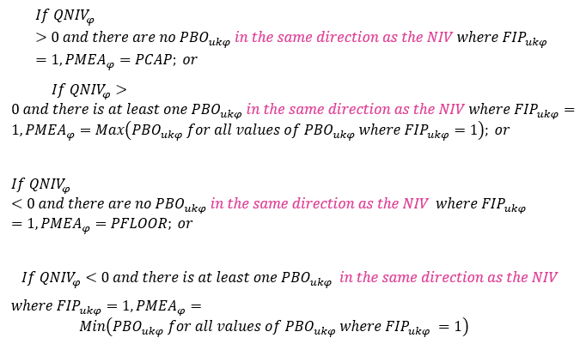
T&SC Drafting

Slide 6
T&SC Drafting
Extends existing functionality
Applies this functionality to a very specific scenario in a targeted fashion
Understandable change which can be evaluated in a straightforward manner
Does not alter how energy actions are defined
Does not change any subsequent stages of the imbalance pricing algebra
Still allows for the theoretical energy action to be opposite to the NIV when there are energy actions on both sides of the stack

Slide 7
Worked Example
Long system, QNIV= -0.5
  Only 1 energy action (Inc @ €250/MWh)
PMEA as drafted: €250/MWh
PMEA with mod: -€1000/MWh
Current drafting results in the PRBO of each action “overwriting” the original input price:
  Negative NIV so PRBO = max(PBO, 250)
Modification retains original PBO’s
  PRBO = max(PBO, -1000)
Imbalance price changes from €250/MWh to €35/MWh
PBOA | QBOA | FIP | PRBO as per TSC | PRBO with Mod
490 | 7 | 0 | 490 | 490
250 | 6 | 1 | 250 | 250
120 | 0.5 | 0 | 250 | 120
80 | 3 | 0 | 250 | 80
35 | -4 | 0 | 250 | 35
30 | -8 | 0 | 250 | 30
29 | -0.5 | 0 | 250 | 29
27 | -3 | 0 | 250 | 27
-2 | -1.5 | 0 | 250 | -2

