Slide 1
Balancing Market Modification Proposal
Expansion of the System Service Flag to include Cross-Zonal Actions for System Security Reasons
11 February 2021

Slide 2
Context – Explanation of Proposed Change
Excessive Exposure to Reliability Option Difference Payments (RODP) for peaking units
Currently a number of peaking units are exposed to RODPs due to Cross-Zonal Actions. These peaking units are offering power at a price considerably below the cost of the Cross-Zonal Actions but are not being scheduled due to a combination of reserve requirements (including TSO cushion), network limitations or the accommodation of early TSO Cross-Zonal-Actions.
The System Service Flag was introduced to meet the requirement introduced in Market where “For any capacity utilised for DS3 System Services such as capacity providing reserve, difference payments will be paid based on the difference between the contracted utilisation payment for that service* and the Strike Price.” (SEM-15-103, p9)
*Likely to be zero – implying no difference payments in respect of the provision of DS3 System Services
It was intended that flexible peaking plant would not be exposed to RODP where the unit was available. It was understood by all in the market development that these units would be called by the TSO where there was scarcity. It was not ‘expected’ that these flexible plants would not be called or ramped. Rather the issue was with less flexible units may not be able to ramp up in time.

Slide 3
Legal Drafting Change
It is clear from the detailed design that the current System Service flag does not meet either the explicit or implicit requirements of the detailed design.
While a more intense change to the System Service Flag may be appropriate, there is a need for an immediate change due to the recurring nature of the Cross-Zonal-Actions for System security reasons. This can be an interim change pending a detailed review of the System Service Flag. The impact of which is on settlement and therefore can be applied after the IMB period and is not price affecting.
Code change details to Appendix N
“2 For each Imbalance Pricing Period, φ, the System Operators shall:
use information from the most recent Indicative Operations Schedule to identify whether a Generator Unit’s scheduled output is bound by the presence of an Operational Constraint relating to the provision of Replacement Reserve, and where they determine that the Generator Unit is so bound, shall set the System Service Flag (FSS_{uφ}) for that Generator Unit, u, equal to zero for that Imbalance Pricing Period, φ. Otherwise, the System Operators shall set the System Service Flag (FSS_{uφ}) for that Generator Unit, u, equal to one for that Imbalance Pricing Period, φ.
where Cross-Zonal Actions have occurred for System security reasons, and where a generator is available and is providing contracted system services, shall set the System Service Flag (FSSuφ) for that Generator Unit, u, equal to zero for that Imbalance Pricing Period, φ. Otherwise, the System Operators shall set the System Service Flag (FSSuφ) for that Generator Unit, u, equal to one for that Imbalance Pricing Period, φ.

Slide 4
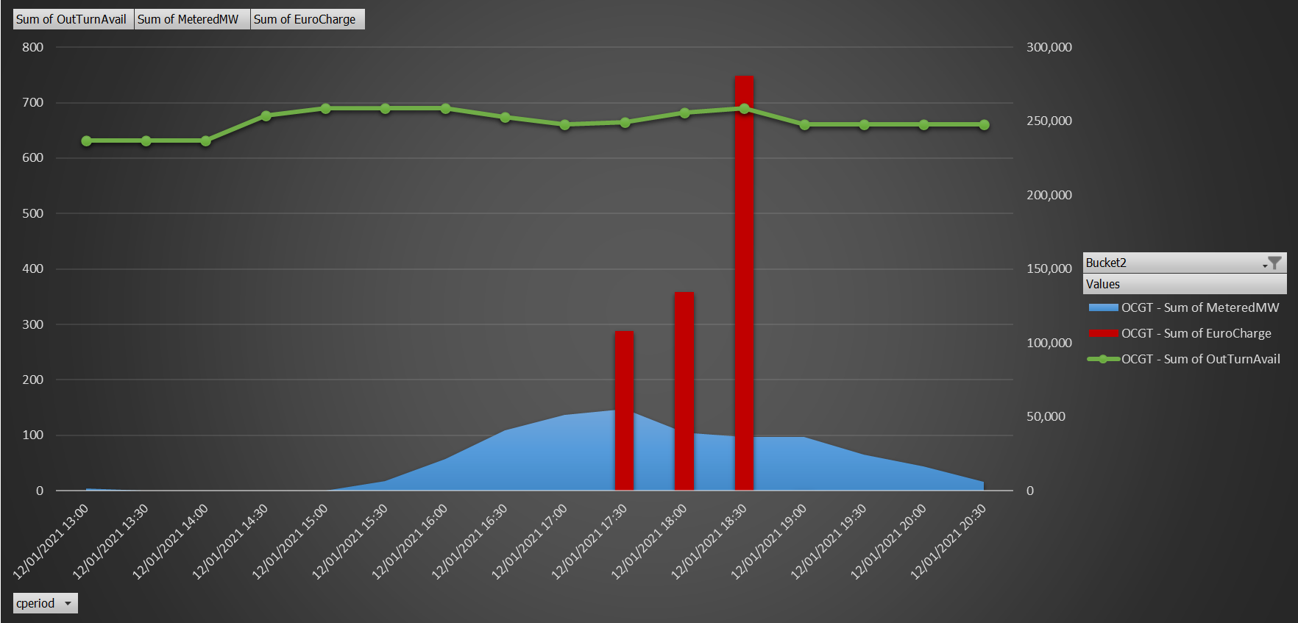
Modification Proposal Justification: 12 January 2021 example
Peaking units paid out > €0.5M for the 1 ½ hr RODP period created by the Cross-Zonal Action
Their load factor < 20% of their available capacity, yet they were priced significantly lower than the Cross-Zonal Action
Energy payments received would not be sufficient to cover the RODP, additional DS3 payments would not be sufficient to cover the loss.
These units were not FSS Flagged.

Slide 5
Modification Proposal Justification
We have had four RODP events since the start of November. High prices are a sign of a functioning market, but the nature of the Irish network means that the TSO only selects those peaking units from the location of the shortage. But even in those cases the TSO has been holding back energy from peaking units that are more in merit favouring power bought through Cross-Zonal Actions with the peaking assets used as Reserve.
The impact for peaking units is that it is likely to become uneconomic for them to continue to operate as they continue to be subject to this largely uncontrollable dispatch risk, leading to large RODP. This is contrary to the detailed system design objectives, instead of flexibility being rewarded, it is being discriminated against due to the presence and management of Operational Constraints
Adopting the proposed modification will help ensure that the Code Objectives are further enhanced.
Failure to implement this modification will continue to see discrimination against peaking plant and undermine their economic viability.

