Slide 1
Mod Proposal for meeting 103 Collateral exposure of Autoproducer and DSU Thomas O’Sullivan, Aughinish Alumina Ltd 11 Feb 2021

Slide 2
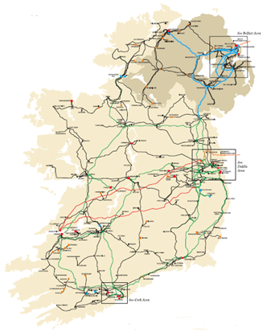
Autoproducer Problem
115MW Generator
Q_{imb} = +0MW
115MW
115MW Autoproducer
Q_{imb} = +160MW and -160MW
115MW
Over collateralisation
Notes:
This is what we do
This is what an Autoproducer is intended to represent in the TSC Part A, B & C

Slide 3
DSU Problem
To avoid double counting of demand reduction DSU have specific settlement configuration
Implemented through a Trading Site Supplier Unit
TSSU consumes power of DSU
Not possible for TSSU to consume power from grid
Setup is a notional settlement approach which could theoretically be done through a netting generator
No need in particular for this to be a supplier
No actual consumption from gird possible
As implementation uses supplier unit, all consumption must be collateralised
Triggers same issue as Autoproducer where gen and supply do not match in credit
Causes a large exposure on the supply side which does not relate to real expected exposures
Does not reflect the net consumption/generation position (i.e. zero)

Slide 4
Materiality Self Assessment
€ 949k calculated by Aughinish
Additional € 400k to 700k if Supplier suspension delay period is changed.
DSU:
Normal exposure of € 1,000,000
Max exposure could be up to € 4,100,000
Huge additional cost if Supplier suspension delay period is changed

Slide 5
Timeline
Mar 2018 interim solution proposed Mod_09_18
27 Aug 2018 effective date
Mod _03_18
Jan 2018 proposed
Dec 2019 approved by Mods Committee
Dec 2020 rejected following risk assessment
Current Mod proposed today

Slide 6
This proposal
Based on the Interim modification
Key aspects include:
Participants with a DSU or an Autoproducer Unit are considered as ‘New’ or ‘Adjusted’ Participants (never as ‘Standard’)
We must submit the net value of our ‘Credit Assessment Volume’
This is the combined total of our expected imbalance position or combined total of our metered volume.
No different to other participant, if a material change occurs above the ‘Credit Cover Adjustment Trigger’ we must resubmit our Credit Assessment Volume
Some house keeping

Slide 7
End

Slide 8
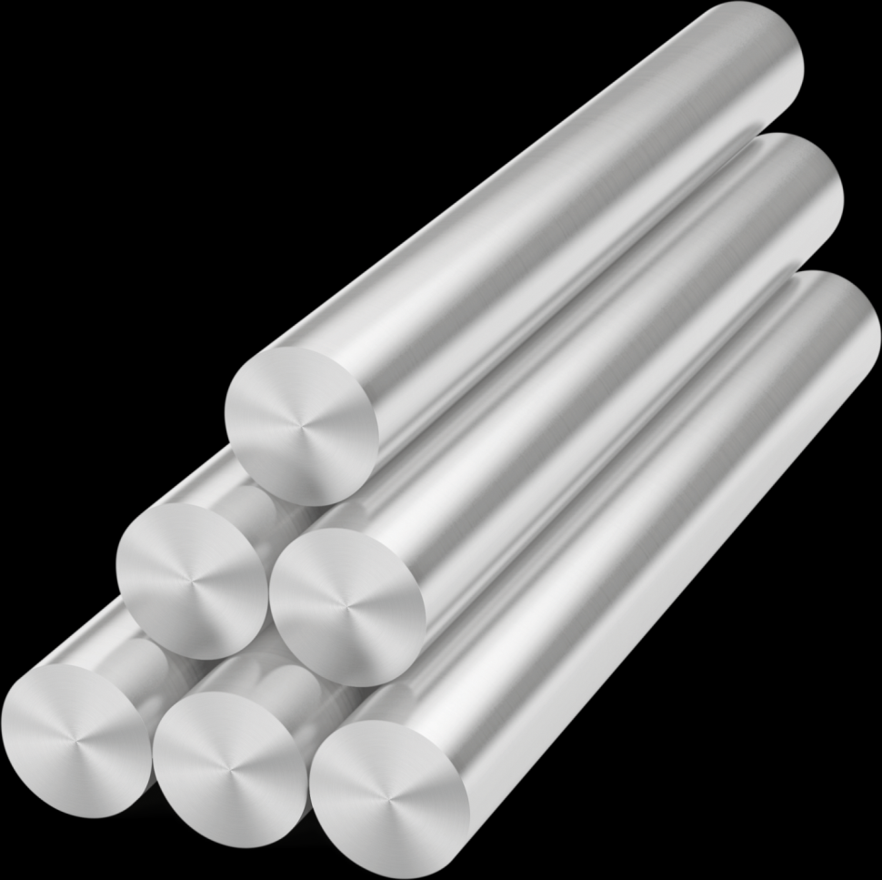
Autoproducers Credit Calculation AUGHINISH Alumina Ltd
Jan 2018

Slide 9
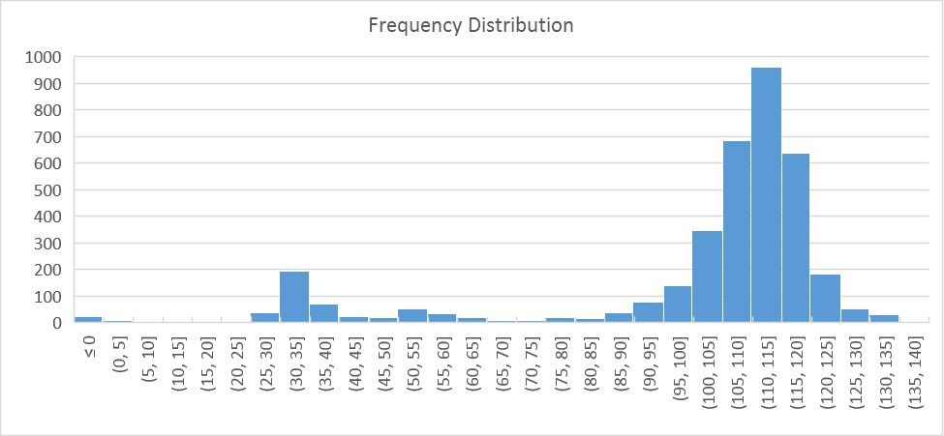
Aughinish historic delivery Freq Distribution over 10 years
99.6% availability in 2017
Consumption <10MW
2nd Tuesday in May
Delivery at 110MW
Or
Delivery at 35MW

Slide 10
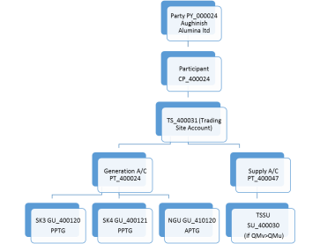
Autoproducer Problem Structure in the I-SEM TSC Part B
Party PY_000024 Aughinish Alumina ltd
Participant
PT_400024
TS_400031 (Trading Site Account)
SK3 GU_400120
PPTG
SK4 GU_400121
PPTG
TSSU SU_400030
TU_400001 Trading Unit
Netting Generator Unit Removed
Q imb
-115MW
+80MW
+80MW
-45MW

Slide 11
Autoproducer Problem Physical units
SK3
80MW
SK4 80MW
In-house
45MW
Station gate Delivery 115MW and
QExAnte = 115MW
Balancing Market Units
In-house
45MW
SK3
80MW
SK4 80MW
QM NGU TSSU - 45MW
TU
Virtual
QM SK4 80MW
QM SK3 80MW
QM TU =0 MW but QExAnte = 115MW
Notes:
This is what we do
This is what an Autoproducer is intended to represent in the TSC Part A, B & C

Slide 12
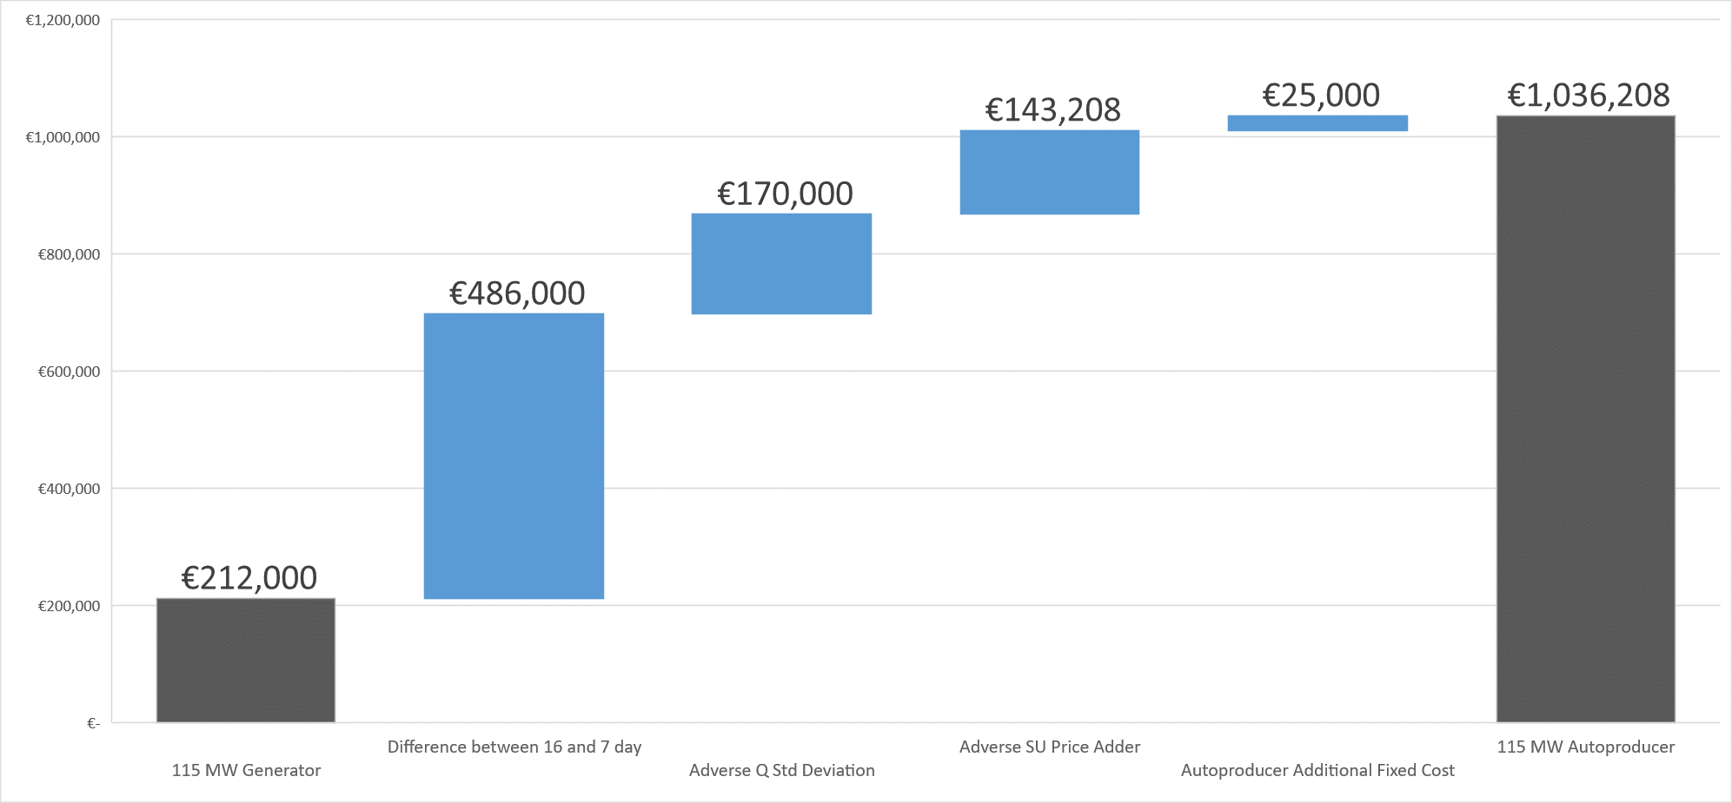
Implication Autoproducer Excess Collateral (100% balance responsible)
€800,000

Slide 13
The Rejected MOD_03_18 Proposal
For all Units
GU Cashflow
CMU Cashflow
SU Cashflow
Registered to an Autoproducer Site
In
Settlement Day, d
For all
d in Sample Undefined Exposure Period, ω
New section G.14.17.1
To calculate the Billing Period Cashflow for an Autoproducer as follows
$${CUB}_{pgω}=\sum_{d in ω}{\left(\sum_{u in p}{{CDAY}_{ud}}+ \sum_{Ω in p}{{CDAY}_{Ωd}}+ \sum_{v in p}{{CDAY}_{vd}}\right)}$$
New section G.14.17.4
can be positive or negative
If CUBM_{pg} => 0 then:
${EUPEAS}_{pg}={CUBM}_{pg}+AnPP\left({CUBSD}_{pg}\right)$
If CUBM_{pg} < 0 then:
${EUPEAS}_{pg}={CUBM}_{pg}−AnPP\left({CUBSD}_{pg}\right)$

