Slide 1
Mod_06_22
Housekeeping Alignment Modification

Slide 2
Context of this proposed change
Mod_06_22 objectives
This MOD Aims to address system action repricing during periods an energy action has not been taken on the same side of the NIV Stack.
Mod aims to prevent Non Energy Actions populating cashout price setting.
Addresses structural flaws associated with high volume system Interconnector actions within the relatively small ISEM balancing market.
The large physical volume behind IC actions make NIV tagging ineffectual, creating a high risk for System IC actions to inappropriately set Cashout prices - as was experienced in July 2022

Slide 3
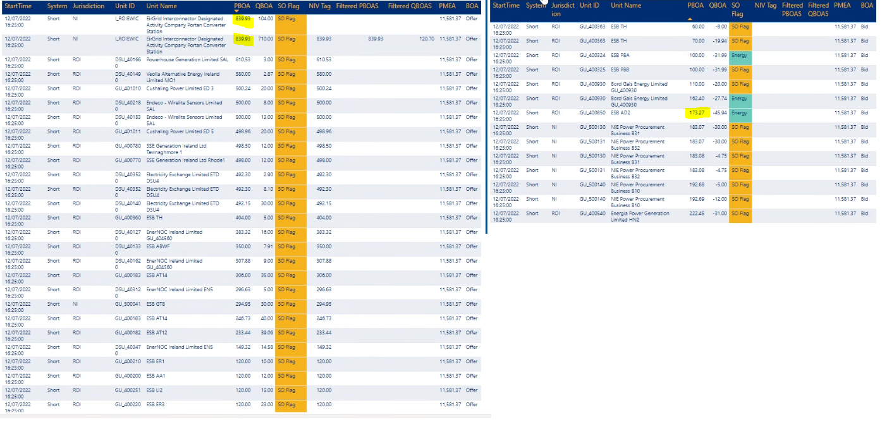
Interaction between Mod 01_20 and Mod 02_21
Over 800MW of actions taken over EWIC at €839/MWh with no system offers. The bid stack was around 100MW (full PAR stack consisted of this IC action)
Pre-Mod 01_20: this IC action would have been repriced to the highest priced energy bid or offer (€173 which would have set cash-out)
As PMEA was set to PCEILING or €11.5k, the IC action kept its price, and this set cash-out
The BOA’s stacks below are relevant for one 5-minute period but the same thing happened in 19 of 24 five minute periods in the 2 hours when the RO was called
This is a material risk during W-22

Slide 4
Proposed change
The action of this mod is to use the same drafting as Mod 01_20, but to redefine the case where the Marginal Energy Action for each Imbalance Pricing Period is calculated using the PSTRm, rather than the PCAP (the Market Price Cap):
E.3.4.2 For each Imbalance Pricing Period, φ, the Market Operator shall calculate the Marginal Energy Action Price (PMEAφ) as follows:
𝐼𝑓 𝑄𝑁𝐼𝑉𝜑 > 0 𝑎𝑛𝑑 𝑡ℎ𝑒𝑟𝑒 𝑎𝑟𝑒 𝑛𝑜 𝑃𝐵𝑂𝑢𝑘𝜑 𝑖𝑛 𝑡ℎ𝑒 𝑠𝑎𝑚𝑒 𝑑𝑖𝑟𝑒𝑐𝑡𝑖𝑜𝑛 𝑎𝑠 𝑡ℎ𝑒 𝑁𝐼𝑉 𝑤ℎ𝑒𝑟𝑒 𝐹𝐼𝑃𝑢𝑘𝜑 = 1,
𝑃𝑀𝐸𝐴𝜑 = PCAP PSTRm;
Where PSTRm is the Strike Price for Month, m, which contains Imbalance Settlement Period, γ
The outcome of this modification is to ensure that cashout continues to be unaffected by IC actions as is expected by Mod 02_21
Only targets the use of PCAP in cases of system/non-energy actions, and not on price formation or depressing of true price.

Slide 5
Alternative proposal
Would a solution here be to split out the logic for replacement pricing during the PAR stage. To my mind this would be:
For all actions not relating to an SO-SO trade:
Replacement price for an INC is min (PMEA, PBO)
For all actions relating to an SO-SO trade:
Replacement price for an INC is min (PMEA, PBO, PSTR)

