Slide 1
TYNAGH ENERGY
Mod_07_22 – Indexation to Calculation of Capacity Payments for New Capacity
Mods Committee Meeting 113

Slide 2
Mod 07_22 – Indexation to Calculation of Capacity Payments
Background
This modification has been discussed previously at Mods Committee Meetings 111 & 112, as well as a specific industry workshop in June 2022.
Following a discussion at Mods Committee 112, the Committee requested a number of legal drafting changes to specific details of the modification.
Proposed Changes
The changes recommended by the Committee include:
Clarification on what “Relevant Capacity Year” refers to;
Clarification on PERIOD terms used in equation;
Tightening of definition of CPI;
Updating of glossaries; and
Clarification of definition of Auction Indexation (AIND).

Slide 3
Mod 07_22 – Implementation of Mod
This first part of the modification, the introduction of the INFMOD term, remains unchanged.
F.17.1.1 The Market Operator shall calculate the Capacity Payment (CCPΩγ) for each Capacity Market Unit, Ω, in each imbalance Settlement Period, γ, as follows:
The legal drafting changes are mainly to the newly proposed Section F.17.1.2 where the INFMOD is calculated.

Slide 4
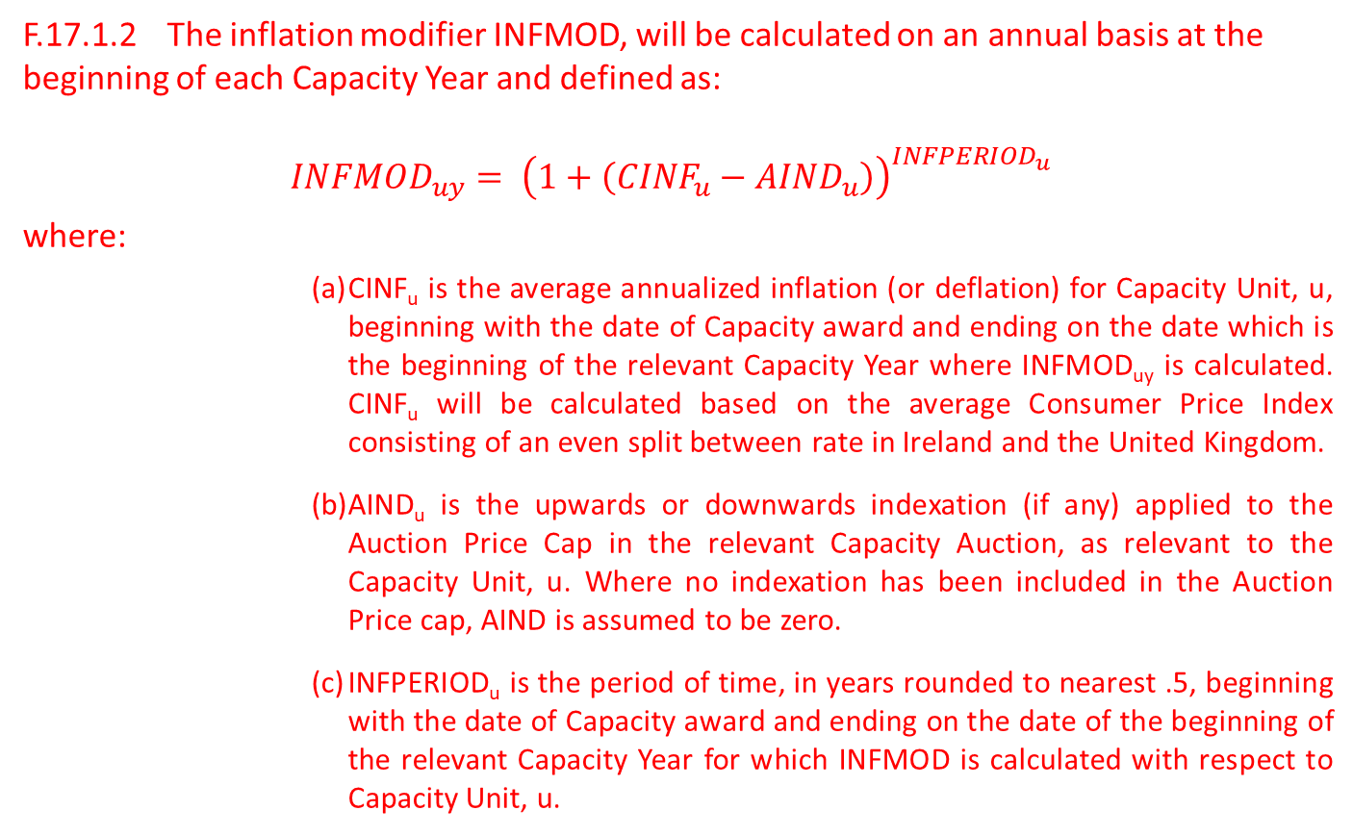
Mod 07_22 – Implementation of Mod
F.17.1.2 The inflation modifier INFMOD, will be calculated on an annual basis at the beginning of each Capacity Year and defined as:
$${INFMOD}_{uy}= {\left(1+\left({CINF}_{u}−{AIND}_{u}\right)\right)}^{{INFPERIOD}_{u}}$$
where:
        CINF_{u} is the average annualized inflation (or deflation) for Capacity Unit, u, beginning with the date of Capacity award and ending on the date which is the beginning of the relevant Capacity Year where INFMOD_{uy} is calculated. CINF_{u} will be calculated based on the average Consumer Price Index consisting of an even split between rate in Ireland and the United Kingdom.
        AIND_{u} is the upwards or downwards indexation (if any) applied to the Auction Price Cap in the relevant Capacity Auction, as relevant to the Capacity Unit, u. Where no indexation has been included in the Auction Price cap, AIND is assumed to be zero.
        INFPERIOD_{u} is the period of time, in years rounded to nearest .5, beginning with the date of Capacity award and ending on the date of the beginning of the relevant Capacity Year for which INFMOD is calculated with respect to Capacity Unit, u.

Slide 5
Mod 07_22 – Legal Drafting Changes
OPERIOD and CPERIOD have been removed and replaced with a single INFPERIOD term, which combines both terms.
INFPERIOD has been clarified as rounding to .5 years.
INFPERIOD and CINF have been more clearly defined as beginning with the date of contract award and ending the date beginning of the relevant Capacity Year for which INFMOD is calculated.
AIND, the indexation rate applied at auction has been clarified. This is now defined by the indexation used at the capacity auction for which capacity has been awarded for the year and unit in question. Where unspecified, it is assumed that no indexation has been applied.
Inflation rate has been clarified as a 50/50 blend between Ireland and the UK CPI rates.
Glossary amendments have been made to account for new terms in equation.

Slide 6
Mod 07_22 – Glossary Changes
This modification would require the following terms added to the TSC glossary:
INFMOD is the inflation modifier as calculated in Section F.17.1.2
Calculated Inflation (CINF) is the average annualized inflation (or deflation) for the period beginning on the date when a New Capacity contract is awarded and ending on the first date of the year in which the Capacity Payments are being calculated. CINF should be calculated based on an average inflation rate representing the Consumer Price Index (CPI) in both Ireland and the United Kingdom.
Auction Indexation (AIND) is the rate of indexation applied to Capacity Auction Price Caps. Changes to Auction Price Caps are published each year through the CRM Parameters with respect to each Capacity Auction. Any changes to indexation should be identified within these Parameters decision.
Inflation Period (INFPERIOD) is the length of time in years beginning on the date when a Capacity Contract is awarded and ending on the first date of the relevant Capacity Year during which Capacity Payments will be calculated. INFPERIOD should be rounded to the nearest .5 years.

