Slide 1
Mod 09_19 - Removal of locational constraints from Imbalance Pricing
After extreme imbalance prices observed on January 24th, SEMO undertook to compile a report on the drivers behind the event;
After publication of the report and presentation to industry at a Market Operator Single Topic (MOST) meeting, SEMO began a review of the findings of the report to consider potential changes;
Working with SEM RAs and TSOs taking account of feedback, a number of areas were identified for further consideration
Design Item
Impact of locational constraints on imbalance pricing
Units required by TSOs for system reasons not being flagged due to being available to provide energy balancing.
Application of Difference Charges on RO holders when they are not on
Application of SO flagging
PAR is not applied when the PMEA is applied.
Participants simple bidding is not subject to any regulation

Slide 2
Mod 09_19 - Removal of locational constraints from Imbalance Pricing
Design Item | Option
Impact of locational constraints on imbalance pricing | Consider if locational constraints can be removed from imbalance pricing calculation
 | Consider if locational constraints can be added to ex-ante markets to allow participants respond to signals
 | Introduce the concept of a notional reference node – a point on the system where generators must be able to provide balancing energy. This can be implemented by removing a subset of MW / MWR constraints from the pricing implementation
Units required by TSOs for system reasons not being flagged due to being available to provide energy balancing. | Add a new constraint to TSO scheduling tools and thereby into pricing tools that would ensure the units are always SO flagged.
 | Change flagging rules to apply an SO flag to all QBOAs on a unit when the unit is synchronised for system reasons
Application of Difference Charges on RO holders when they are not on | Extend the conditions where an RO holder is excused from Difference Charges beyond the Replacement Reserve requirement to include other SO flags.
Application of SO flagging | Switch to simple NIV tagging.
 | Switch to simple NIV tagging during alerts
PAR is not applied when the PMEA is applied. | Change the implementation to ensure that PAR is applied regardless of whether PMEA is used as a replacement Bid / Offer Price
Participants simple bidding is not subject to any regulation | Apply the BMPCOP / BCOP rules to simple commercial offer data as well as to complex.

Slide 3
Mod 09_19 - Removal of locational constraints from Imbalance Pricing
Of these approaches, immediate focus on options that could be implemented quickly (i.e., through system configuration);
Option “Application of Difference Charges on RO holders when they are not on” already subject to T&SC modification, so not considered further as part of our review;
Of remaining considerations (“Application of SO flagging” and “Impact of locational constraints on imbalance pricing”), report on Jan 24th strongly indicates the impact of locational constraints on the calculation of the imbalance price;
Considering the options for addressing locational constraints –
  Consider if locational constraints can be removed from imbalance pricing calculation
  Consider if locational constraints can be added to ex-ante markets
  Introduce the concept of a notional reference node
Second and third approaches discounted in our review

Slide 4
Mod 09_19 - Removal of locational constraints from Imbalance Pricing
Options based on this work were presented to the SEMC at their last meeting and they endorsed the approach set out in the modification;
Modification proposed seeks to remove the application of flagging for locational constraints from imbalance pricing;
As only some locational constraints are modelled through TCGs, this means only a subset of locational constraints are actually flagged;
Removal of those explicitly modelled applies rules in a consistent manner;
Additional impacts?
  Overall impact on imbalance prices?

Slide 5
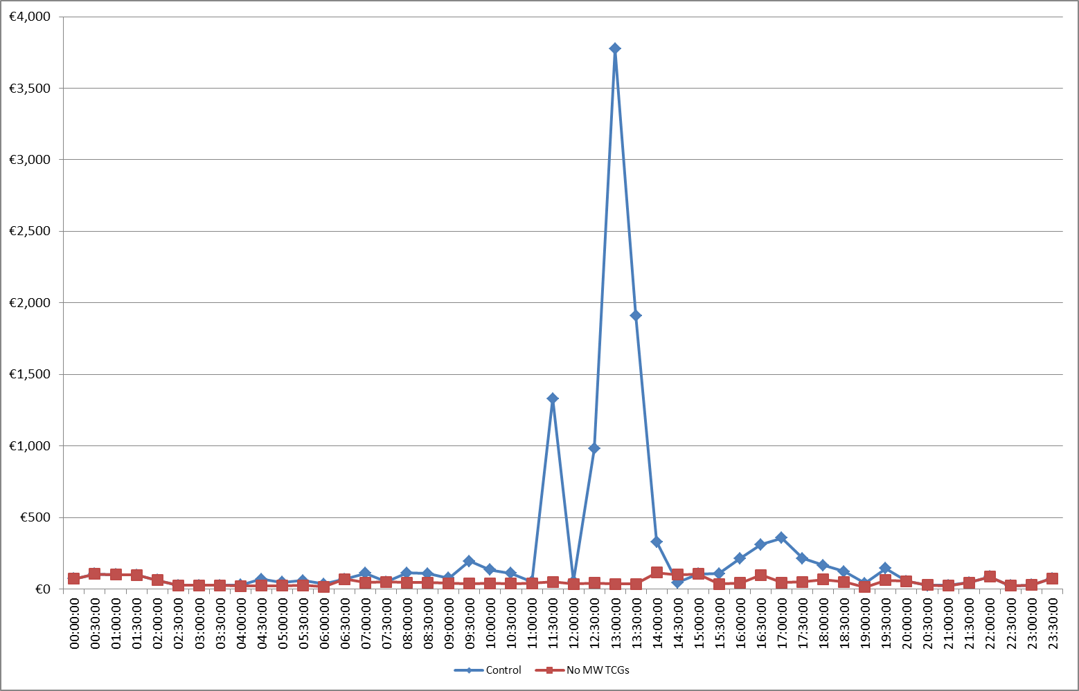
Mod 09_19 - Removal of locational constraints from Imbalance Pricing
Half hour Imbalance Settlement Price for Jan 24th

Slide 6
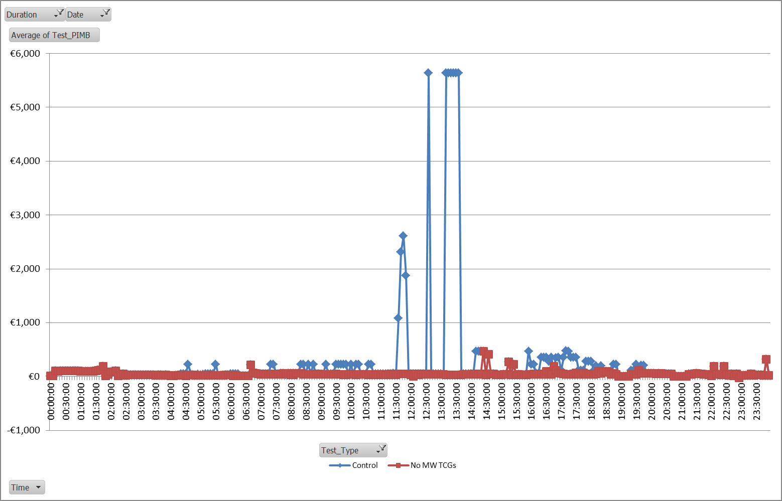
Mod 09_19 - Removal of locational constraints from Imbalance Pricing
Five minute Imbalance Price for Jan 24th

Slide 7
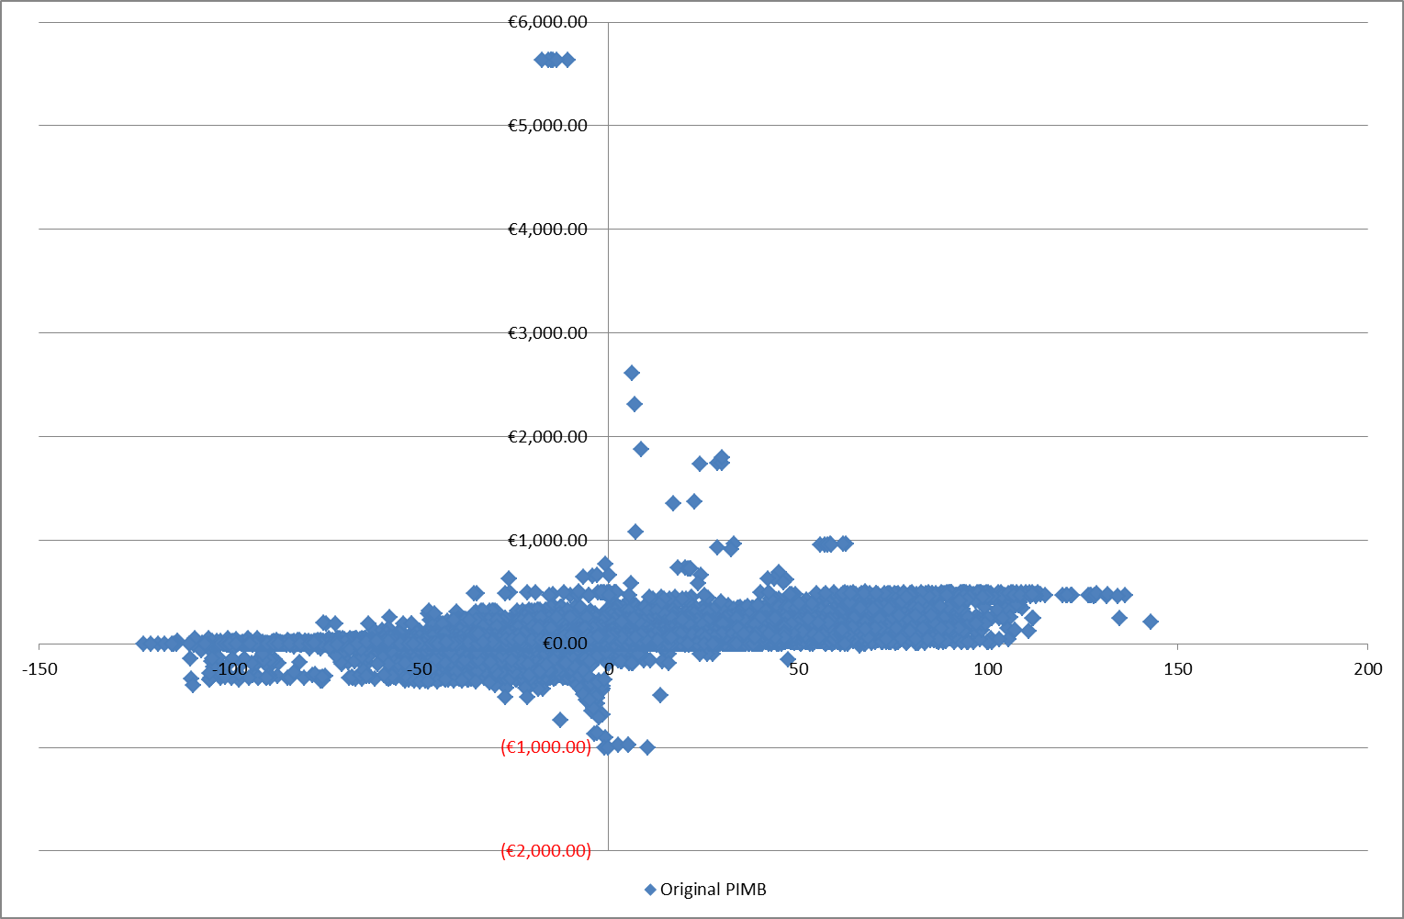
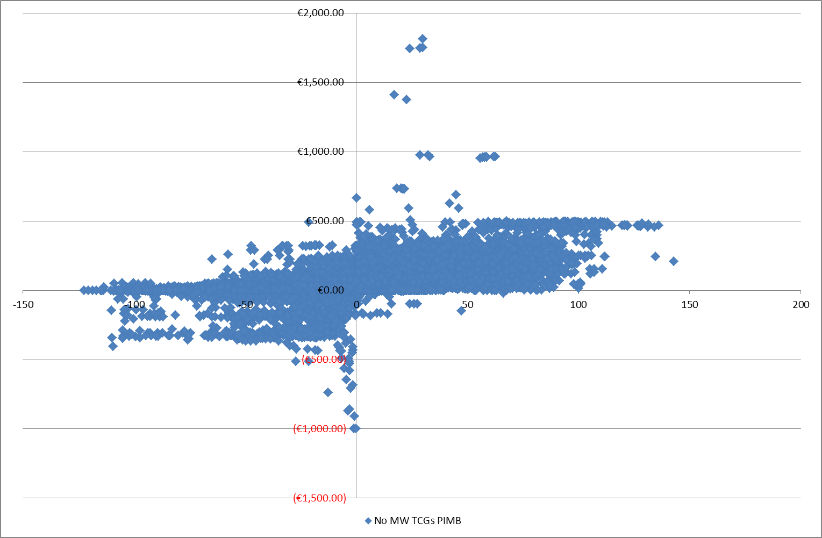
Mod 09_19 - Removal of locational constraints from Imbalance Pricing
Scatter graphs of NIV and PIMB for original and with no MW Constraints flagged

Slide 8
Mod 09_19 - Removal of locational constraints from Imbalance Pricing
Options based on this work were presented to the SEMC at their last meeting and they endorsed the approach set out in the modification;
Modification proposed seeks to remove the application of flagging for locational constraints from imbalance pricing;
As only some locational constraints are modelled through TCGs, this means only a subset of locational constraints are actually flagged;
Removal of those explicitly modelled applies rules in a consistent manner;
Additional impacts?
  Overall impact on imbalance prices?
  Does not remove all high prices seen since the transition to the new arrangements…

Slide 9
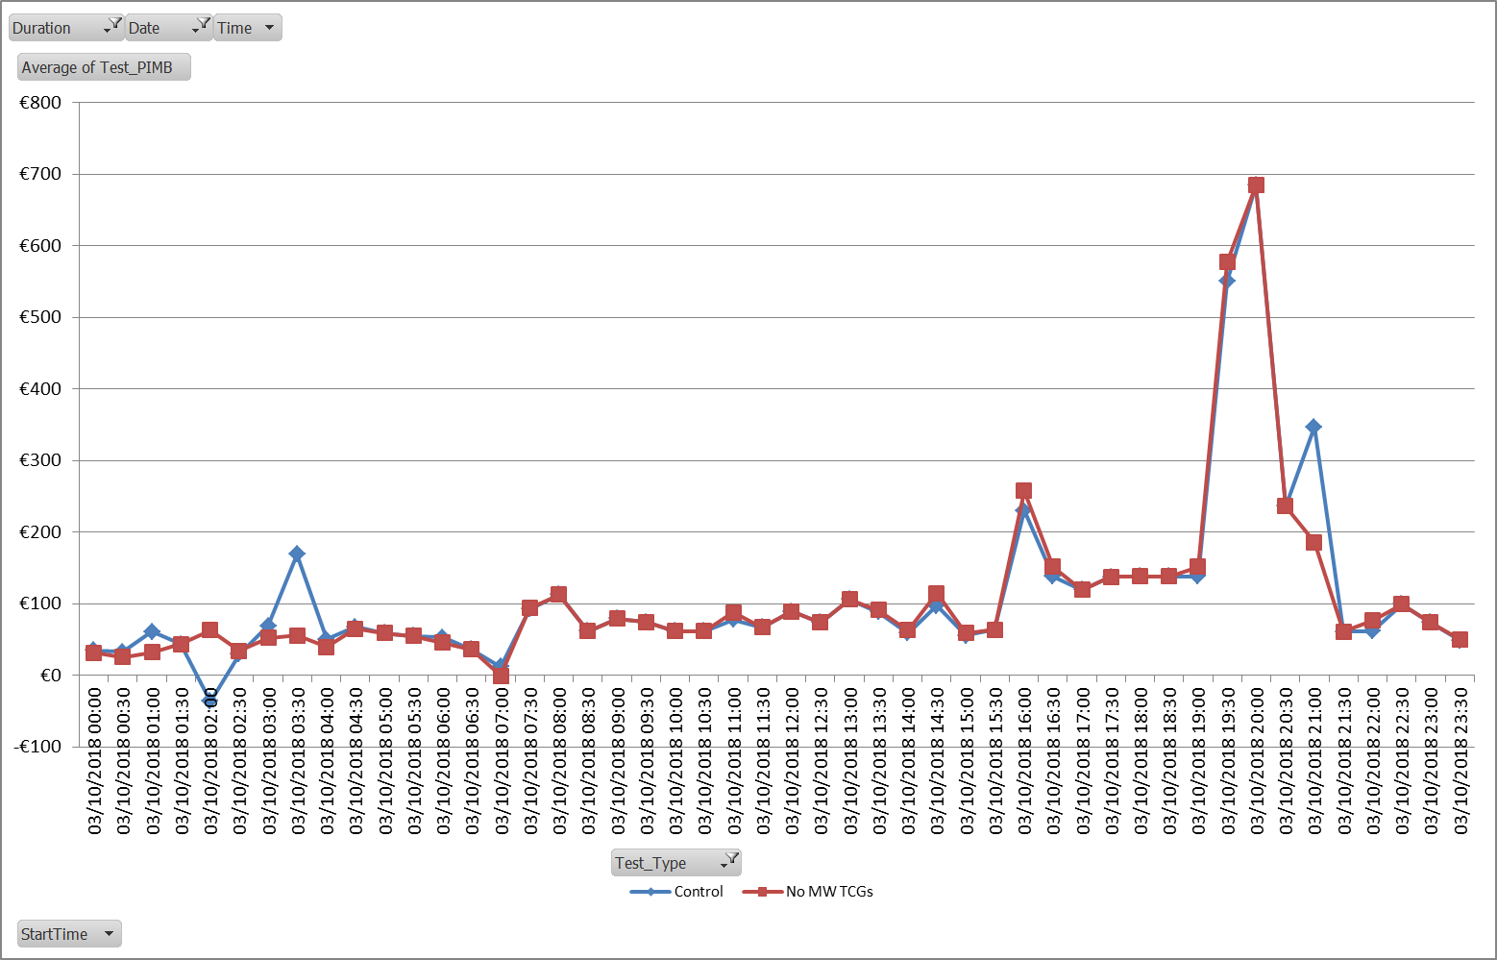
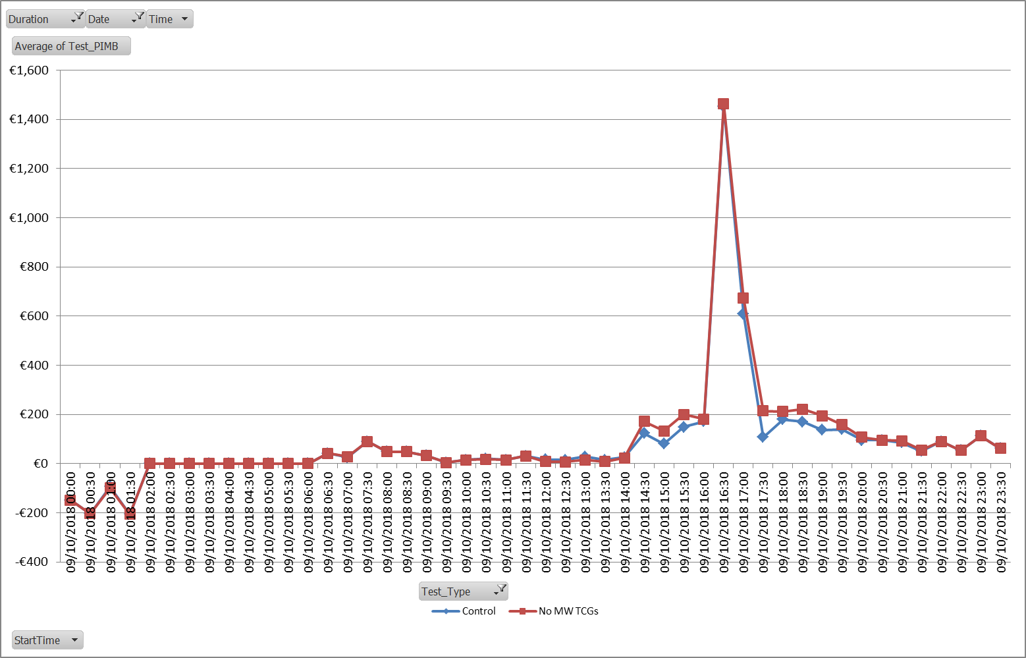
Mod 09_19 - Removal of locational constraints from Imbalance Pricing
Half hour Imbalance Settlement Price for
Oct 3rd…
Half hour Imbalance Settlement Price for
Oct 9th …

Slide 10
Mod 09_19 - Removal of locational constraints from Imbalance Pricing
Options based on this work were presented to the SEMC at their last meeting and they endorsed the approach set out in the modification;
Modification proposed seeks to remove the application of flagging for locational constraints from imbalance pricing;
As only some locational constraints are modelled through TCGs, this means only a subset of locational constraints are actually flagged;
Removal of those explicitly modelled applies rules in a consistent manner;
Additional impacts?
  Overall impact on imbalance prices?
  Does not remove all high prices seen since the transition to the new arrangements…
  Impact on Dispatch Balancing Costs – cash-out has to go somewhere

Slide 11
Mod 09_19 - Removal of locational constraints from Imbalance Pricing
This modification can be considered as a step on the road to refining imbalance price calculation for the I-SEM
Further modifications may come to deal with other issues (e.g., those requiring vendor system changes)
This proposal is not a stand-alone solution; however, it should be considered on its own merit and not in the context of further modifications still to come
For now, we chose to raise this following internal discussions, feedback from participants on the report on Jan 24th, etc.
Putting this modification through removes the risk that local constraints can drive the price across the island
There may be other issues to solve with other modifications

