Slide 1
Mod 14_21

Slide 2
Contents
What did the High Level Design State?
How was this defined?
How is the solution explained?
How does the solution not work?
What needs to be fixed?

Slide 3
1.High Level Design
The High Level Design was very clear.
Those units who are providing replacement reserve should not be exposed to high prices.
This is fundamental to the modification.
It is not looking for something new, instead something that does exist is not working as expected.
There is a reason for this, the TSO is not behaving as was expected by the SEMO team in 2017.

Slide 4
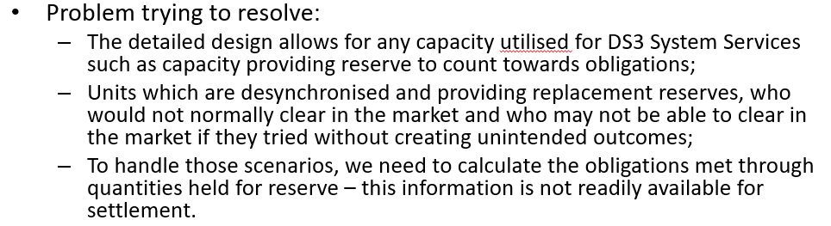
2. Definition from I-SEM team
I-SEM team on Rules Working Group 13 clarified the design as follows:
There are two key points to this:
Unit has to be desynchronised and providing replacement reserve
Unit would not normally clear in the market

Slide 5
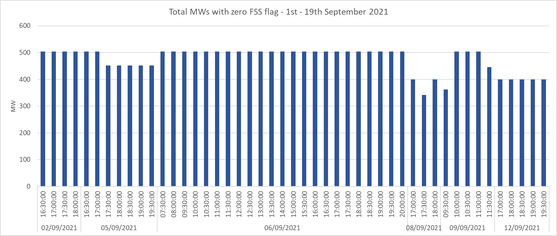
3. How is the solution defined
The I-SEM team built a solution based on this definition. However it did not work as intended.
SEMO have defined the solution as:
FSS is configured to apply against a SO constraint and it will only do so when the constraint is binding.
This system is in place, the following chart shows the total MWs that have been flagged in first 19 days of September. All of the units flagged in this period were OCGTs in Ireland. Since April 2019, just over 10,000 zero FSS flags have been applied, only 43 have been applied to units in NI

Slide 6
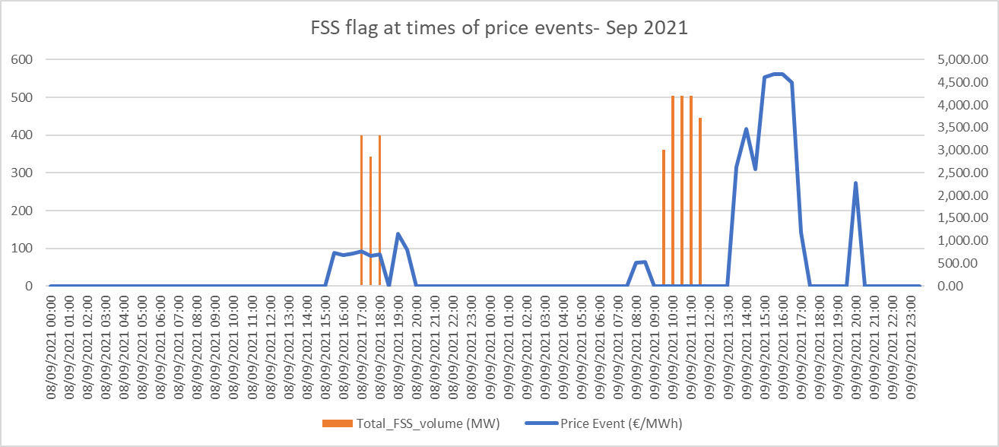
4. Is it working correctly?
Fundamentally it is not working correctly.
Those units that have been flagged are all in the Republic. There are a number of units in the North with similar characteristics were not dispatched & were not FSS flagged. Since April 2019, just over 10,000 zero FSS flags have been applied, only 43 have been applied to units in NI.
SEMO when they sought to deliver the requirements of the Detailed Design decided to only apply the flag when the constraint was binding
They did not foresee high priced events where the TSO did not call the reserve.
But the TSO has said in these meetings that they withhold the reserve till absolutely necessary.
Which means that there are high price events where the replacement reserve constraint is not binding see following chart:

Slide 7
5. How can it be fixed
The logic for the fix needs to reflect that which was described by the I-SEM team in 2016:
The solution should be that those providing replacement reserve and who would not normally clear without creating unintended outcomes are not exposed to events.
The solution is that those who are providing Replacement reserve as defined by the TSO are those that should be protected.
The FSS flag for these units should be set at all price events.

Slide 8
6. Legal Drafting Change

