Slide 1
MOD_18_19
Clarification to apply Recoverable Start Up Costs to DSUs
24th October 2019
Katia Compagnoni

Slide 2
Summary Information
Mod_18_19 provides a clarification to paragraph F.11.2.6 of the T&SC Part B, and a correction of typos in paragraphs F.11.2.2 and F.11.2.4;
This Modification does not affect the systems or the interpretation of the market design;
The correct outputs did not show in Initial statements because of a defect in Settlement that was fixed in M+4;
This Modification just emphasizes the decision principle of same treatment between standard GUs and DSUs;
The need for the Modification was highlighted following a query from a DSU Participant with regard to the interpretation of the affected section of the T&SC.
Notes:
Quick summary of the background and expected outcome for this proposal

Slide 3
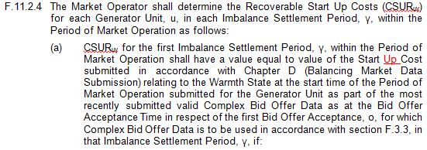
Legal Drafting for F.11.2.2 and F.11.2.4

Slide 4
Legal Drafting for F.11.2.6 and Glossary definition
Because Shut Down Cost is now defined in the paragraph above, there is no need for a separate variable definition (CSD_{uγ}) in the Glossary. This has then been removed while the additional explanatory text has been incorporated in the standard definiton for Shut Down Cost;

Slide 5
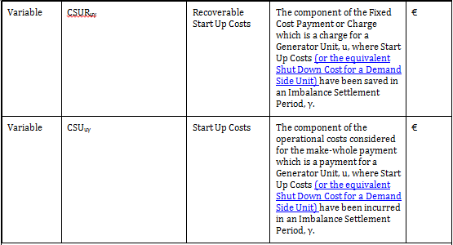
Legal Drafting for Glossary Variables
The relation between Start Up Cost and Recoverable vs Shut Down Cost and Recoverable, has also been re-iterated in the relevant variables CSU_{uγ} and CSUR_{uγ} .

Slide 6
Justifications for Mod_18_19
Increased transparency in the rules;
Reflect the intent of ‘I-SEM ETA Detailed Design – Markets Decision Paper’ in a more explicit way;
Emphasize that treatment of DSUs and GUs are on the same basis with regards to all aspects of Fixed Cost Payments;

