Slide 1
Mod_33_18
Update to Unit Under Test Process

Slide 2
Learning Objectives
Overview
Unit Under Test Process in TSC does not accurately reflect actual process, as a result of changes over time and particularly as a result of I-SEM
Testing Tariffs have changed significantly post I-SEM:
Only tariff for high impact testing
Assumed balance responsibility will cover energy costs
Only unit commitment and costs associated with reserve
https://www.semcommittee.com/news-centre/i-sem-portion-2018-testing-tariffs-decision-paper
Mod needed to ensure TSC accurately details process

Slide 3
Learning Objectives
Summary Information
Mod_33_18 raised November 2018.
Proposed to remove reference of MO. Process for acceptance/rejection of test flags is now fully driven by SO.
Proposal to remove unit under test notice from the Glossary and throughout T&SC as replaced by Under Test Flag submitted in PNs.
Clarification in Appendix F that SO will confirm to the MO the units and relevant dates where testing tariffs are to be applied.

Slide 4
Legal Drafting Changes (D.7.3)

Slide 5
Legal Drafting Changes (D.7.3)
Proposed:
The System Operator may grant

Slide 6
Glossary Changes

Slide 7
Changes to Appendix F: Other Communications

Slide 8
Changes to AP04: Transaction Submission and validation
Procedural steps 3.1 for Submission, approval and rejection of a Unit Under Test Request modified
Removes reference to MO
Includes reference to PNs
Details rejection of PNs
Refers to Grid Code.

Slide 9
Links
http://www.soni.ltd.uk/media/documents/181008_Unit-Under-Test_Guidelines-for-I-SEM.pdf
http://www.eirgridgroup.com/site-files/library/EirGrid/181008_Unit-Under-Test_Guidelines-for-I-SEM.pdf
http://www.eirgridgroup.com/site-files/library/EirGrid/1819-Proposed-GTUoS-Tariffs-v0.1.pdf

Slide 10
Near Time Operations Contact Information
neartime@eirgrid.com
neartime@soni.ltd.uk

Slide 11
Unit Under Test in I-SEM
A single Under Test mechanism for I-SEM, with changes including:
All testing visible to the market
All Unit types follow the same process*
Testing can be requested by trading periods
Modified timelines for submissions
Participants will be able to submit Commercial Offer Data
*A separate process will be developed for managing Interconnectors Under Test and priority dispatch units which are not dispatchable-Wind and Solar.
Notes:
Pumped Storage Units, Demand Side Units, Interconnector Units, Interconnector Residual Capacity Units or Autonomous Generator Units have Unit Under Test status in ISEM

Slide 12
Types of Testing
For the purpose of under test PN submissions, testing can be categorised as follows:
1. Significant Testing: Including commissioning new or existing units, Grid Code testing, testing following modifications to control systems or any tests that propose an additional risk of trip. Can be high impact test or low impact test. Greater than or equal to 3 hours, 3 times the active energy(of the unit registered capacity in 1 hr production
2. Minor Testing: Any testing that does not pose an increased risk of trip. Can be high impact or low impact. Must be less than 6 hours or 3 times active energy of the unit or 500MWhr.

Slide 13
Justification and Implications of not Implementing
This proposal is required to clarify testing in new I-SEM market
If this proposal is not implemented the Code will be technically incorrect

Slide 14
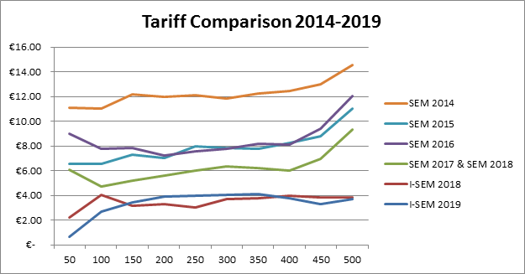
Ongoing Reduction in Testing Tariffs

