Slide 1
Mod_33_18
Update to Unit Under Test Process 2.0

Slide 2
Learning Objectives
Overview
Unit Under Test Process in TSC does not accurately reflect actual process, as a result of changes over time and particularly as a result of I-SEM
Mod needed to ensure TSC accurately details process
Corrections to previous Mod
  Removal of System Operator from D.7.3.2
  Linked Para 8 to Para 7 in Appendix F
  Removal of reference to Grid Code in Appendix F Para 8 and in Agreed Procedure 04 Step 3 and Step 4
  Not in Mod but necessary for completeness :
    Correction of spelling in Agreed Procedure 04 to make sure all capitalised terms are defined within TSC

Slide 3
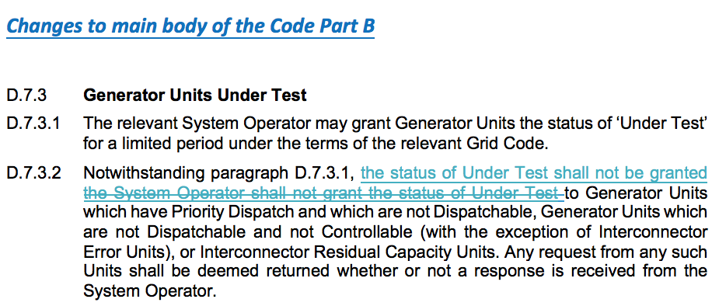
Legal Drafting Changes (D.7.3)

Slide 4
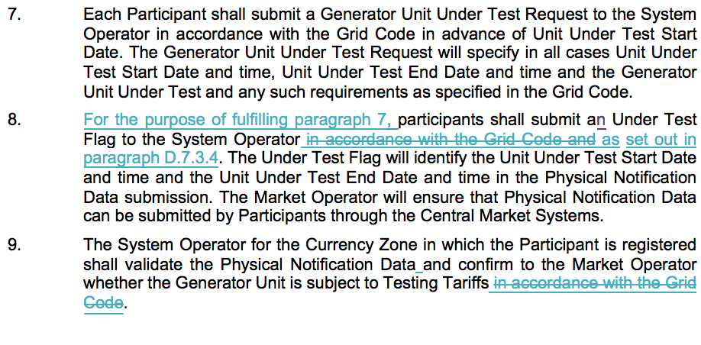
Changes to Appendix F

Slide 5
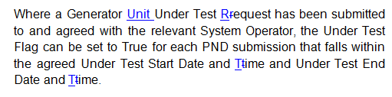
Changes to AP04: Transaction Submission and validation
Table 4: Data Transaction Approval Requirements

Slide 6
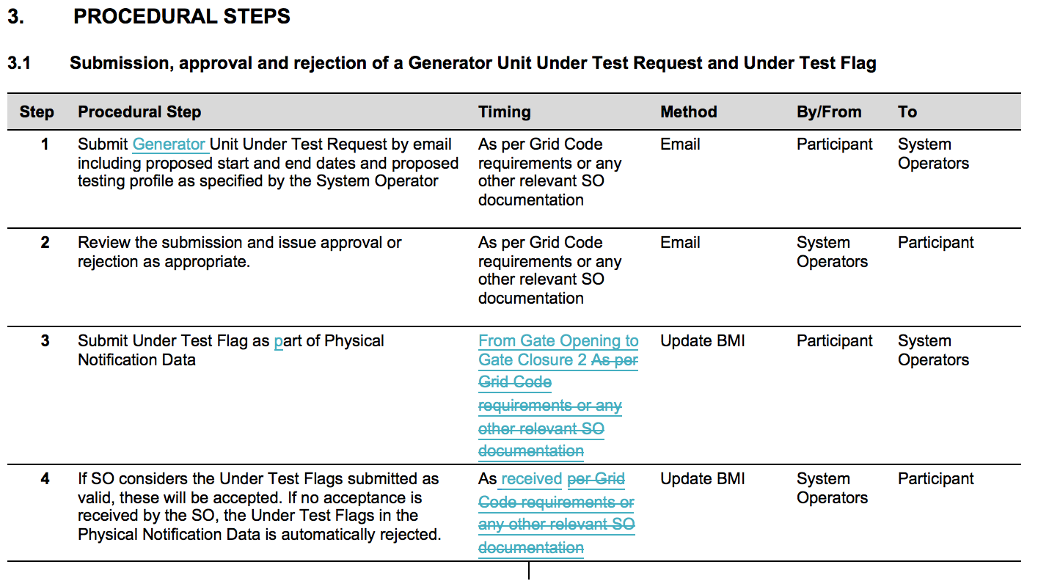
Changes to AP04: Transaction Submission and validation

Slide 7
Links
http://www.soni.ltd.uk/media/documents/181008_Unit-Under-Test_Guidelines-for-I-SEM.pdf
http://www.eirgridgroup.com/site-files/library/EirGrid/181008_Unit-Under-Test_Guidelines-for-I-SEM.pdf
http://www.eirgridgroup.com/site-files/library/EirGrid/1819-Proposed-GTUoS-Tariffs-v0.1.pdf

