Slide 1
Mod_38_18
Limitation of Capacity Market Difference Payments to Loss Adjusted Metered Quantity.
12th December 2018

Slide 2
Summary Information
The quantity component of Capacity Market Difference Charges is capped at QCOB, which is the load following obligated quantity. Any Capacity Market Unit in receipt of Capacity Payments in return is obligated to deliver the quantity associated with its QCOB at a price of no greater than the strike price.
Suppliers pay Capacity Charges based on their loss adjusted Metered Quantity during day time hours to fund Capacity Payments and in return receive protection for their demand from prices higher than the strike price. As the TSCB is currently drafted, a Supplier Unit receives protection for any traded quantity even where this may greatly exceed their metered quantity.
This Modification Proposal seeks to confine the protection from high prices to the Supplier Unit’s Metered Quantity and thus aligns Difference Payments with Difference Charges.

Slide 3
Legal Drafting Changes (TSC Part B F.20.1.1 and F.20.2.3)

Slide 4
Justification and Implications of Not Implementing
There is a possibility that a Supplier Unit could trade in the following way:
Purchase a very large volume in the DAM / IDM, e.g. a level that unit would not be physically capable of consuming, and in doing so drive the clearing price very high to the point that it is above the Strike Price;
In the imbalance arrangements, their actual metered demand would be compared with their net traded level causing a positive imbalance, meaning they will be paid the imbalance price;
If the Imbalance Price is set to the backup price, or is calculated in the normal way to a level which is close or equal to the level of the DAM / IDM, then they would be paid an amount which would largely or wholly make up their costs for purchasing that quantity at the high price in the DAM;
In the Capacity arrangements, they would also receive a Difference Payment for the day-ahead purchase at a price above the Strike Price, and those who were selling in that market would be charged a Difference Charge;
However the units who has sold in the market would only be charged based on a scaled down quantity to reflect actual consumption, not the cleared purchases in that market, which is insufficient to meet the payment.

Slide 5
Justification and Implications of Not Implementing
To look at an example scenario,
In the DAM arrangements, they would be charged, e.g. 3000 x -2 = -6000.
In the imbalance arrangements, with the Imbalance Price is set to the backup price, they would be paid, for example 3000 x 1 = 3000.
In the Capacity arrangements, they would also receive a Difference Payment for the day-ahead purchase, (500 – 3000) x -2 = 5000;
The units who has sold in the market would be charged based on a scaled down quantity to reflect actual consumption, (500 – 3000) x 1 = -2500;
The supplier unit would be net paid 2000 for consuming 1.

Slide 6
Justification and Implications of Not Implementing
Therefore, for a net consumption of their metered demand at positive clearing prices, the supplier unit would end up being net paid, due to the combination of selling an imbalance quantity and receiving a difference charge.
If the Imbalance Price is at least above the following level: PIMB = [QTDA/(QM-QEX)] x PSTR, then this would be a net payment to the supplier for their consumption;
Also, the revenue received from Difference Charges would not be sufficient to meet the Difference Payments for this unit, as the charges are scaled to reflect actual demand while the payments are based on the total purchase and not related to demand. If other funds are not available, this shortfall would need to be socialised over the whole market until such a time as there is sufficient funds to reimburse it;
It would take time to build up sufficient funds through the socialisation charge to cover this shortfall.

Slide 7
Justification and Implications of Not Implementing
With the modification, the same example scenario would play out as follows:
In DAM, they would be charged, e.g. 3000 x -2 = -6000.
In the imbalance arrangements, with the Imbalance Price is set to the backup price, they would be paid, for example 3000 x 1 = 3000.
In the Capacity arrangements, they would receive a Difference Payment for the day-ahead purchase up to the level of their meter, i.e. (500 – 3000) x -1 = 2500;
The units who has sold in the market would be charged based on a scaled down quantity to reflect actual consumption, (500 – 3000) x 1 = -2500;
The supplier unit would be net charged -500 for consumption of 1, i.e. they are charged for consumption at the rate for the hedging Strike Price.

Slide 8
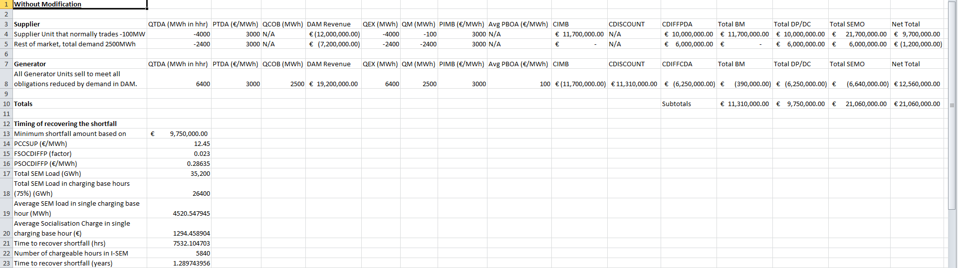
Justification and Implications of Not Implementing
Analysis of more realistic scenario: With shortfall in difference charge vs difference payment, takes over a year to recover the amount through the socialisation charge with current rates for a single event.

Slide 9
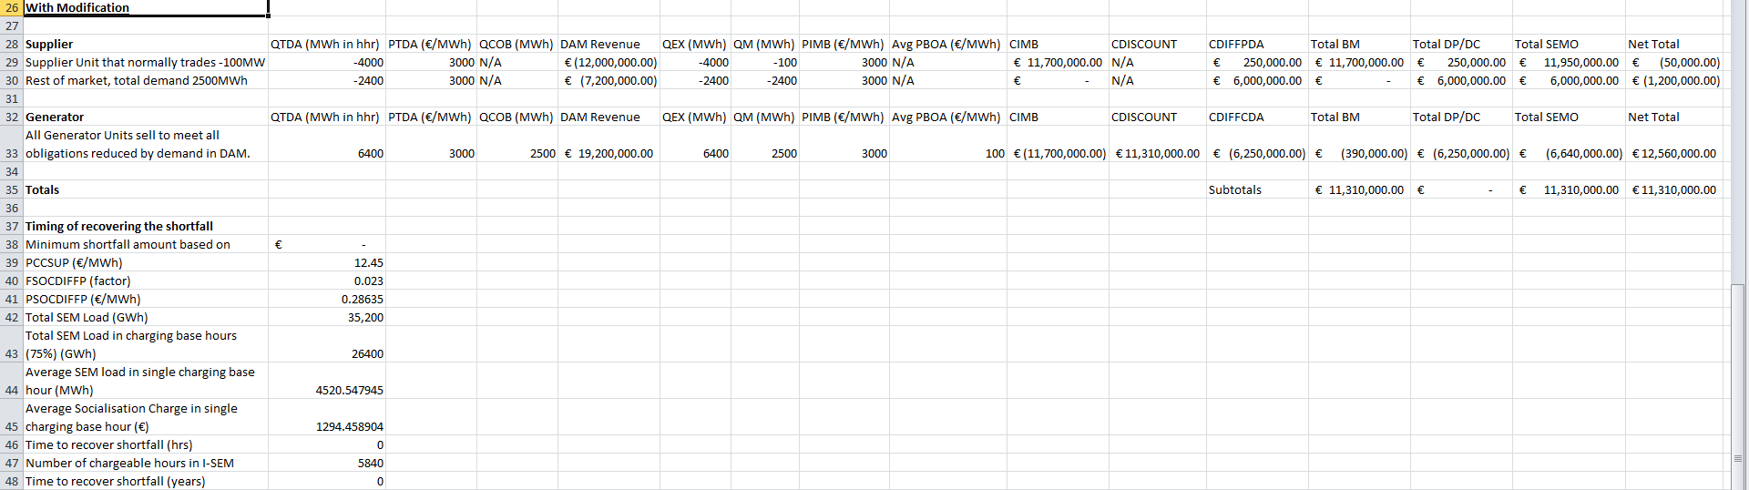
Justification and Implications of Not Implementing
Analysis of more realistic scenario: With the modification, the net settlement for the Supplier Unit results in them being charged for their consumption at the Strike Price, applying the hedge to the amount consumed.

Slide 10
Justification and Implications of Not Implementing
Having an unlimited hedge for all trade amounts can be used for speculative reasons and not based on protecting customers from price spikes;
Introducing this change would maintain the incentive on suppliers to trade in the ex-ante markets to minimise exposure to imbalances, one of the higher level intentions in the energy market policies of balance responsibility;
It also maintains the higher level intentions from the capacity market policies, which is that consumers are protected against spikes in the price in any of the ex-ante or balancing markets above the Strike Price;
Having difference payments for trades in excess of metered demand reduces the incentive to trade in a way which minimises exposure to imbalances. In certain scenarios may encourage trading in a way which drives large imbalances, which undermines the higher level intentions in the energy market.

Slide 11
Justification and Implications of Not Implementing
Because the Difference Charges available are based on the amount of actual consumption in the period, the Difference Payments for trades in excess of the actual consumption cannot be sourced from these payments, i.e. they are part of the hole in the hedge;
Take the simplest regular case, assuming that the suppliers are aiming to purchase enough to meet their metered quantities and capacity units structure their units to sell their obligated quantities. This would mean that charges in would meet the payments out;
Once there is a situation where suppliers are buying much more than the metered demand, then the scaling factor being included in the charge creates a hole in the hedge. In that case the quantity eligible for a payment increases, but the quantity exposed for the charge does not increase. This has the effect of needing to increase the amount socialised among all suppliers, and therefore charged to all consumers, through the Difference Payment Socialisation Charge;
The potential for this activity would not have been considered as part of the analysis to determine the level of this charge to apply for go-live.

Slide 12
Justification and Implications of Not Implementing
The supplier with the large purchase, large imbalance and large Difference Payment would mostly be receiving this payment from other suppliers through an increased socialisation charge. Depending on their size, the difference payment would be relatively much greater than their own increased socialisation charge;
It can also have an impact on the timing of the difference payments. If there is a large shortfall between the amounts required to be paid and the amounts available to make this payment (which is at least limited by the actual demand on the system), this would result in shortfalls needing to be determined on the difference payments for all suppliers possibly due to the actions of one participant. The participant who causes this behaviour to occur would also be subject to these shortfalls;
Therefore this would cause cash flow issues for all suppliers, where the difference payment would not be available to cover their whole energy revenue between the strike price and the reference price, meaning they will have to cover those charges for a longer period of time than if the amount of payments to be made, and the trading being carried out, was on the basis of meeting the actual consumption of supplier customers.

