Slide 1
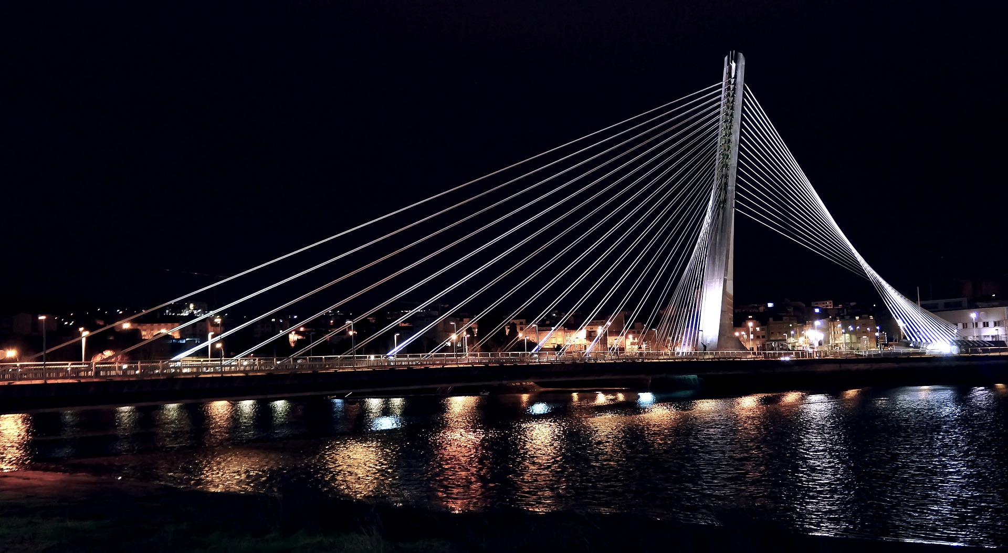
Chapter 18: Non-Firm Quantities

Slide 2
SLT
Non-Firm Quantities
In both the SEM and the I-SEM, a unit with non-firm access does not have the right to be compensated for not being able to have it’s non-firm capacity accommodated on the system:
A unit’s Firm Access Quantity is a value which represents the amount of a Participant’s output which can be accommodated on the system based on network reinforcement. If the unit is dispatched down below that level, it is entitled to compensation.
The way this is implemented in the I-SEM is different to the SEM, in that it only impacts the balancing and imbalance arrangements:
There is no longer a restriction on Participants to gain a market position for their non-firm capacity, they can trade their entire output range above their Firm Access Quantity in the ex-ante markets;
Normally Bid Offer Acceptances are settled at the better of the Imbalance Settlement Price or Bid Offer Price. For Dec actions to turn a unit down / off from their market position, this means that the units can be compensated for being turned down – they may only need to pay back what they’ve stated in the Bid Offer Price, which may only reflect their costs of running, or less through the Imbalance Price, meaning they retain any inframarginal rent they achieved from their ex-ante market revenue;
However this treatment is removed for non-firm Dec actions: if a unit traded its Non-Firm capacity but it could not be physically accommodated on the system, it will be treated as an imbalance and they have to pay back for the difference at the Imbalance Settlement Price only;
This is implemented through calculating the Non-Firm Accepted Bid Quantity and subtracting it in the Discount Component to ensure that it does not receive a discount, and therefore it is settled only through the Imbalance Component.

Slide 3
SLT and ILT
Non-Firm Quantities
Firm Access is a Trading Site concept, therefore there needs to be functionality to assign the Firm Access Quantity to the units under the Trading Site to allow for unit-level non-firm quantities to be calculated:
FAQ is divided in a way which is inversely proportional to the Accepted Bid Quantity on each unit:
If unit dispatched to PN, fully firm;
If unit dispatched below PN, non-firm;
The greater the dec volume, the lower the firmness.
Unit A
Unit B
Unit C
Unit D
PN (A, B, C, D), QD (A, B), FAQ (A, B)
QABNF C
QABNF D
FAQ (C)
FAQ (D)
QAB C
QAB D
QD (C)
QD (D)

Slide 4
SLT and ILT
Non-Firm Quantities
Was any of that volume in non-firm range?
qFPN
i = 5
MW
i = 4
qD
i = 3
i = 2
i = 1
γ
γ + 1
$${CPREMIUM}_{uγ}=\sum_{o}{\sum_{i}{\left(Max\left({PBO}_{uoiγ}−{PIMB}_{γ}, 0\right)×\left({QAOLF}_{uoiγ}− Max\left({QAOOPOLF}_{uoiγ}, {QAOBIAS}_{uoiγ}, {QAOUNDEL}_{uoiγ}, {QAOTOTSOLF}_{uoiγ}\right)\right)\right)}}$$
$${CDISCOUNT}_{uγ}=\sum_{o}{\sum_{i}{\left(Min\left({PBO}_{uoiγ}−{PIMB}_{γ},0\right)×\left({QABLF}_{uoiγ}−Min\left({QABBPOLF}_{uoiγ}, {QABBIAS}_{uoiγ}, {QABUNDEL}_{uoiγ}, {QABNFLF}_{uoiγ}, {QABCURLLF}_{uoiγ}, {QABTOTSOLF}_{uoiγ}\right)\right)\right)}}$$

Slide 5
SLT and ILT
Non-Firm Quantities
Was any of that volume in non-firm range?
qFPN
i = 5
MW
qFAQ
i = 4
qD
i = 3
i = 2
i = 1
γ
γ + 1
$${CPREMIUM}_{uγ}=\sum_{o}{\sum_{i}{\left(Max\left({PBO}_{uoiγ}−{PIMB}_{γ}, 0\right)×\left({QAOLF}_{uoiγ}− Max\left({QAOOPOLF}_{uoiγ}, {QAOBIAS}_{uoiγ}, {QAOUNDEL}_{uoiγ}, {QAOTOTSOLF}_{uoiγ}\right)\right)\right)}}$$
$${CDISCOUNT}_{uγ}=\sum_{o}{\sum_{i}{\left(Min\left({PBO}_{uoiγ}−{PIMB}_{γ},0\right)×\left({QABLF}_{uoiγ}−Min\left({QABBPOLF}_{uoiγ}, {QABBIAS}_{uoiγ}, {QABUNDEL}_{uoiγ}, {QABNFLF}_{uoiγ}, {QABCURLLF}_{uoiγ}, {QABTOTSOLF}_{uoiγ}\right)\right)\right)}}$$

Slide 6
SLT and ILT
Non-Firm Quantities
Was any of that volume in non-firm range?
qFPN
i = 5
MW
qFAQ
i = 4
qD
i = 3
i = 2
i = 1
γ
γ + 1
$${CPREMIUM}_{uγ}=\sum_{o}{\sum_{i}{\left(Max\left({PBO}_{uoiγ}−{PIMB}_{γ}, 0\right)×\left({QAOLF}_{uoiγ}− Max\left({QAOOPOLF}_{uoiγ}, {QAOBIAS}_{uoiγ}, {QAOUNDEL}_{uoiγ}, {QAOTOTSOLF}_{uoiγ}\right)\right)\right)}}$$
$${CDISCOUNT}_{uγ}=\sum_{o}{\sum_{i}{\left(Min\left({PBO}_{uoiγ}−{PIMB}_{γ},0\right)×\left({QABLF}_{uoiγ}−Min\left({QABBPOLF}_{uoiγ}, {QABBIAS}_{uoiγ}, {QABUNDEL}_{uoiγ}, {QABNFLF}_{uoiγ}, {QABCURLLF}_{uoiγ}, {QABTOTSOLF}_{uoiγ}\right)\right)\right)}}$$

